Slide 1
Intelligent Parking & Sightseeing Vessel Introduction

Slide 2
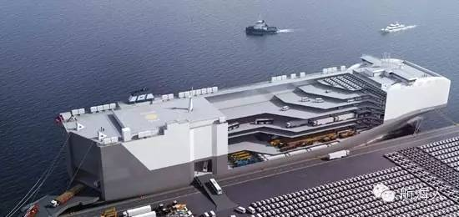
—Intelligent Parking & Sightseeing Vessel Introduction ：
Preliminary Design
CCS Standard Setting
Feasibility
Project Report
Construction
Patent Protection

Slide 3
Main Dim: Length oa. 198.90m, length b.p 187.00m, Width 40.00m, Depth updeck 31.10m, Depth freebord 8.50m, Draft about 3.80m.
A total of 11-layer deck, the 1st to the 10th as the parking deck, the 11th for the sightseeing deck, the 3rd deck for vehicle entrances and exits are designed with three RORO ramps.
Park Capacity 2000 vehicles with a small number of large and medium-sized bus parking spaces.
▲ ▲ ▲

Slide 4
Innovated the new train of thought of city parking.
R & D in line with the latest technology
Provide car selling/warehousing/logistics/service
Support shipbuilding industry
Drives urban tourism.
Parking function extends from the land to the open water
Breaks through bottleneck problem of urban parking
Advertisement
Sightseeing new hotspot

Slide 5
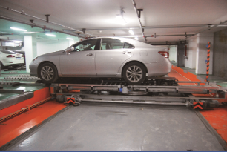

Slide 6
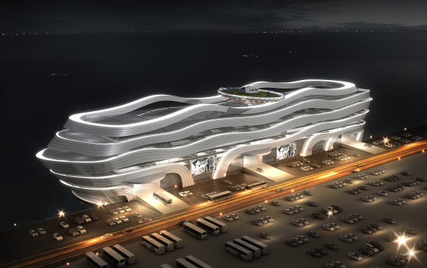
Plan A "Time Travel"

Slide 7
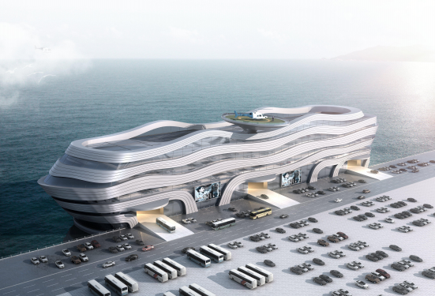
Plan A "Time Travel"

Slide 8
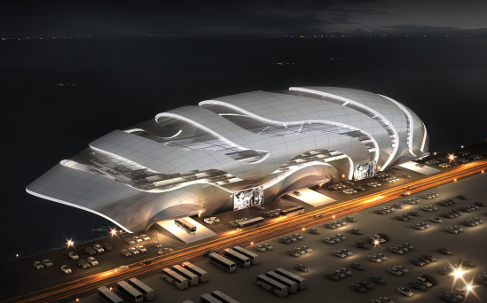
Plan B "Dragon Sea"

Slide 9
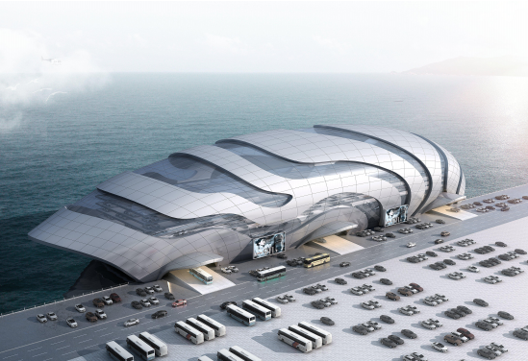
Plan B "Dragon Sea"

Slide 10
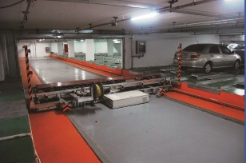
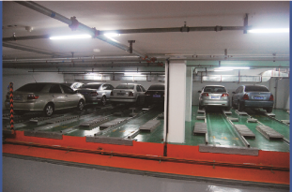
Intelligent Mobile Equipment for Parking

Slide 11
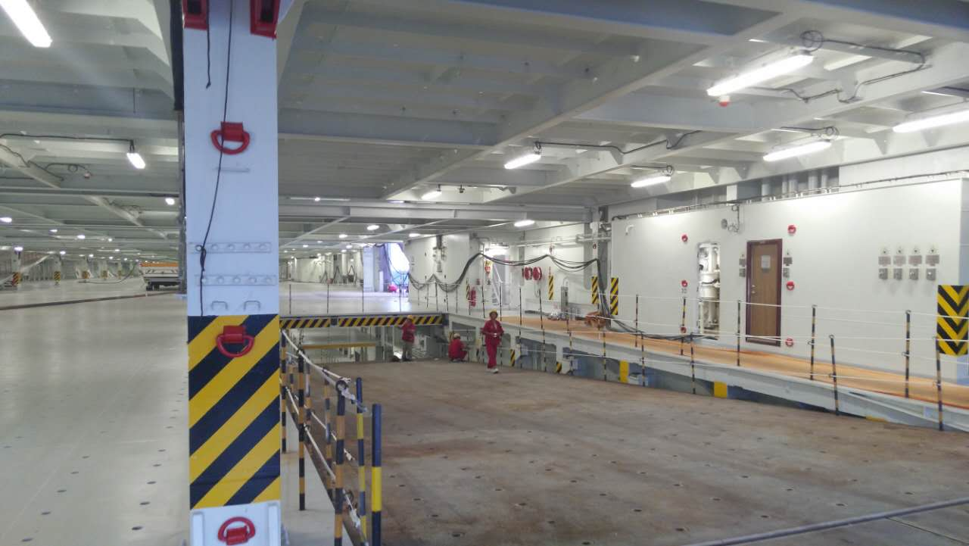
Parking Ramp

Slide 12
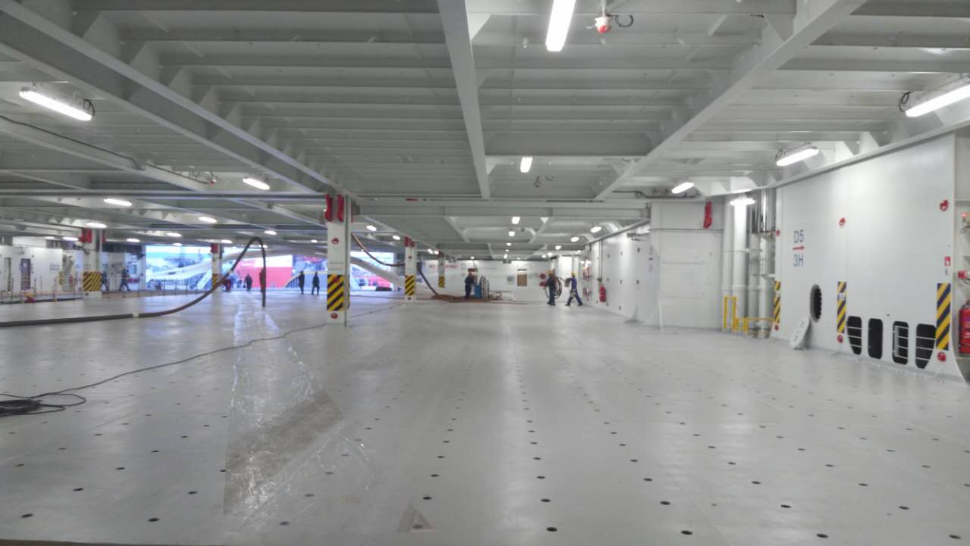
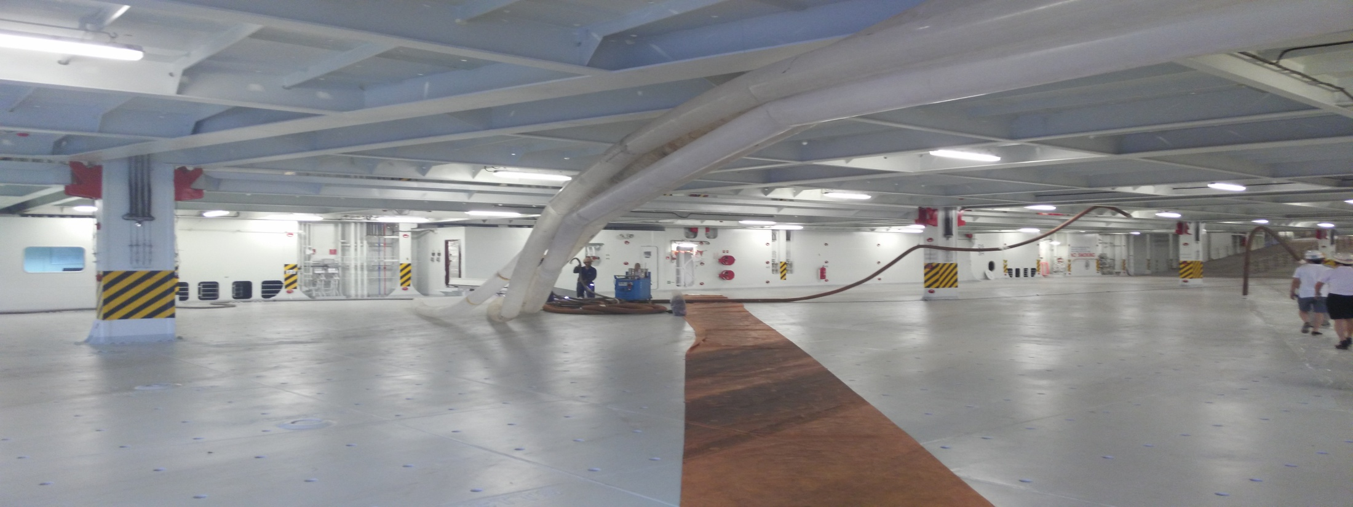
Parking Deck

