Slide 1
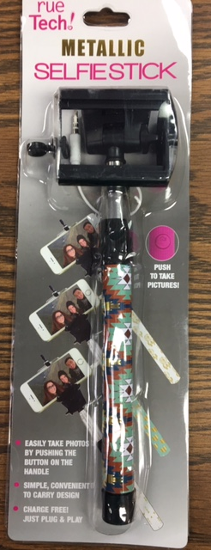
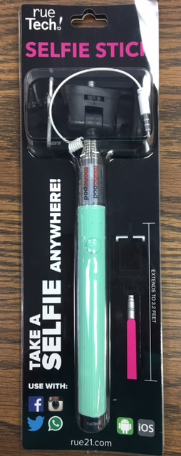
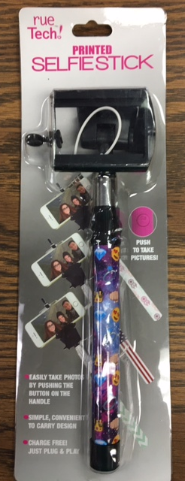
SELFIE STICKS
10 Colors
Multiple case packs
48, 90 & 102
FOB in 3 States, GA, NY & PA

