Slide 1
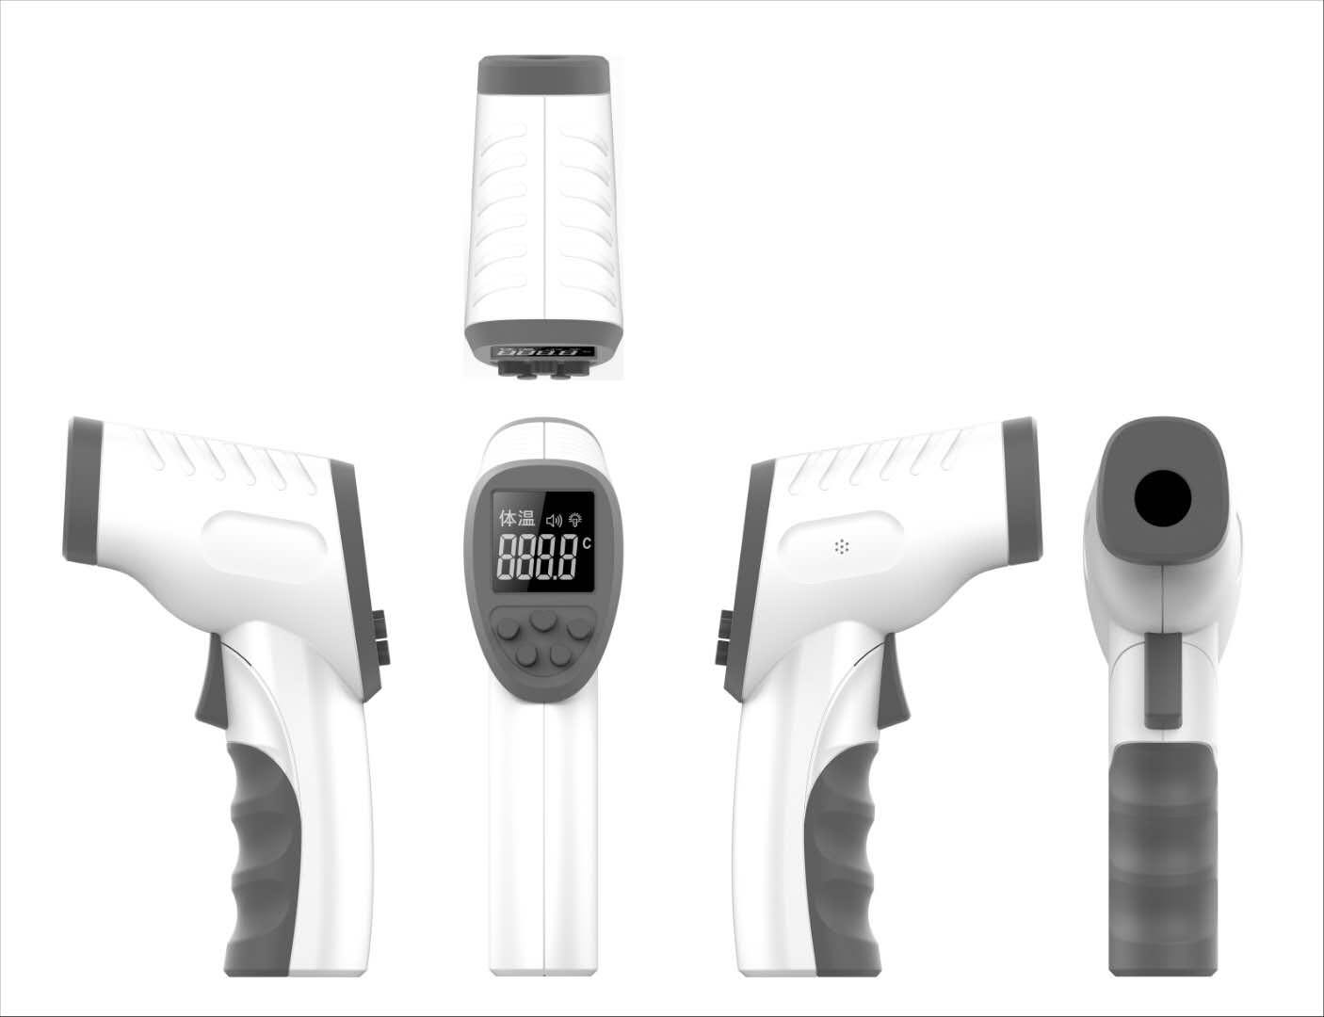
Product Pictures
Forehead Thermometer

Slide 2
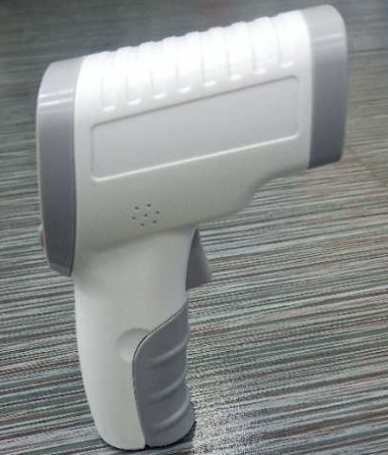
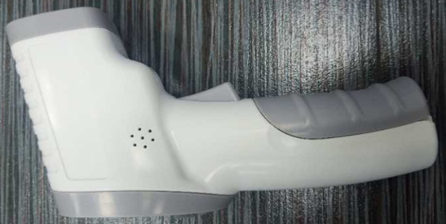
Product Features
Measurement mode：Body temperature, object temperature
Mpdel No.: 18A
Measurement accurancy A：±0.2℃
Measuring range：32℃-42.9℃（body temperature),
0℃-60℃（object temperature）
Measuring distance：3-5cm
Power saving mode:：About 30 seconds of automatic shutdown without operation
Mearing time duration：0.5 seconds
Power supply：DC3V（2 AAA alkaline batteries）
Forehead Thermometer

Slide 3
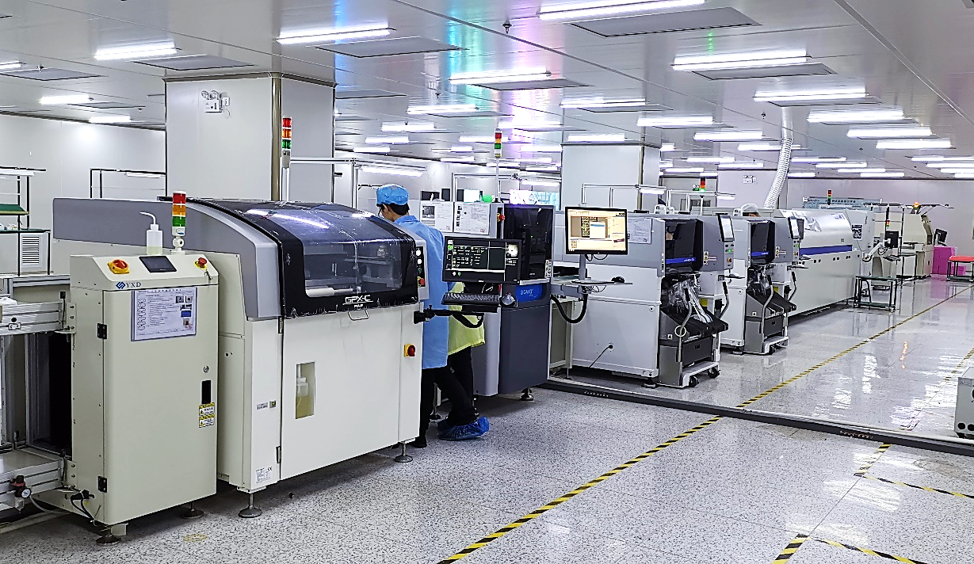
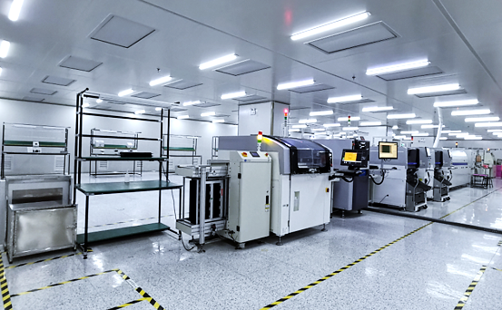
Factory Introduction
Workshop

Slide 4
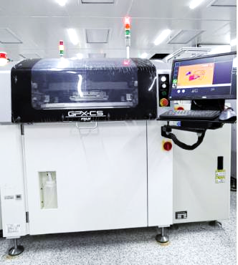
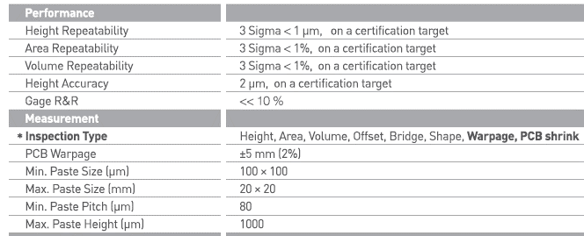
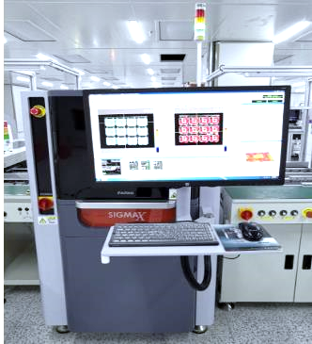
Factory Introduction
Equipment Introduction

Slide 5
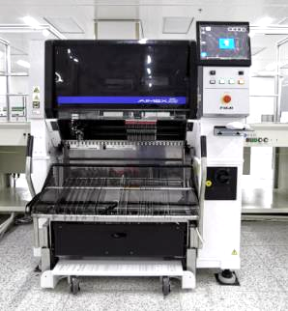
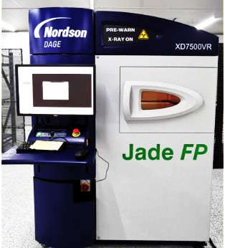
Factory Introduction
Equipment Introduction
Nordson DAGE open, transmissive x-ray tubefeature
Resolution <0.95μm1400x geometric magnification, 4200x system magnificationat
The highest 160kv tube voltage,at 3w tardage get power, sub-micron-level feature resolution can still be achieved up to 65 degrees tilt angle
Detection.
– test point 360-degree rotation detection
– the isocenter operating platform structure guarantees image resolution in the visible range.

