Slide 1
New Mask Products

Slide 2
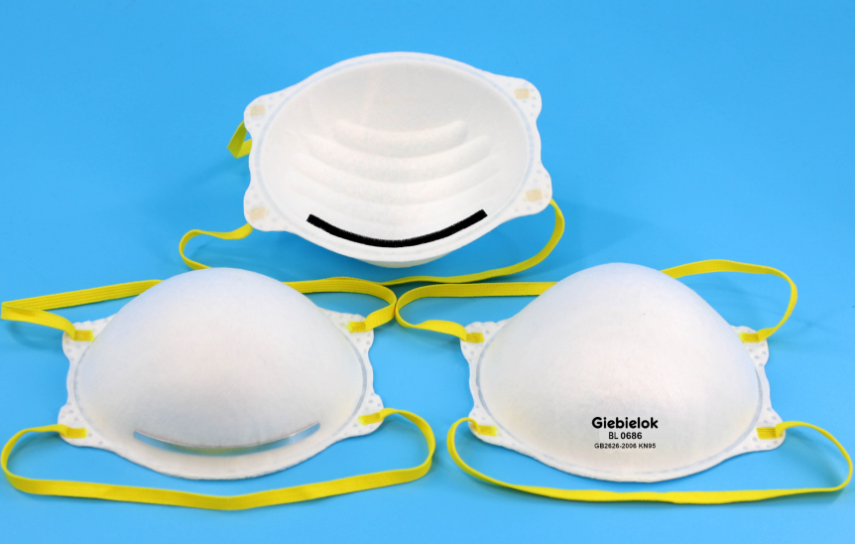
KN95
Product Description
Model no.: FL0686
KN95 Face mask,
Style: Tie-on，Without Valve
Material: Non-woven Fabric,
0.3 Micron particulates filtering >95%,
Function: Anti-dust-smog-pollen,
Scope of application: Adult
BRAND
Giebielok
Certification / Standard
GB2626-2006
(CN Standard)
***Price Info
6000~50,000pcs FOB Shanghai USD1.25 /pcs 50,000-100,000pcs FOB Shanghai USD1.10/pc
≧100000pcs or other quantity USD1.00/PCS FOB SHANGHAI,C negotiate
Logistics Info
Carton size: 63x53x40cm/0.13356 500pcs/CTN
Gross Weight: 9.1kgs
20’ GPQty: 222,400 pcs
40’ GPQty: 161,200 pcs
40’HQ Qty: 189,200 pcs

Slide 3
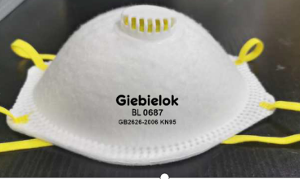
KN95 Face mask with Vavle
Product date sheet
Model no.:FL0687
KN95 Face mask,
Style: EAR LOOP BAND，With Valve
Material: Non-woven Fabric,
0.3 Micron particulates filtering >95%,
Function: Anti-dust-smog-pollen,
Scope of application: Adult
BRAND
Giebielok
Certification / Standard
GB2626-2006 (CN Standard)
***Price Info
6000~50000pcs FOB Shanghai USD1.40 /pcs 5w-10w FOB Shanghai USD1.30/pc
≧100,000pcs or other quantity USD1.10/PCS FOB SHANGHAI, negotiate
Logistics Info
Carton size: 69x30x52cm /0.1076CBM
Qty：400pcs/CTN
Gross Weight: 8.5kgs
20’ GPQty: 91200 pcs

Slide 4
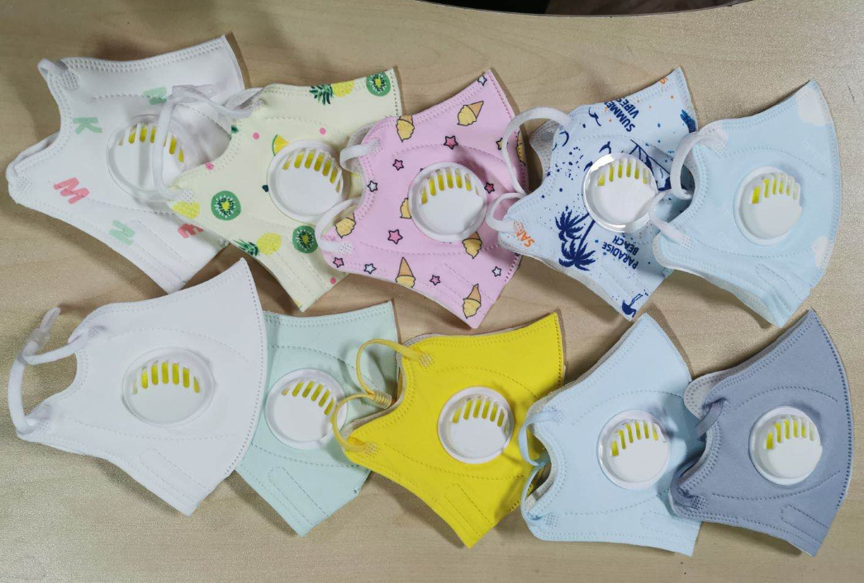
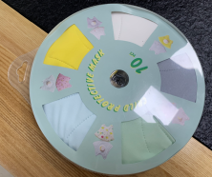
KN95 kids face mask with valve
Product Description
Model no.:Disposable mask
KN95 face mask with valve
Style: Ear-Loop
Material: Non-woven Fabric, meltblown
0.3 Micron particulates filtering >95%,
Function: Anti-dust-smog-pollen
Certification / Standard
GB2626-2006
CE-NB2163
Logistics Info
Carton size: 57x14.5x41.5cm,0.098CBM 1000pcs/CTN
Gross Weight: 8.4kgs
Volume weight:13kgs
20’ GPQty: 306122 pcs
40’ GPQty: 571428 pcs
40’HQ Qty: 693877 pcs
***Price Info
6000~50000pcs FOB Shanghai USD0.70 /pcs 50,000-100,000pcs FOB Shanghai USD0.60 /pc
≧100000pcs or other quantity USD0.45/PCS negotiable
单价：RMB5.0 ,出厂价
数量：1000pcs

Slide 5
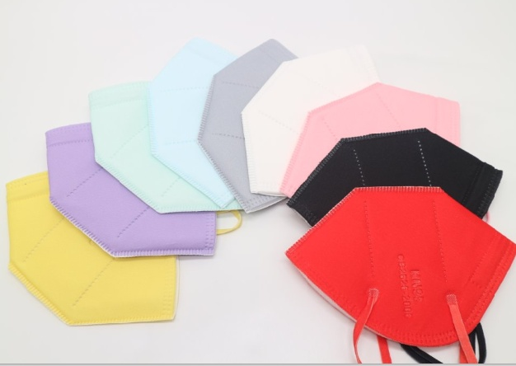
KN95 face mask
Product Description
Model no.:Disposable mask
KN95 face mask
Style: Ear-Loop
Material: Non-woven Fabric, meltblown
0.3 Micron particulates filtering >95%,
Function: Anti-dust-smog-pollen
BRAND
尔漫
KN95-5
Certification / Standard
GB2626-2006
CE-NB2163
Logistics Info
Carton size: 64x35x34cm,0.076CBM 900pcs/CTN
Gross Weight: 4kgs
Volume weight:4.6kgs
20’ GPQty: 355263 pcs
40’ GPQty: 663157 pcs
40’HQ Qty: 805263 pcs
***Price Info
6000~50000pcs FOB Shanghai USD0.65/pcs 50,000-100,000pcs FOB Shanghai USD0.60 /pc
≧100000pcs or other quantity USD0.45/PCS FOB SHANGHAI, negotiate

Slide 6
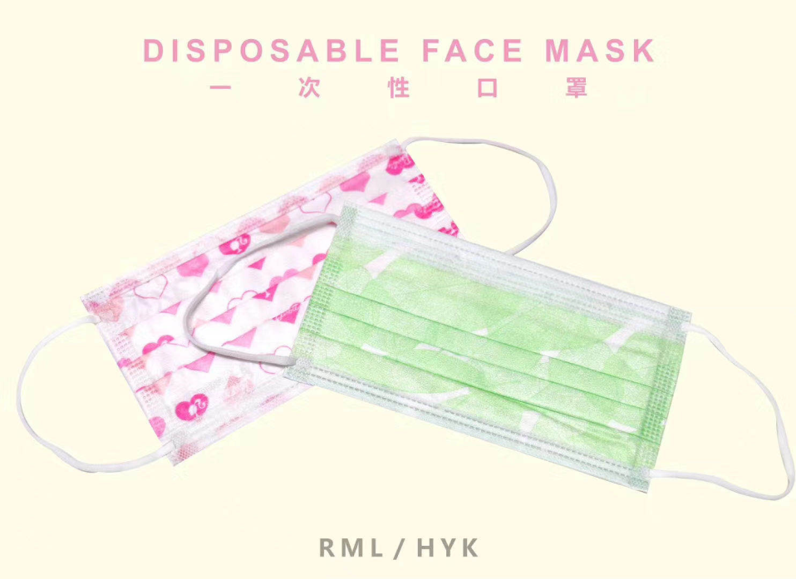
Disposable kids face mask
Product Description
Model no.:Disposable mask
Disposable kids face mask
Style: Ear-Loop
Material: Non-woven Fabric, meltblown
0.3 Micron particulates filtering >95%,
Function: Anti-dust-smog-pollen
BRAND
RML
Certification / Standard
GB2626-2006
CE-NB2163
Logistics Info
Carton size: 52x35x38cm ,2000pcs/CTN
Gross Weight: 6kgs
Volume weight: 6.8kgs
20’ GPQty: 869565 pcs
40’ GPQty: 1623188 pcs
40’HQ Qty: 2028985 pcs
***Price Info
50,000-100,000pcs FOB Shanghai USD0.09/pc
≧100000pcs or other quantity USD0.07/PCS FOB SHANGHAI, negotiate

Slide 7
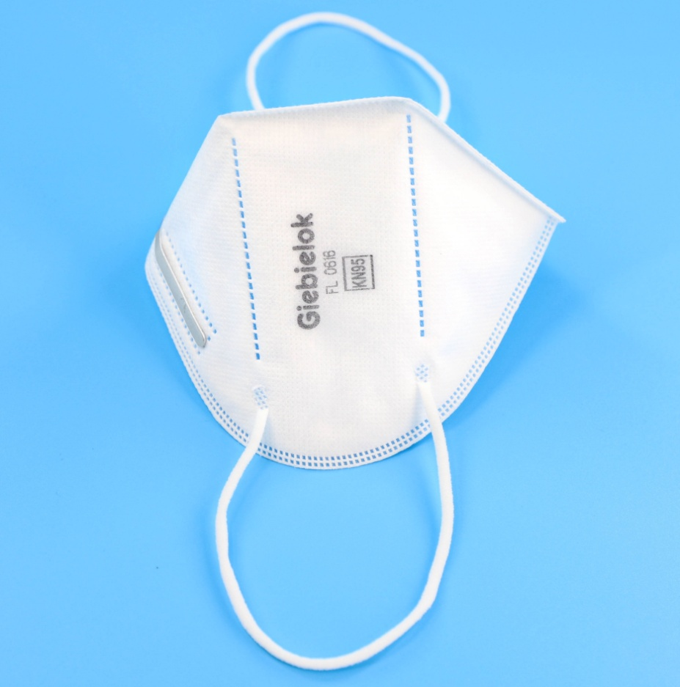
KN95 face mask
Product Description
Model no.:FL0616
KN95 Face mask with Valve Filter,
Style: Ear-Loop
Material: Non-woven Fabric, meltblown
0.3 Micron particulates filtering >95%,
Function: Anti-dust-smog-pollen
BRAND
Giebielok
Certification / Standard
GB2626-2006
Logistics Info
Carton size: 62x29x28cm 600pcs/CTN
Gross Weight: 5.5kgs
Volume weight: 13kgs
20’ GPQty: 177,600 pcs
40’ GPQty: 291,840 pcs
40’HQ Qty: 9328,320 pcs
***Price Info
6000~50000pcs FOB Shanghai USD0.60/pcs 50,000-100,000pcs FOB Shanghai USD0.55/pc
≧100000pcs or other quantity USD0.30/PCS FOB SHANGHAI, negotiate

Slide 8
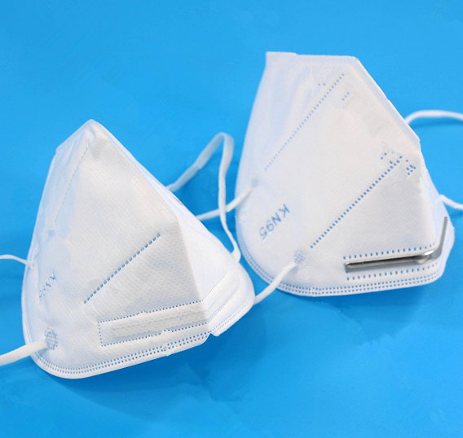
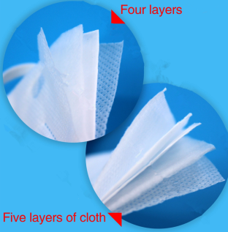
KN95 - BLANK
Product Description
Model No.:GB-001,002
Security Mask KN95
Layer: 4ply( or 3 layers), PM 2.5 pollution,
Material : Non-woven, soft cotton, melt blown filter
Color : White，Without Valve
BRAND
ONEMIX
Certification / Standard
GB2626-2006
Logistics Info
Carton size: 62x29x42cm 1000pcs/CTN
Gross Weight: 9.0kgs
Volume weight: 15.1kgs
20’ GPQty: 370,000 pcs
40’ GPQty: 768,000 pcs
40’HQ Qty: 900,200 pcs
***Price Info
6000~50000pcs FOB Shanghai USD0.55./pc
50001~100000pcs FOB Shanghai USD0.50/pc
≧100000pcs or other quantity FOB Shanghai USD0.39/pcS negotiate

Slide 9
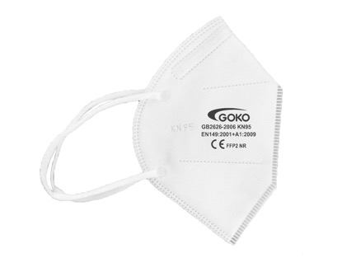
FFP2 mask
Product Description
Model no.:FL0616 with no Valve
KN95 Face mask with no Valve Filter,
Style: Ear-Loop
Material: Non-woven Fabric,
0.3 Micron particulates filtering >95%,
Function: Anti-dust-smog-pollen
BRAND
Giebielok
Certification / Standard
CE
(EN149:2001+A1:2009FF92NR)
Logistics Info
Carton size: 62x29x28cm 400pcs/CTN
Gross Weight: 4.7kgs
20’ GPQty: 222,400 pcs
40’ GPQty: 161,200 pcs
40’HQ Qty: 189,200 pcs
***Price Info
6000~50000pcs FOB Shanghai USD0.80/pc
50001~100000pcs FOB Shanghai USD0.75/pc
≧100000pcs or other quantity FOB Shanghai USD0.60/pcS negotiate

Slide 10
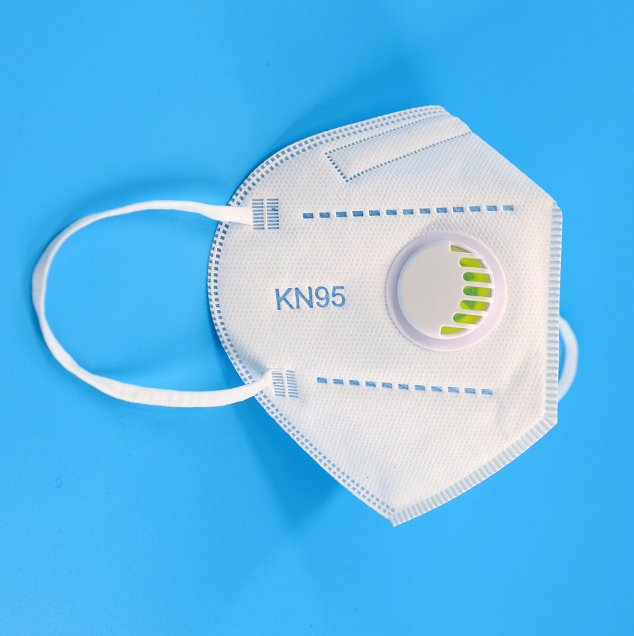
KN95 with Valve Filter
Product Description
Virus-revention KN95 Face mask with Valve Filter,
Style: Ear-Loop
Material: Non-woven Fabric,
0.3 Micron particulates filtering >95%,
Function: Anti-dust-smog-pollen
BRAND
GOKO
Certification / Standard
GB2626-2006
Logistics Info
Carton size: 62x29x28cm 400pcs/CTN
Gross Weight: 4.7kgs
20’ GPQty: 222,400 pcs
40’ GPQty: 161,200 pcs
40’HQ Qty: 189,200 pcs
***Price Info
6000~50000pcs FOB Shanghai USD0.65/pc
50001~100000pcs FOB Shanghai USD0.60/pc
≧100000pcs or other quantity FOB Shanghai USD0.40/pcs negotiate

Slide 11
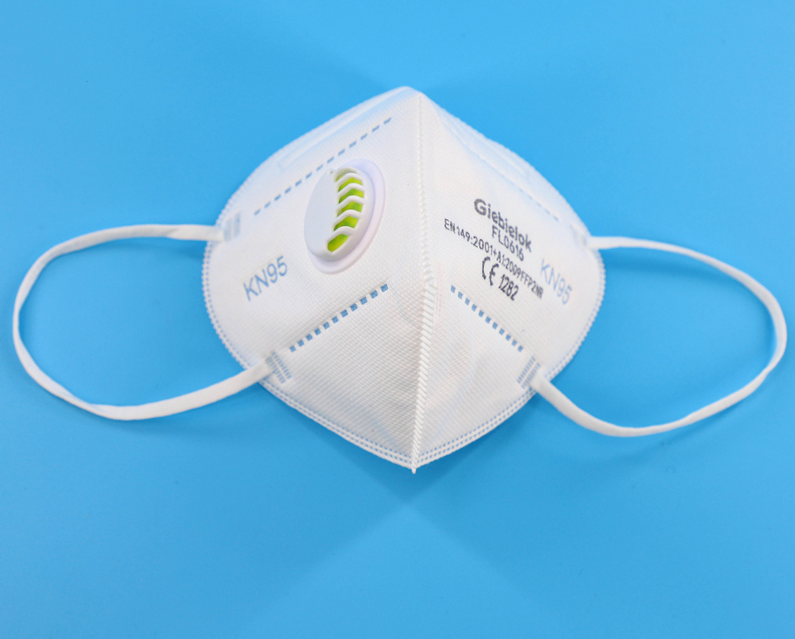
with Valve Filter FFP2
Product Description
Model no.:FL0616
KN95 Face mask with Valve Filter,
Style: Ear-Loop
Material: Non-woven Fabric,
0.3 Micron particulates filtering >95%,
Function: Anti-dust-smog-pollen
BRAND
Giebielok
Certification / Standard
CE EN149:2001+A1:2009FF92NR
（EU Standard)
Logistics Info
Carton size: 62x29x42cm 1000pcs/CTN
Gross Weight: 9.0kgs
Volume weight: 10.1kgs
20’ GPQty: 222,400 pcs
40’ GPQty: 460,800 pcs
40’HQ Qty: 540,000 pcs
***Price Info
6000~50000pcs FOB Shanghai USD0.87/pc
50001~100000pcs FOB Shanghai USD0.80/pc
≧100000pcs or other quantity FOB Shanghai USD0.70pcs negotiate

Slide 12
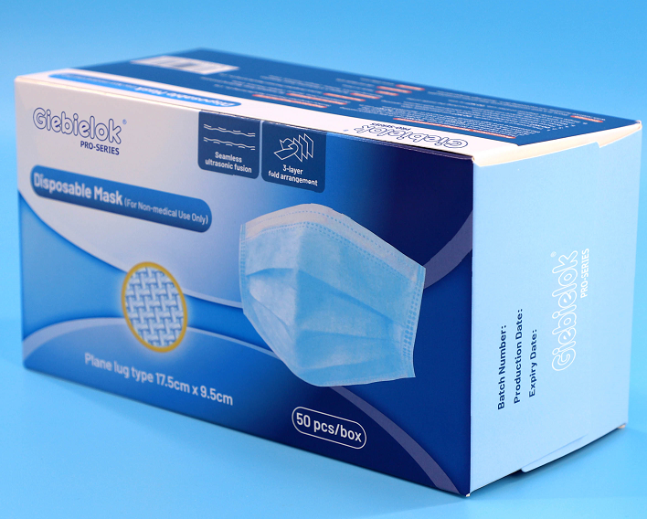
3 ply Disposable Mask (for Non-medical Use)
Product Description
Model no.: GB-003
Safety Mask for Non-Medical Use.
3-Layers fold arrangment.
Seamless ultrasonic fusion
Application: Public Place,
Usage:Smog & Antiviral, Personal protection
Color: Blue.,Age group: Audt, 99% Filtering
Plane lug type: 17.5cm x 9.5 cm
BRAND
Giebielok
Certification / Standard
GB15979-2002
Logistics Info
Carton size: 52x39.5x34cm 2,000pcs/CTN
Gross Weight: 9.9kgs
Volume weight: 14.0kgs
20’ GPQty: 800,000 pcs
40’ GPQty: 1,660,000 pcs
40’HQ Qty: 1,946,000 pcs
***Price Info
50001~100000pcs FOB Shanghai USD0.10/pc
≧100000pcs or other quantity FOB Shanghai USD0.07/pcs, negotiate

Slide 13
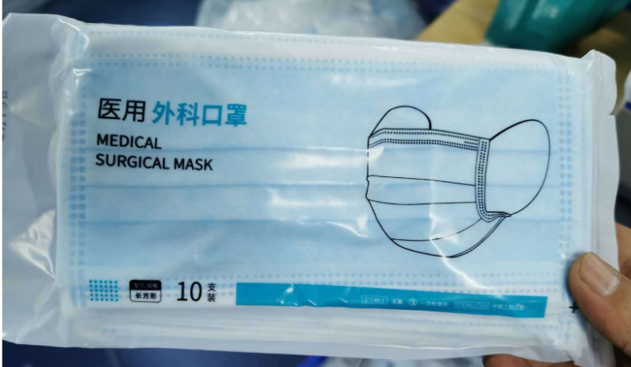
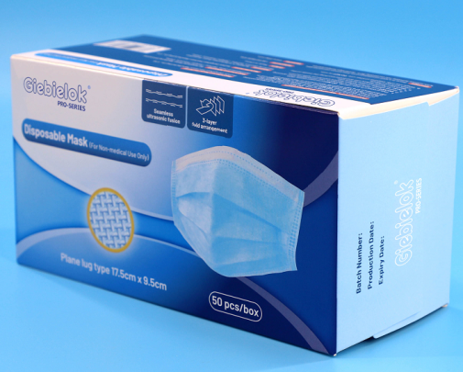
3 ply Medical Mask (for medical Use)
Product Description
Model no.: GB-003
Safety Mask for Medical Use.
3-Layers fold arrangment.
Seamless ultrasonic fusion
Application: Public Place,
Usage:Smog & Antiviral, Personal protection
Color: Blue.,Age group: Audt, 99% Filtering
Plane lug type: 17.5cm x 9.5 cm
Certification / Standard
yy0969-2013
Logistics Info
Carton size: 52x39.5x34cm 2,000pcs/CTN
Gross Weight: 9.9kgs
Volume weight: 14.0kgs
20’ GPQty: 800,000 pcs
40’ GPQty: 1,660,000 pcs
40’HQ Qty: 1,946,000 pcs
***Price Info
≧100000pcs or other quantity FOB USD0.17/pcs,

Slide 14
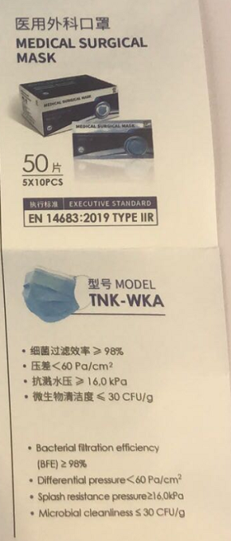
3 ply Surgical Mask (for Surge Use)
Product Description
Model no.: GB-004
Safety Mask for Medical Use.
3-Layers fold arrangment.
Seamless ultrasonic fusion
Application: Public Place,
Usage:Smog & Antiviral, Personal protection
Color: Blue.,Age group: Audt, 99% Filtering
Plane lug type: 17.5cm x 9.5 cm
Certification / Standard
yy0469-2013
EN14683--type II R
Logistics Info
Carton size: 52x39.5x34cm 2,000pcs/CTN
Gross Weight: 9.9kgs
Volume weight: 14.0kgs
20’ GPQty: 800,000 pcs
40’ GPQty: 1,660,000 pcs
40’HQ Qty: 1,946,000 pcs
***Price Info
≧10000000pcs or other quantity FOB USD0.17/pcs,

Slide 15
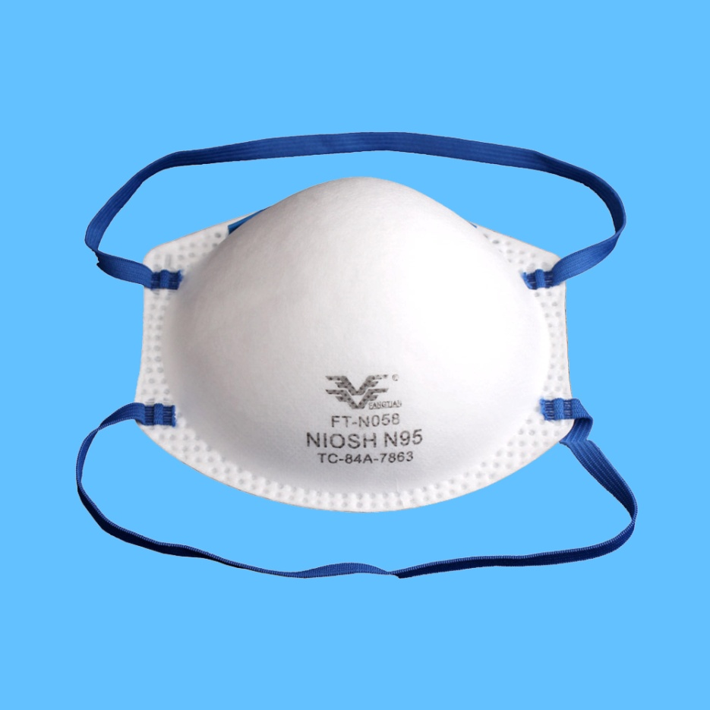
N95 Face Mask Cup shape
Product Description
Model no.:FT-N058
N95 Face Mask,Without Valve
Shape:Cup shape
Safe-Type. Filter Rating:95% .
personal protection
BRAND
FANTIAN
Certification / Standard
NIOSH TC-84A-7863
(USA Standard)
Logistics Info
Carton size: 66.5x29x37.5cm 400pcs/CTN
Gross Weight: 5.0kgs
Volume weight: 14.5kgs
20’ GPQty: 154,800 pcs
40’ GPQty: 320,800 pcs
40’HQ Qty: 376,000 pcs
***Price Info
4000~10000pcs FOB Shanghai USD3.50/pc
50001~100000pcs FOB Shanghai USD3.00/pc
≧100000pcs or other quantity FOB Shanghai USD2.70/pcs negotiate

Slide 16
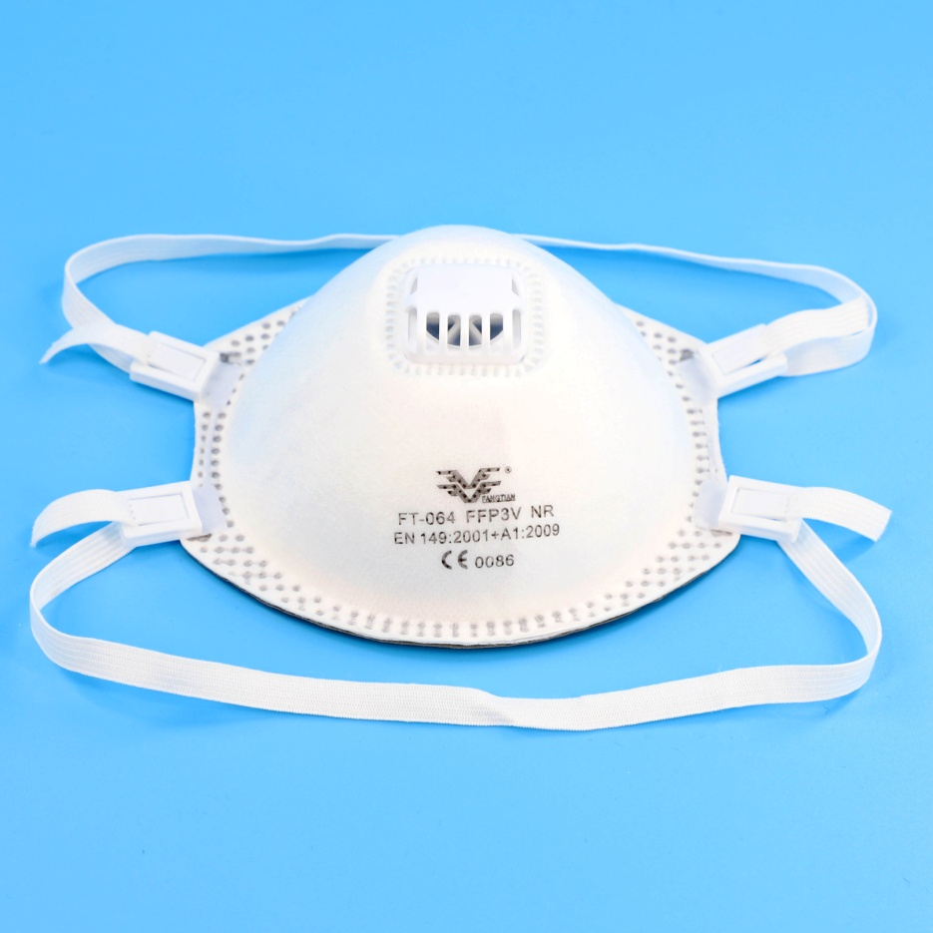
FFP3 with valve Face Mask
Product Description
Ffp3 Face Mask, WITH VALVE FILTER.
Shape:Cup shape
Safe-Type.
Filter Rating:99%
BRAND
FANTIAN
Certification / Standard
CE EN149-2001+A1 2009
(EU Standard)
Logistics Info
Carton size: 66.5x36x39.5cm /0.096CBM 200pcs/CTN
Gross Weight: 7.0kgs
Volume weight: 14.0kgs
20’ GPQty: 64,800 pcs
40’ GPQty: 129,600 pcs
40’HQ Qty: 140,400 pcs
***Price Info
4000~10000pcs FOB Shanghai USD3.50/pc
10001~50000pcs FOB Shanghai USD3.00/pc
≧50000pcs or other quantity FOB Shanghai USD2.90/pcs negotiate

Slide 17
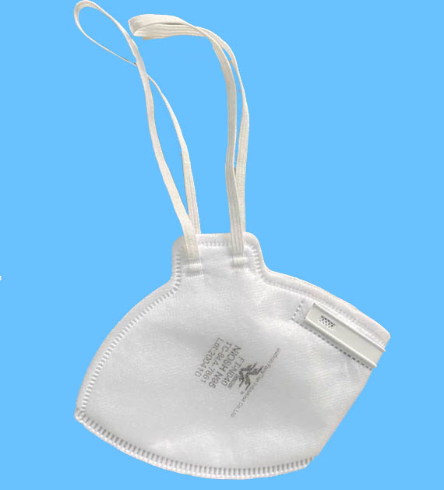
N95 NIOSH Certificated
Product Description
Model no.:FT-N040
N95 Face Mask,Without Valve
Shape:Foladble
Safe-Type. Filter Rating:95% .
personal protection
BRAND
FANTIAN
Certification / Standard
NIOSH TC-84A-7861
(USA Standard)
Logistics Info
Carton size: 62x29x28cm 400pcs/CTN
Gross Weight: 4.7kgs
20’ GPQty: 222,400 pcs
40’ GPQty: 161,200 pcs
40’HQ Qty: 189,200 pcs
***Price Info ( FOB Shanghai)
5000~10000pcs FOB Shanghai USD2.95/pc
10001~50000pcs FOB Shanghai USD2.50/pc
≧50000pcs or other quantity FOB Shanghai USD2.20/pcs negotiate

Slide 18
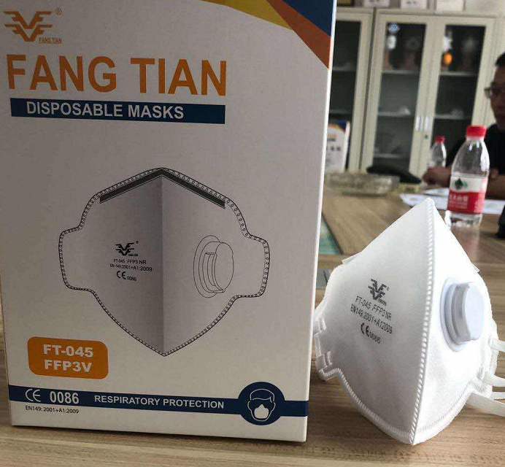
FFP3 with filter Certificated
Product Description
Model no.:FT-N045
N95 Face Mask,Without Valve
Shape:Foladble
Safe-Type. Filter Rating:95% .
personal protection
BRAND
FANTIAN
Certification / Standard
CE EN149-2001+A1 2009
(EU Standard)
Logistics Info
Carton size: 62x29x28cm 400pcs/CTN
Gross Weight: 4.7kgs
20’ GPQty: 222,400 pcs
40’ GPQty: 161,200 pcs
40’HQ Qty: 189,200 pcs
***Price Info ( FOB Shanghai)
5000~10000pcs FOB Shanghai USD3.50/pc
10001~50000pcs FOB Shanghai USD2.99/pc
≧50000pcs or other quantity FOB Shanghai USD2.89/pcs negotiate

Slide 19
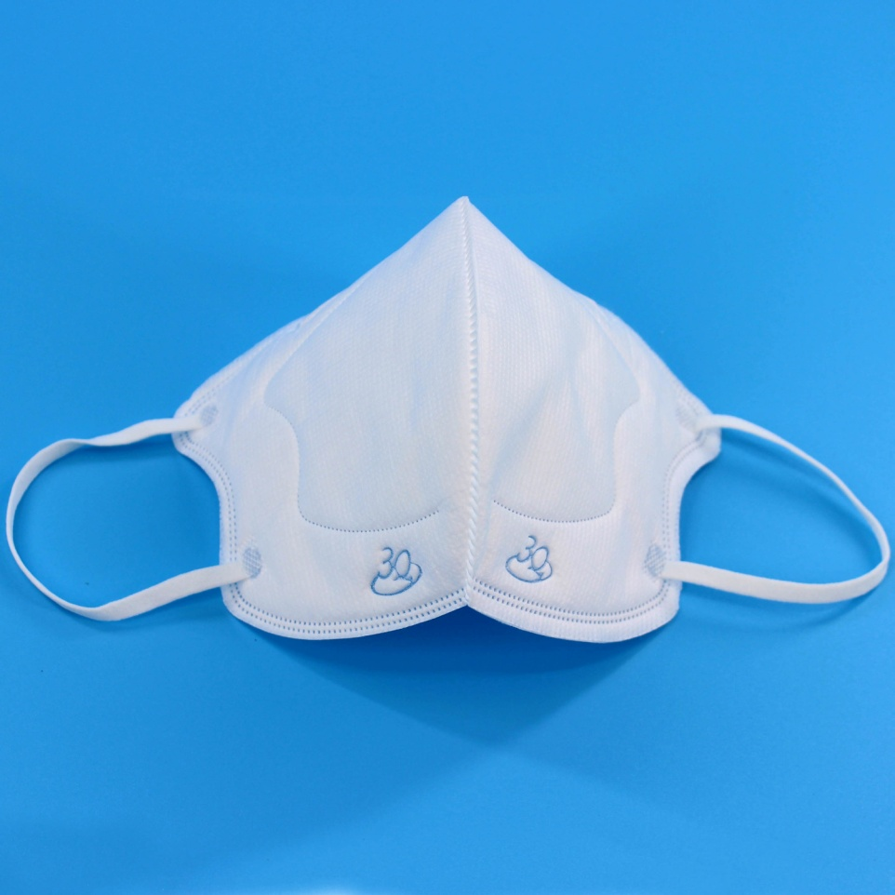
KN95 Face mask
Product Description
Model no.: KN95(N95 grade)
KN95 Face mask,
Style: foladable，Without Valve
Material: Non-woven Fabric, meltblown cloth
0.3 Micron particulates filtering >95%,
Function: Anti-dust-smog-pollen,
Scope of application: Adult
BRAND
3Q
Certification / Standard
GB2626-2006
Logistics Info
Carton size: 62x56x62cm 1500pcs/CTN
Reference Gross Weight: 12 kgs
20’ GPQty: 162,000 pcs
40’ GPQty: 570,000 pcs
40’HQ Qty: 684,000 pcs
***Price Info ( FOB Shanghai)
5000~10000pcs FOB Shanghai USD4.00/pc
10001~50000pcs FOB Shanghai USD3.25/pc
≧50000pcs or other quantity FOB Shanghai USD3.00/pcs negotiate

Slide 20
N95 Face mask (medical use, accept custom)
Product Description
Model no.: N95-1
KN95 Face mask,
Style: foladable，Without Valve
Material: Non-woven Fabric, meltblown cloth
0.3 Micron particulates filtering >95%,
Function: Anti-dust-smog-pollen,
Scope of application: Adult
BRAND
3Q
Certification / Standard
GB19083-2010
Logistics Info
Carton size: 62x56x62cm 1500pcs/CTN
Reference Gross Weight: 12 kgs
20’ GPQty: 162,000 pcs
40’ GPQty: 570,000 pcs
40’HQ Qty: 684,000 pcs
***Price Info ( FOB Shanghai)
5000~10000pcs FOB Shanghai USD3.99/pc
10001~50000pcs FOB Shanghai USD3.65/pc
≧50000pcs or other quantity FOB Shanghai USD3.50/pcs negotiate

Slide 21
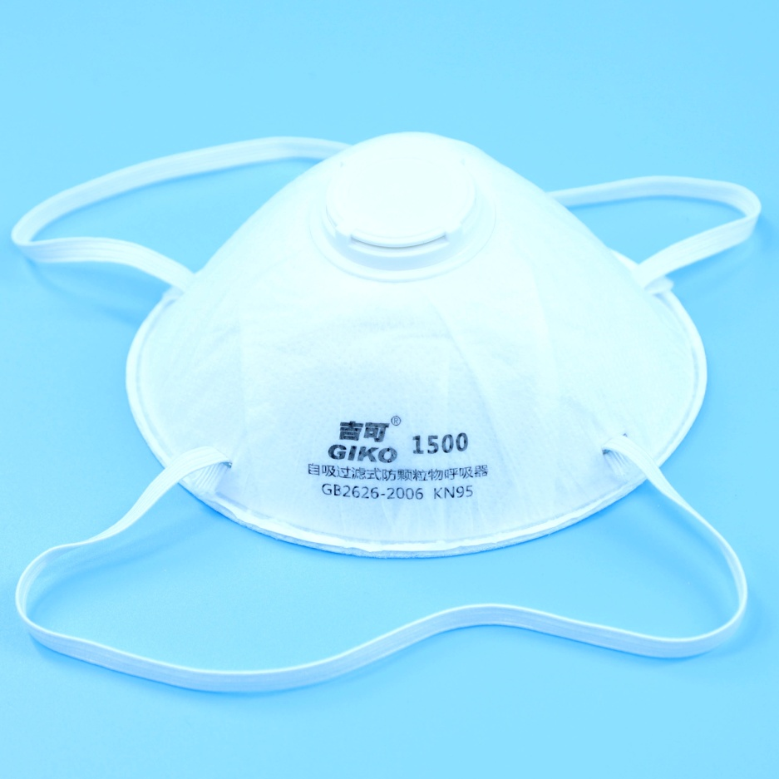
KN95 Face mask with valve
Product Description
Model no.: 1500
KN95 Face mask,
Style: head mounted，With Valve
Material: Non-woven Fabric,
0.3 Micron particulates filtering >95%,
Function: Anti-dust-smog-pollen,
Scope of application: Adult
BRAND
GIKO
Certification / Standard
GB2626-2006
Logistics Info
Carton size: 53x43x47cm 360pcs/CTN
Gross Weight: 6.0kgs
20’ GPQty: 99,000 pcs
40’ GPQty: 198,000 pcs
40’HQ Qty: 237,600 pcs
***Price Info
5000~10000pcs FOB Shanghai USD1.60/pc
10001~50000pcs FOB Shanghai USD1.35/pc
≧50000pcs or other quantity negotiate

Slide 22
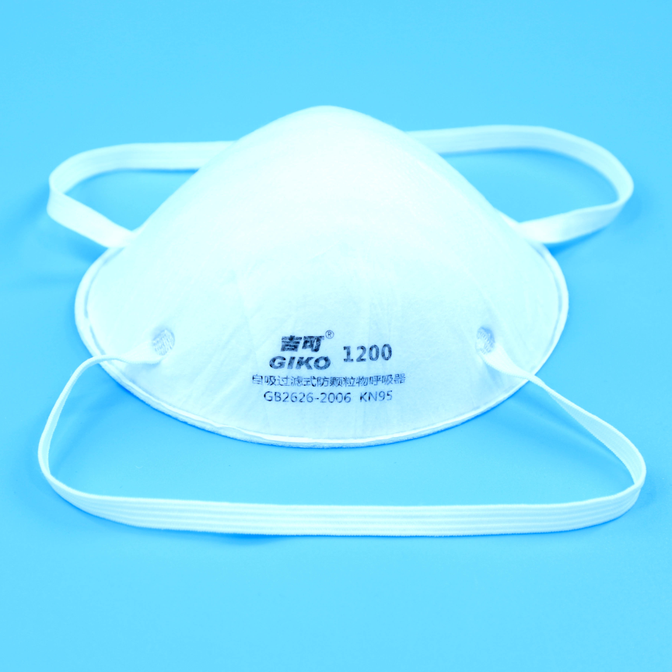
KN95 Face mask
Product Description
Model no.:1200
KN95 Face mask,
Style: head mounted，Without Valve
Material: Non-woven Fabric,
0.3 Micron particulates filtering >95%,
Function: Anti-dust-smog-pollen,
Scope of application: Adult
BRAND
GIKO
Certification / Standard
GB2626-2006
Logistics Info
Carton size: 53x43x47cm 400pcs/CTN
Gross Weight: 6.0kgs
20’ GPQty:110,000 pcs
40’ GPQty: 220,000 pcs
40’HQ Qty: 264,000 pcs
***Price Info
5000~10000pcs FOB Shanghai USD1.50/pc
10001~50000pcs FOB Shanghai USD1.25/pc
≧50000pcs or other quantity negotiate

Slide 23
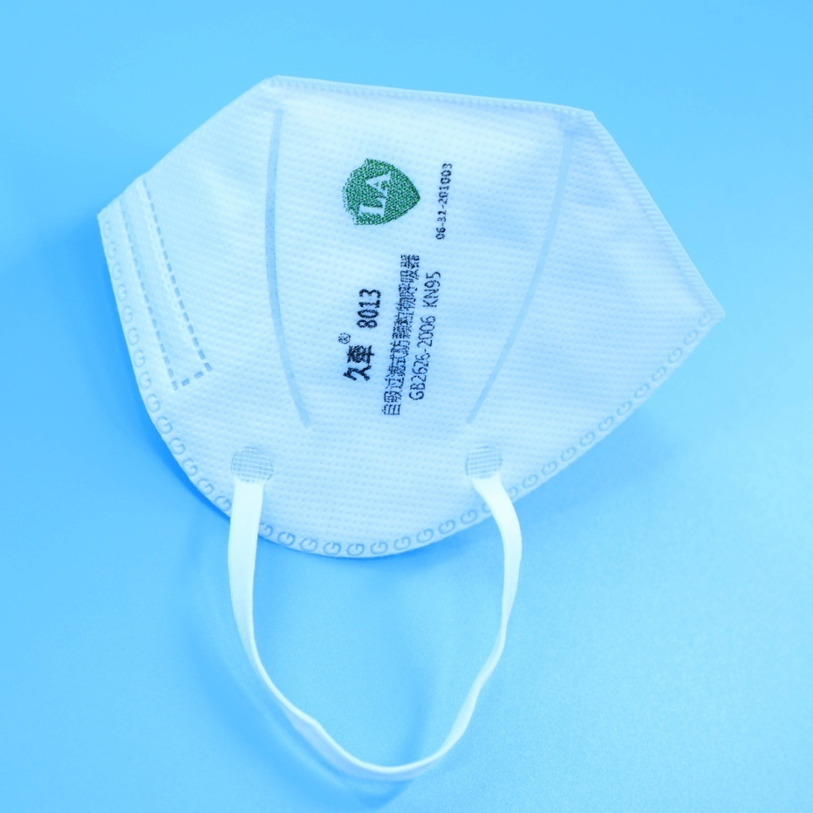
KN95 Face mask
Product Description
Model no.: 8013
KN95 Face mask,
Style: Earloop，Without Valve
Material: Non-woven Fabric,
0.3 Micron particulates filtering >95%,
Function: Anti-dust-smog-pollen,
Scope of application: Adult
Certification / Standard
GB2626-2006
Logistics Info
Carton size: 50x44.5x53cm 1200pcs/CTN
Reference gross Weight: 10kgs
20’ GPQty: 283,200 pcs
40’ GPQty: 576,000 pcs
40’HQ Qty: 720,000 pcs
***Price Info
5000~10000pcs FOB Shanghai USD2.20/pc
10001~50000pcs FOB Shanghai USD1.90/pc
≧50000pcs or other quantity negotiate

