Slide 1

Our Supplier is one of the biggest specialized manufacturer and exporter of new light weight energy saving wall panel and its machinery in China, integrating the development, production, sale, installation and so on.
Internal Top Brand
1.
Specialized Manufacturer Of Light Weight Energy Saving Wall Panel.
2.
Specialized Manufacturer Of Production Line.
3.
Specialized Manufacturer Of Prefab House.

Slide 2
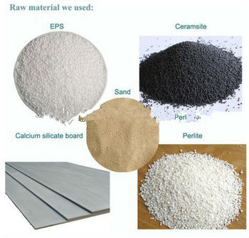

Slide 3
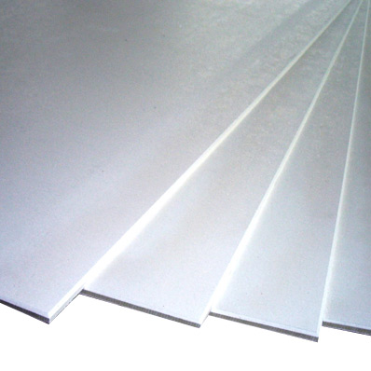
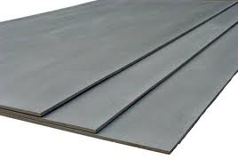
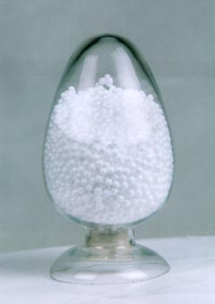

Raw Materials
Calcium Silicate Board:
Face Panel of RIGEL Sandwich Panel
EPS(Expandable Polystyrene):
Core of Huigu Light Weight Panel

Slide 4
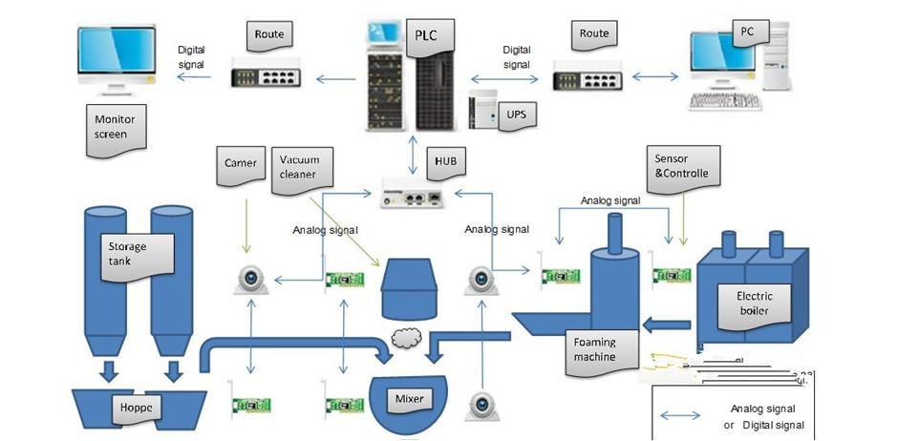
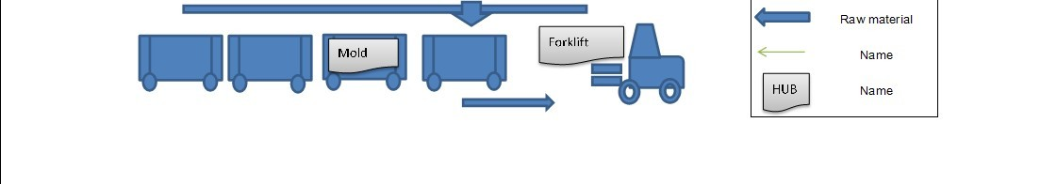
Technological process
www.hubeijinyi.cn

Slide 5


auto-production line system solution supplier
Double system oriented automatic solution
Cooperative R D
SIMENS AUTOMATIC
TECHNOLOGY
Huazhong University of
Science and technology
laboratory
PRODUCTION
DEPARTMENT
engineering
department
Text1
Text1

Slide 6
Engineering Capability
A professional engineering team
6+ Engineering project staff（2years engineering work experience )
5+ Different engineering oriented （Control system, frequency ,belt drive ,software , installation and adjustment , instruction ）
Nine million ㎡+
Project implementation capacity per year
6

Slide 7
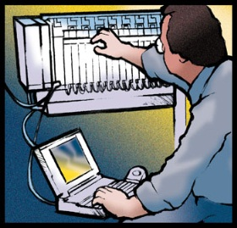


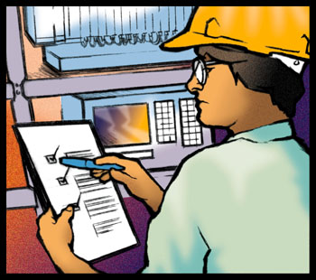



System Solution
Site Service
Project consultation
System Test
Project Management
  We know the heavy responsibility for us !
Hardware installation
Design team
7

Slide 8
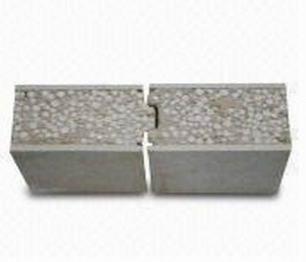
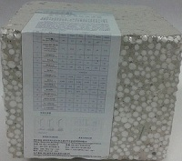
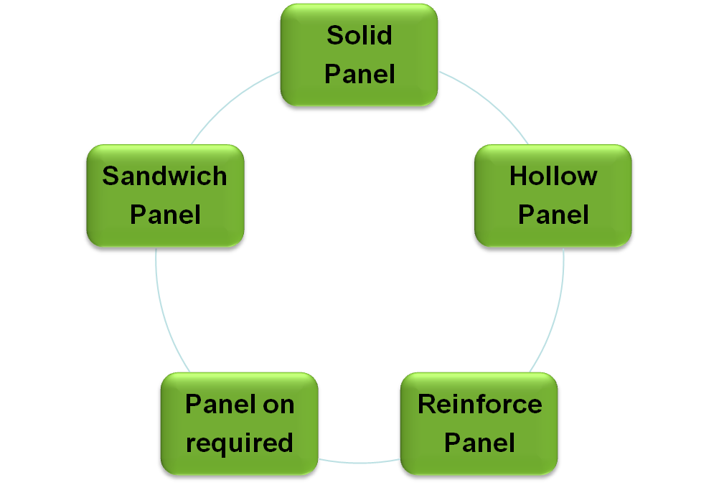
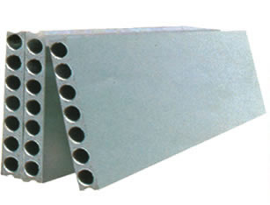
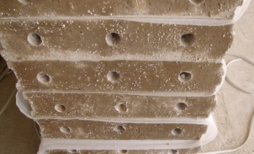
Light Weight Panel Series

Slide 9


II. Light Weight Panel Compositions
Sandwich Panel:
4.5mm Calcium silicate board as face panel
EPS and Cement as core
Solid heart
Solid Panel:
No face panel
EPS and Cement
Solid heart
Hollow Panel:
No face panel
EPS and Cement
With holes going through the panel

Slide 10
III. Light Weight Panel Specifications
Items Panels | Length mm | Width mm | Thickness mm | Density kg/m2
Sandwich Panel | 1500~3000 | 610 | 60,75,90,120,150,180 | 45,54,63,81,99,117
Solid Panel | 1500~3000 | 600 | 60,75,90,120,150,180 | 41,51,61,81,101,121
Hollow Panel | 1500~3000 | 600 | 90,120,150,180 | 33,52,65,77

Slide 11



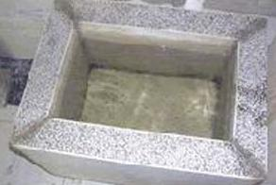



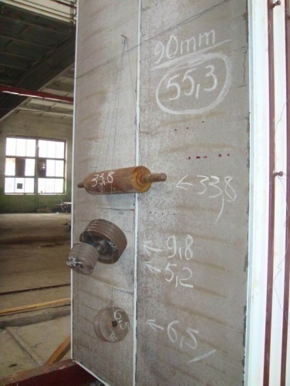


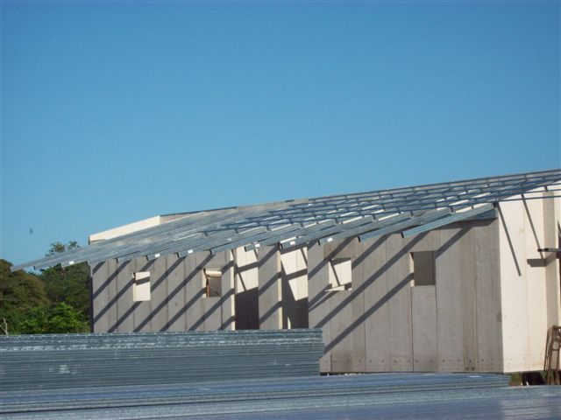
Light Weight Panel Advantages
Water
Proof
Fire
Proof
Heat
Insulation
Light
Weight
Sound
Insulation
High
Strength
Fast
Construction

Slide 12
Advantages
1, Waterproof and dampproof –The experiment shows that make a water pool with our panel and fill the water .Without any waterproof facing , after one year , the outside of ppl keep dry and no water mark , there is no bead on the surface in the wet climate
2, Fireproof : The panel has good fireproof performance , Attested by the national construction materials quality supervision and inspection center , the fireproof limite is 4 hours and national level A incombustibility .
3 , The raw materials of the panel is EPS Polystyrene grain which has good sound insulation and absorption performance
4, Short construction period , high efficiency .
Dry way construction , can be sawed , can be cut , can be drilled . Achieved the assembly installation , the speed is 6-7 times higher than the traditional block , greatly reduce the construction period

Slide 13
5 , Light weight and earthquack proof
The weight of the panel is 10 times lighter than the trantional brick , can solve the beam , column , foundation problems . The panel column connection has good earthquack proof performance . Not only appy to the low –rise building , also apply to the high rise building and soft geology building .
6, Energy saving and enviroment friendly
The core materials of the panel is the EPS polystyrene grain which has good preservation function can reduce the cost of the electric . It is the best choice for energy saving . All the raw materials are according to the requirement of national enviroment protection department , no pollution in produce , no , waste in the installation
7, Increase the usable area , reduce the construction cost
The panel is thinner than the tradional block and it can increase more than 8-10% area , save a lot of construction space and reduce the cost . Meanwhile , light in weight , also can save the cost on the structure of building . s

Slide 14
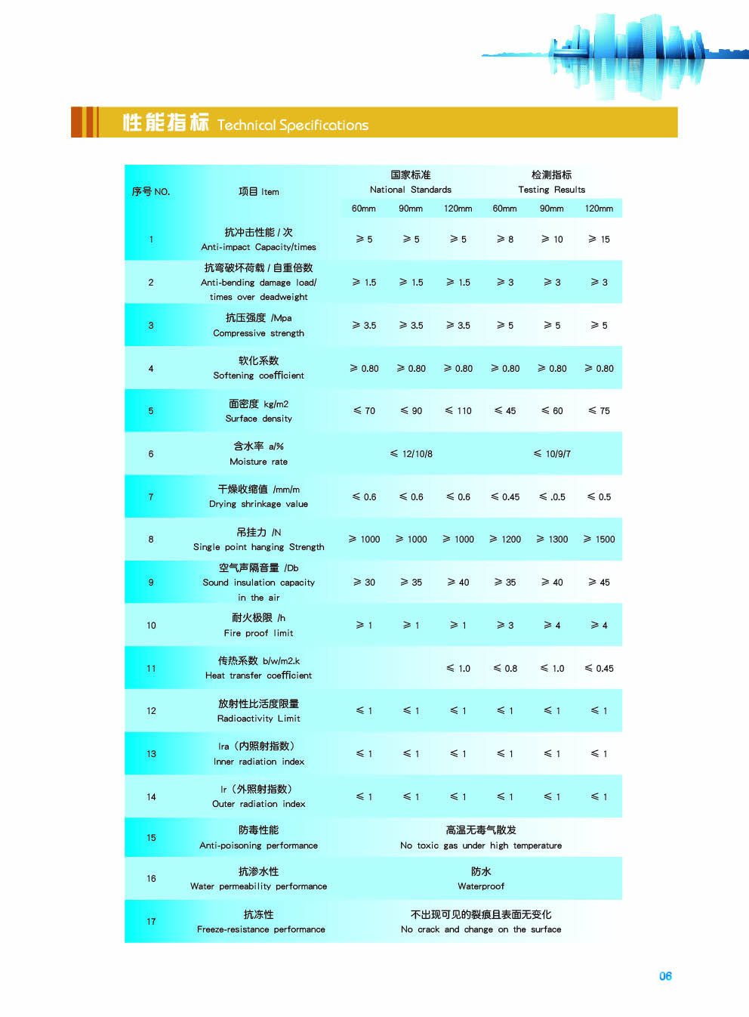
V. Light Weight Panel Performances

Slide 15
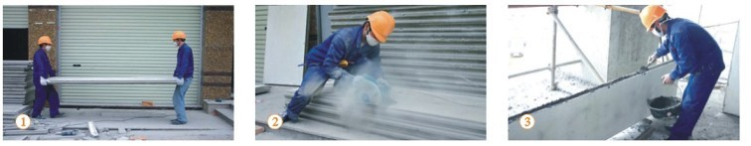
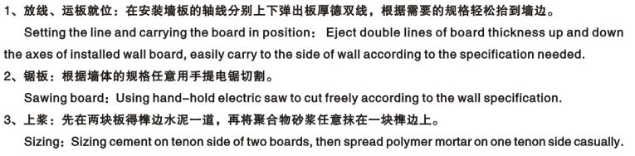
installation flow of light weight weight compound sandwich panel

Slide 16
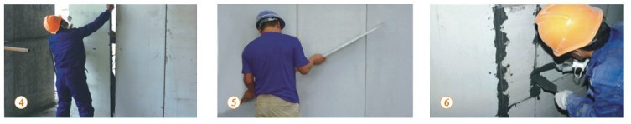
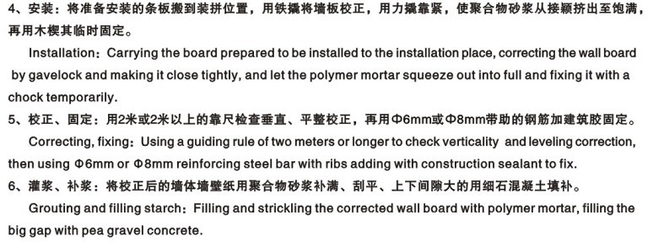

Slide 17
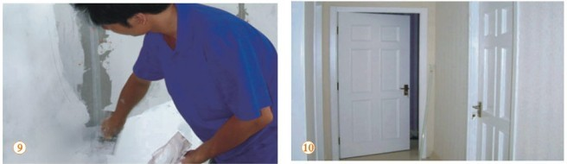
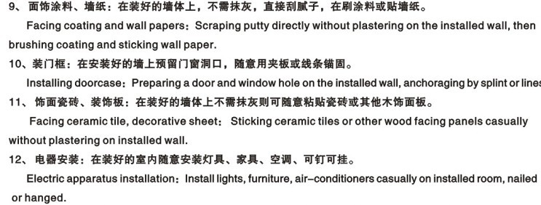

Slide 18
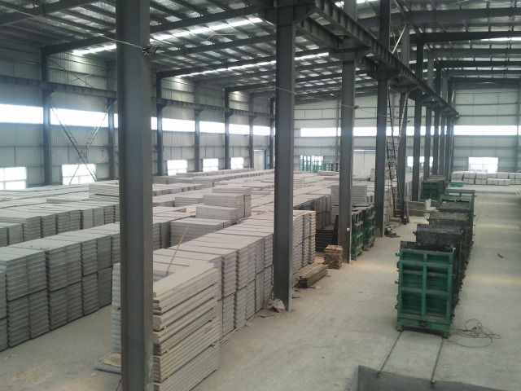
The Production factory

Slide 19
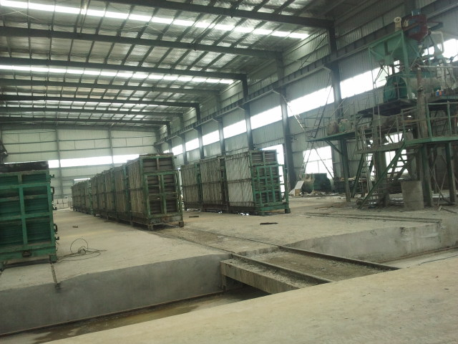
THE MOULD TO PRODUCE THE SANDWICH WALL PANEL

Slide 20
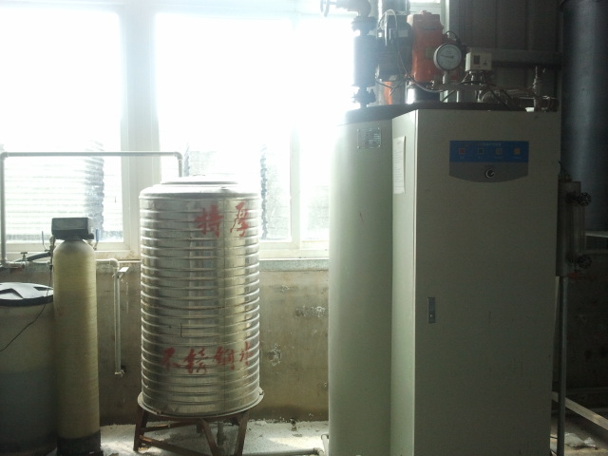
The process for the production line introducton
The boiler provide the heat to expand the EPS expander machine to expand the EPS bead
The gas boiler

Slide 21
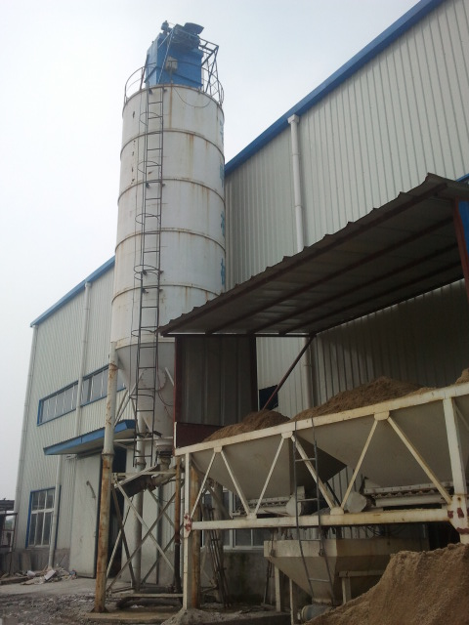
THE CEMENT TANK FOR THE CEMENT TRANSFER

Slide 22
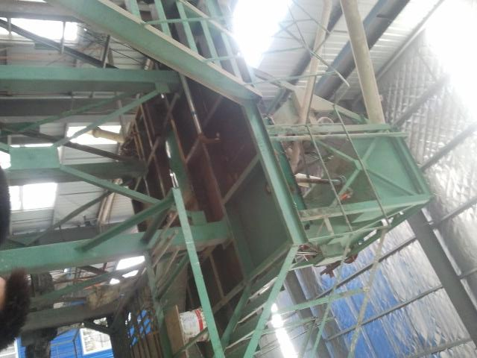
JS 1500 Mixer machine for the raw materials mix
Productin
Administration
Engeering
l

Slide 23
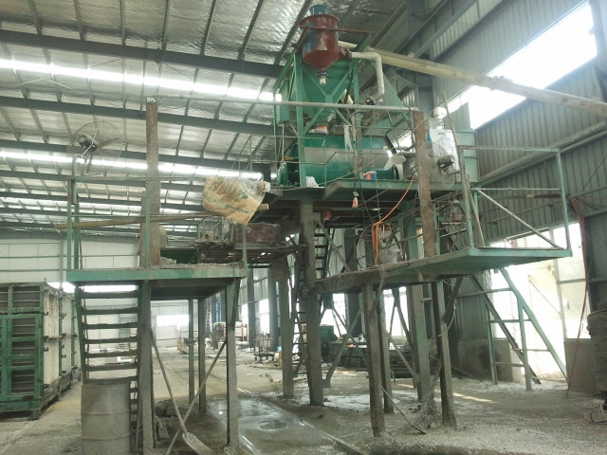
The Automatic cement , sand , water ,eps system

Slide 24
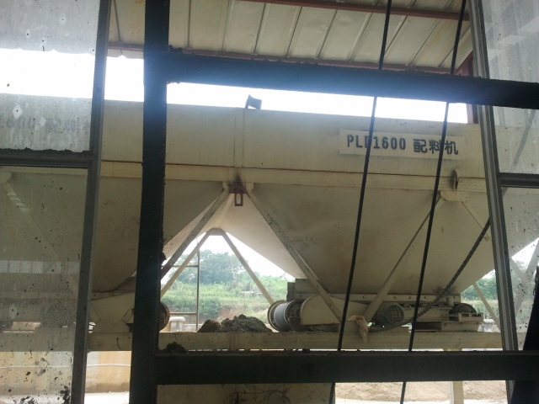
The sand weight system

Slide 25
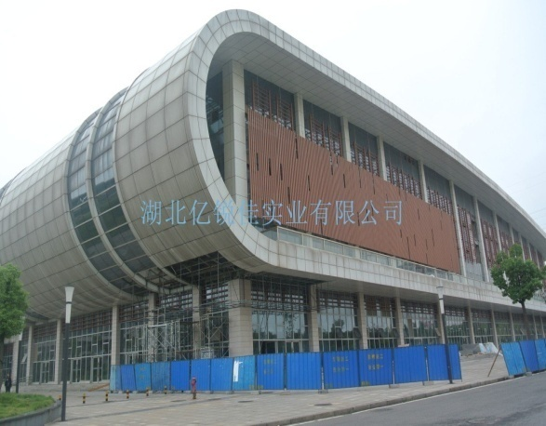
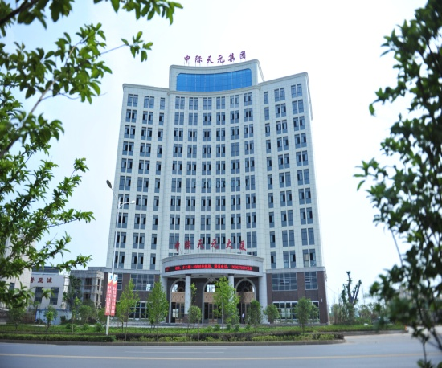
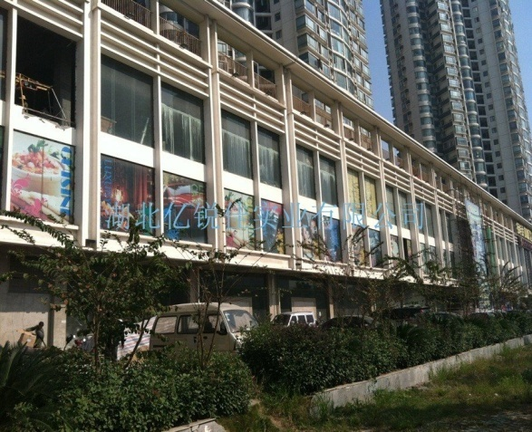
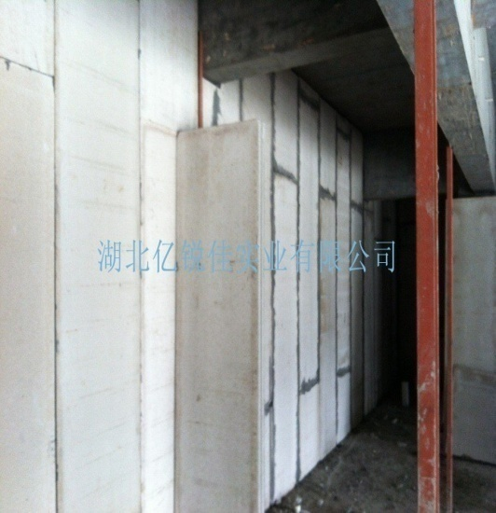
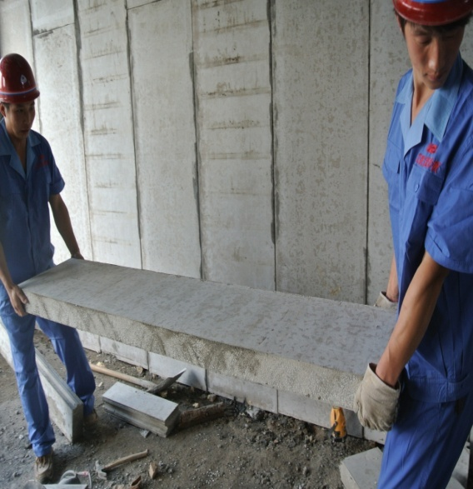

China demestic Achievment
Wuhan train station
The goverment building
The shopping mall hotel

Slide 26
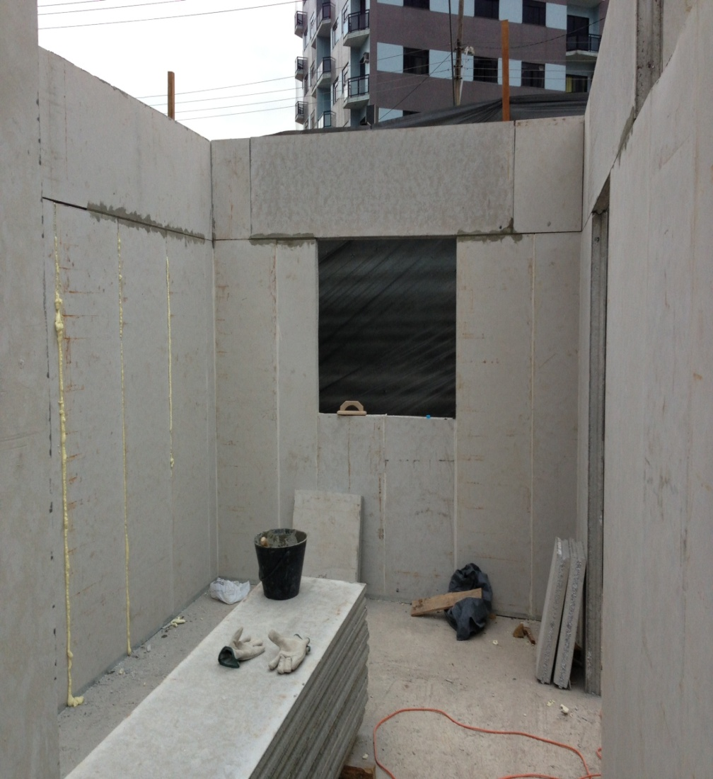
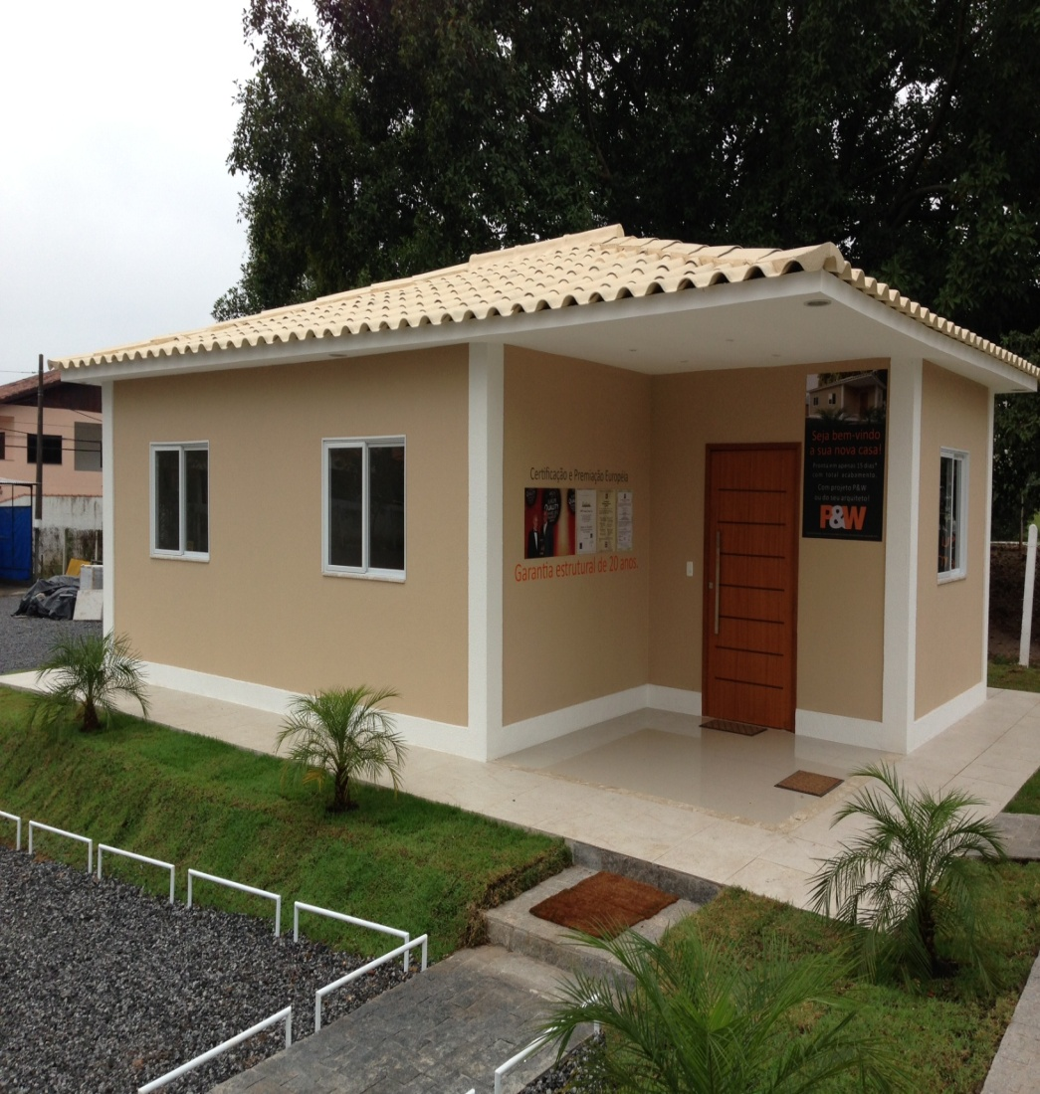
One floor Brizal Sample House

Slide 27
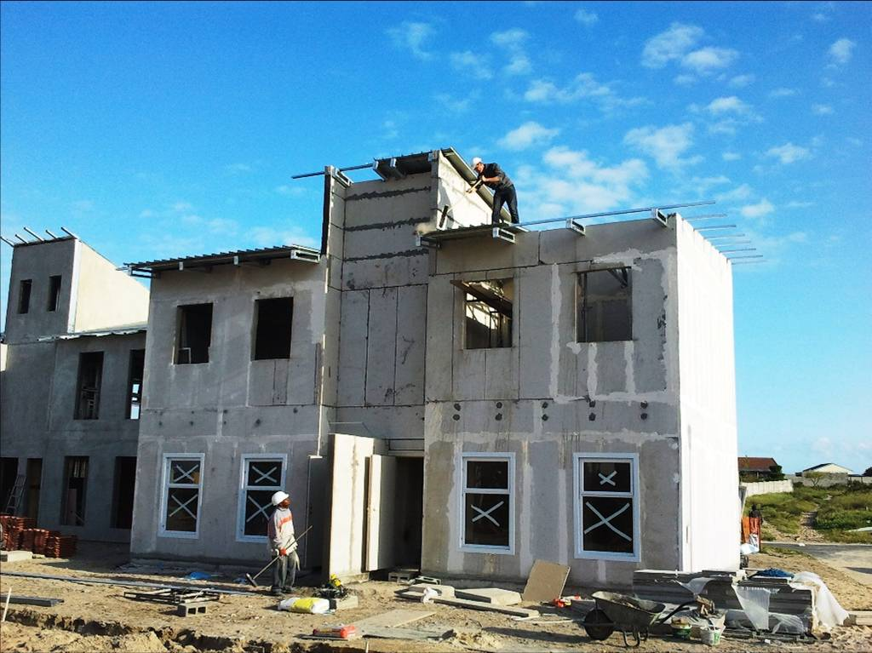
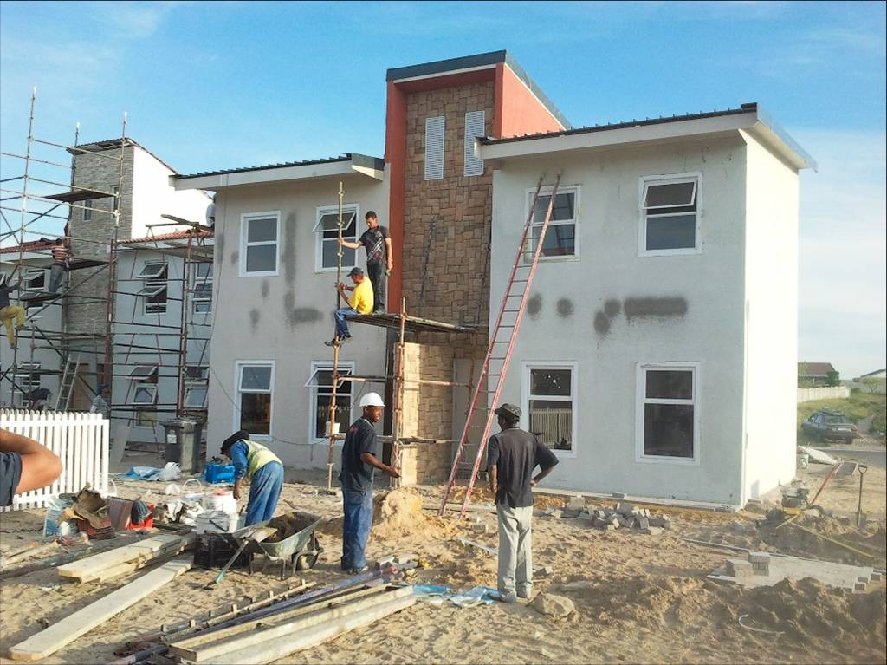
The African two floor project

Slide 28
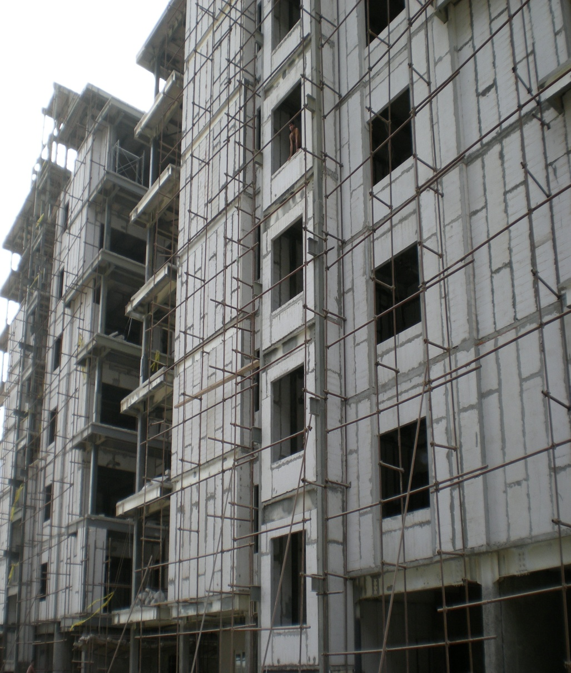
IRAN MULTILAYER PROJECT

Slide 29
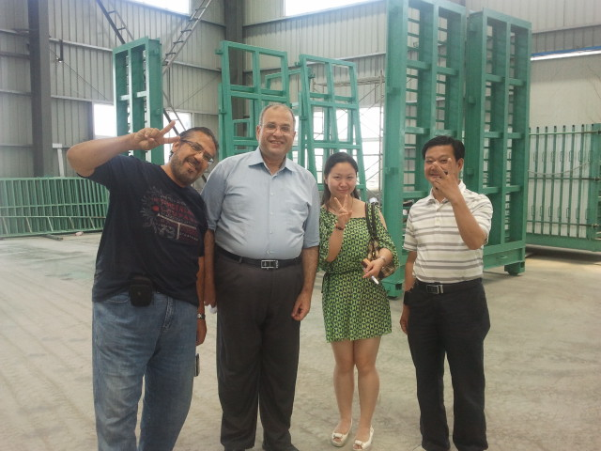
The Saudi Arabia customer

Slide 30
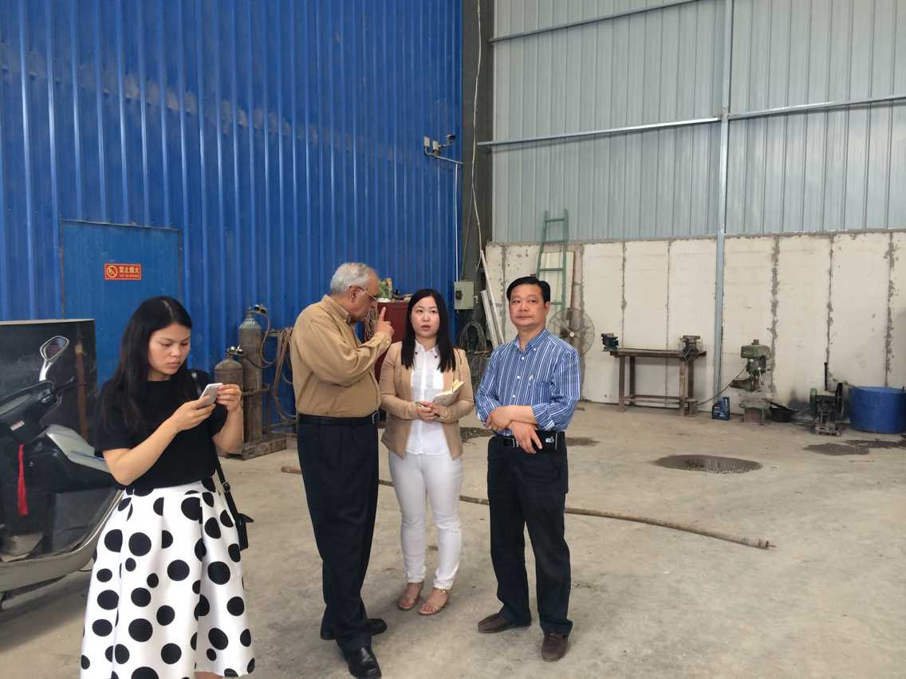
Indian custoemr to visit

Slide 31
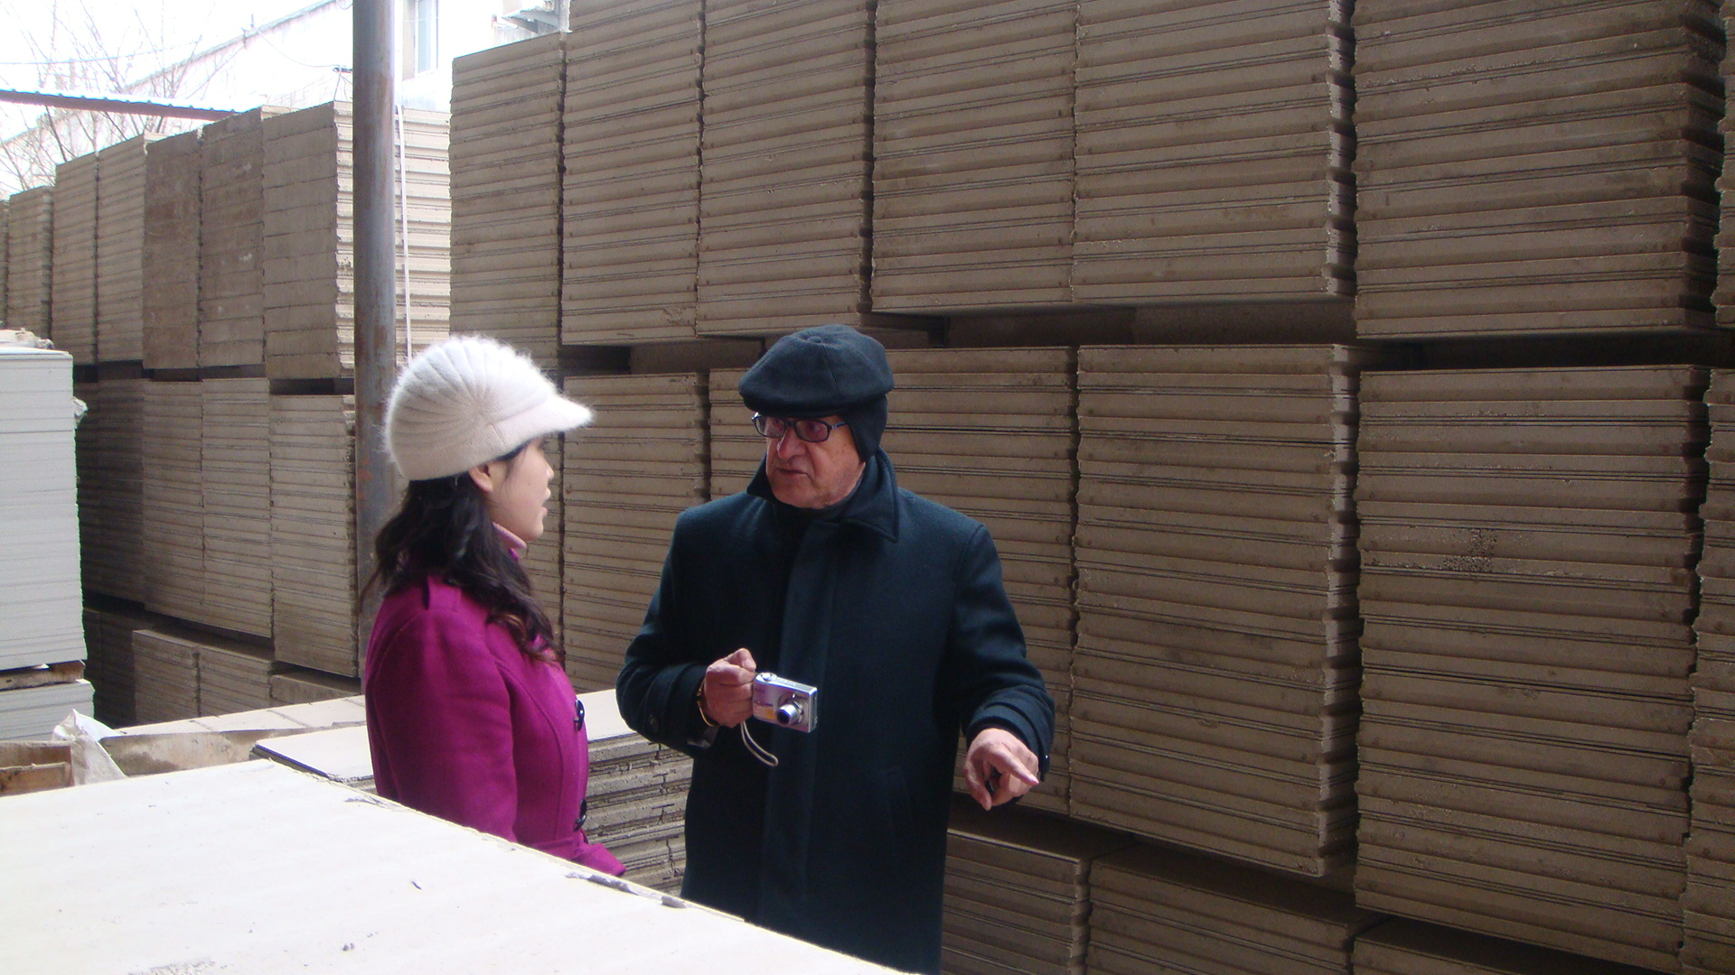
The Chile Customer to visit

Slide 32
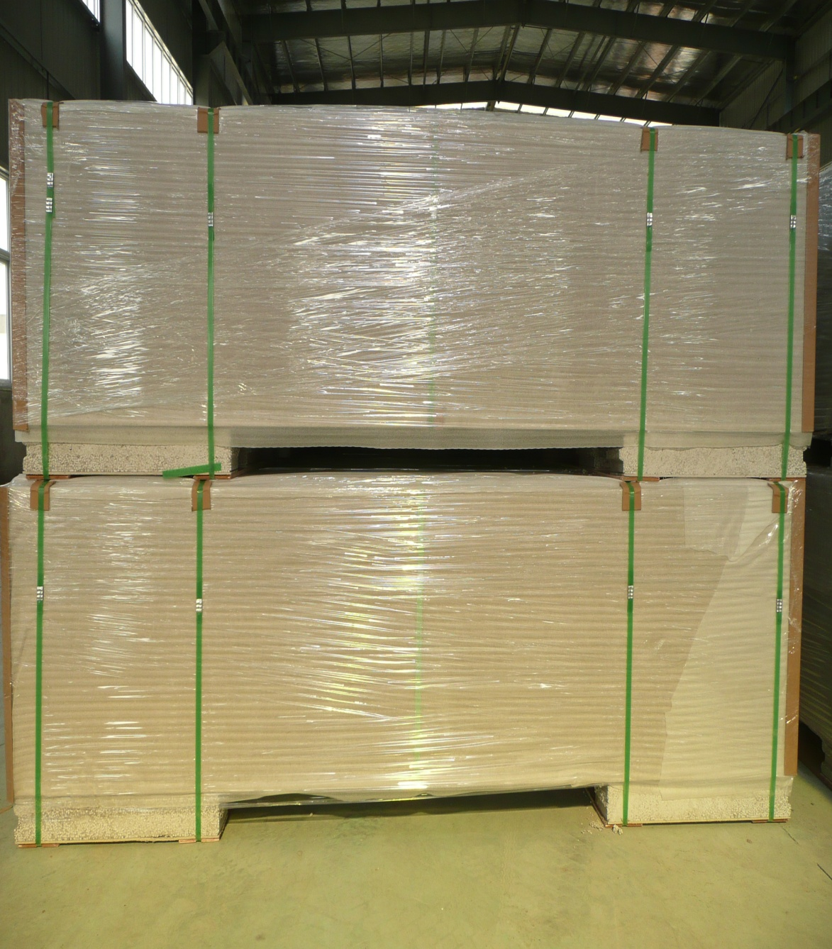
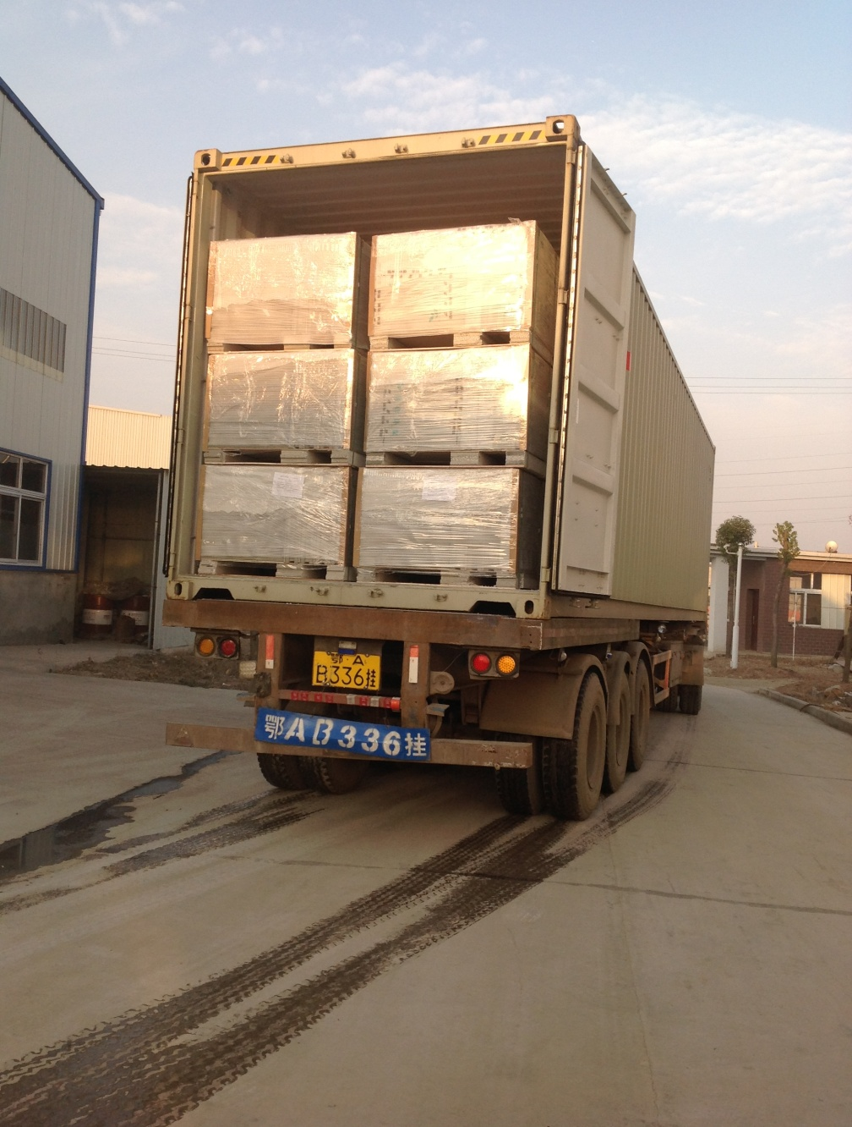
Our pacckage and loading

Slide 33
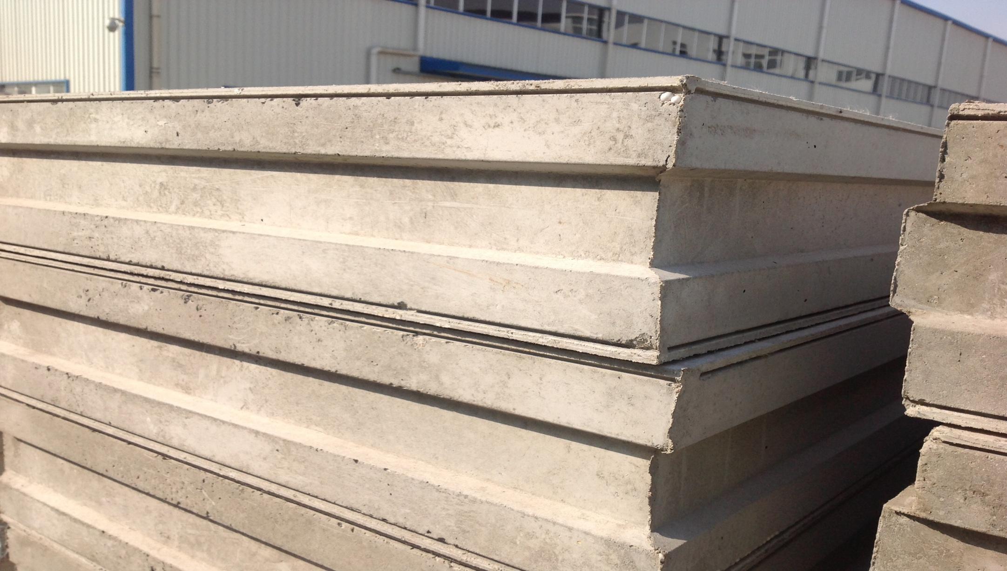
Our product is very good density and good quality as photos

Slide 34
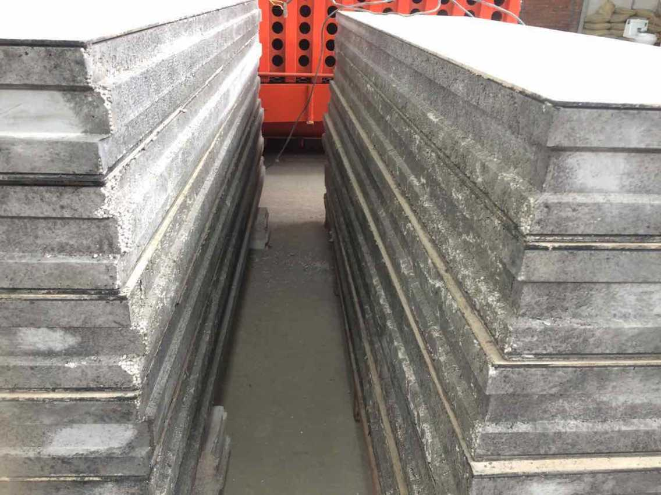
The other company quality is not good density and easy to break , even the beads come out !

Slide 35
So after the the quality company you must know which supplier is your best selection , thanks !

Slide 36
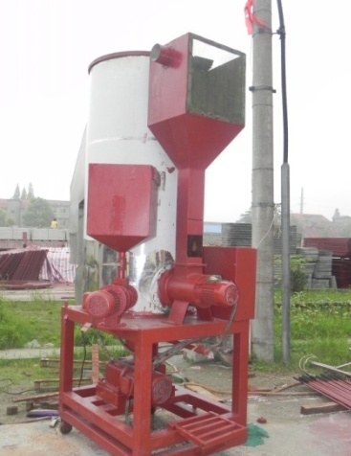
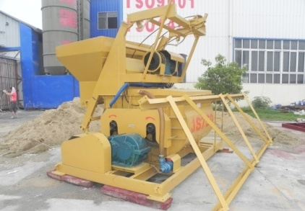
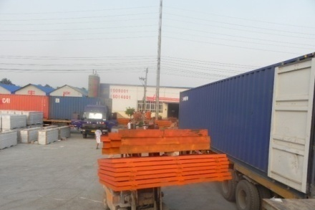









The other option is you can buy the production lineproduction line home for yourself production

Slide 37


Slide 38
MIANZ
FOOD

Slide 39


Slide 40


Slide 41


Slide 42


ABOUT design sketch

Slide 43


VERTICAL
VIEW

Slide 44




ELEVATION
Windowing is recommended
for this elevation

