Slide 1


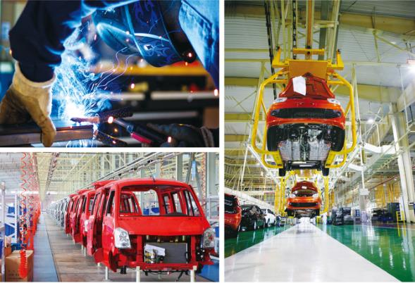
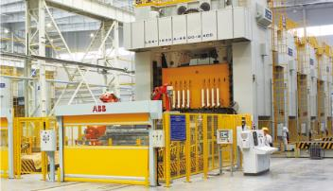
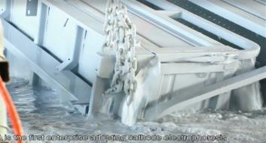
Assembly Line

Slide 2
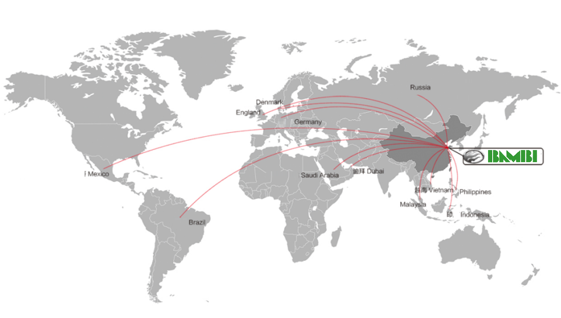

Slide 3
2
PRODUCT Introduction

Slide 4
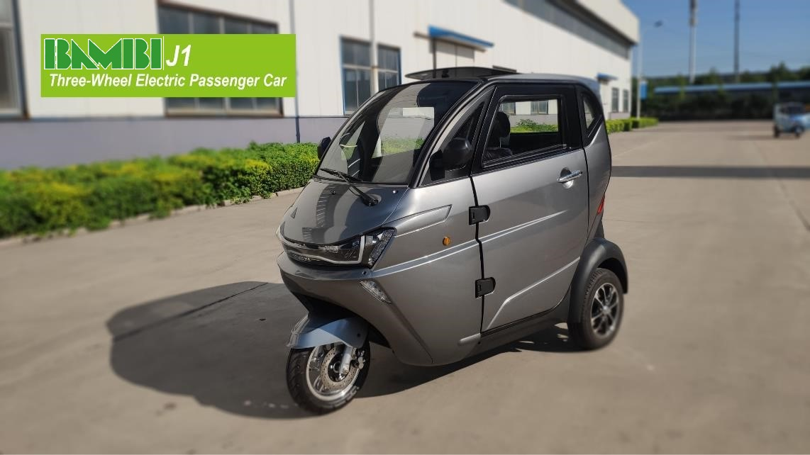
EEC L2e

Slide 5

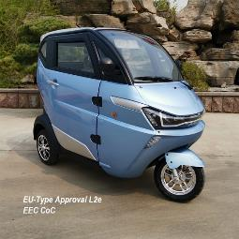
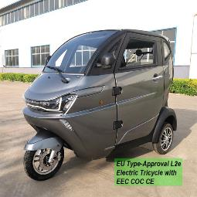
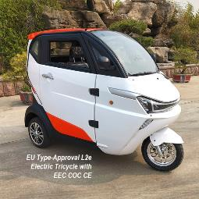
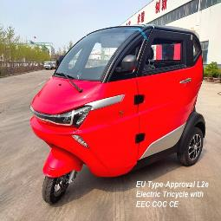
Configuration | Item | Standard
Parameter | L*W*H （mm) | 2160*1150*1680
 | Speed Limit(km/h) | 45
 | Max. Distance（km） | 80-150
 | Capacity (Person) | 3
 | Curb Weight（kg） | 320
Power System | Motor | 1500w/2200w/3000w
 | Lithium Battery | 60V70Ah or 60V100Ah Lithium iron phosphate battery(Including BMS and Heating)
 | Lead-acid Batteries | 60v80ah Lead-acid Maintenance-free
 | Charger | Smart Charger
Brake System | Front | Disc
 | Rear | Disc
Suspension System | Front | Independent Suspension
 | Rear | Integral Rear Axle
Wheel Suspension | Type | F: 120/70-R12 R:135/70-R12
 | Wheel Hub | Aluminum Alloy Wheel
Function | Multi Media | Mp5+rearview Camera
 | Electric Heater | 60v400w
 | Central Lock | ●
 | Electric Door And Window | ●
 | One-button Start | ●
J1
EEC L2e

Slide 6
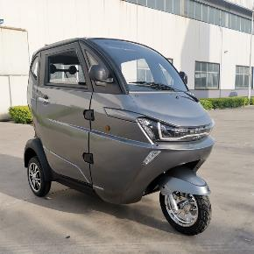
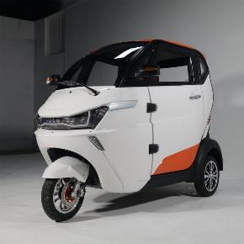
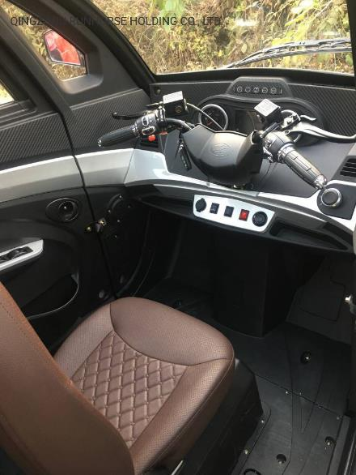
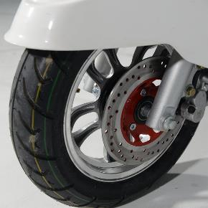
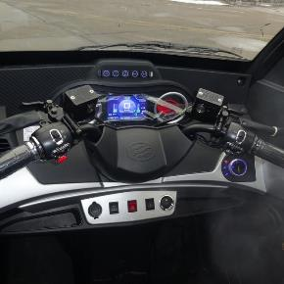
Runhorse J1

Slide 7
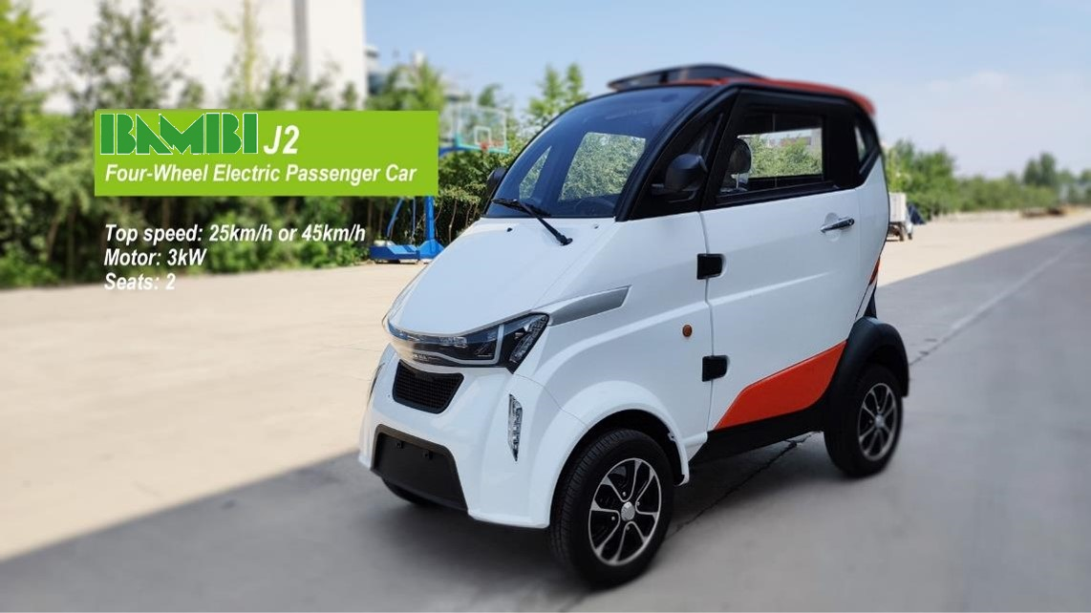
EEC L6e

Slide 8
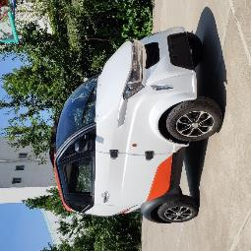
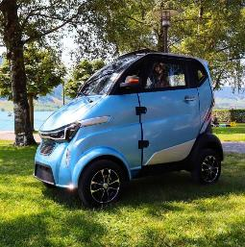
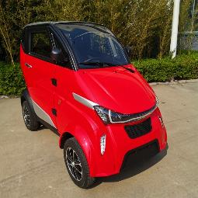
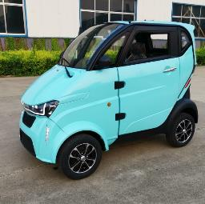
Configuration | Item | Standard
Parameter | L*W*H （mm) | 2800*1260*1700
 | Speed Limit(km/h) | 50
 | Max. Distance（km） | 80-120
 | Capacity (Person) | 1
 | Curb Weight（kg） | 420
Power System | Motor | 3000w/4000w/5000w
 | Lithium Battery | 60V70Ah ,60V100Ah Lithium iron phosphate battery(Including BMS and Heating)
 | Lead Acid battery | 60v80ah Lead-acid Maintenance-free
 | Charger | Smart Charger
Brake System | Front | Disc
 | Rear | Drum
Suspension System | Front | Independent Suspension
 | Rear | Integral Rear Axle
Wheel Suspension | Type | F:120/70-R12 R:135/70-R12
 | Wheel Hub | Aluminum Alloy Wheel
Function | Multi Media | Mp5+rearview Camera
 | Electric Heater | 60v400w
 | Central Lock | ●
 | Electric Door And Window | ●
 | One-button Start | ●
J2
EEC L6e

Slide 9
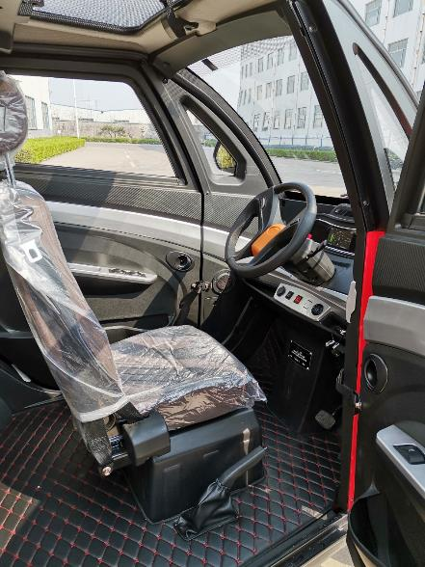
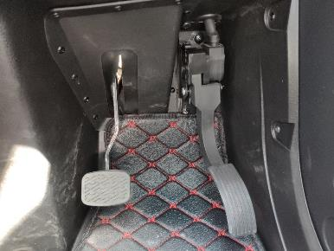
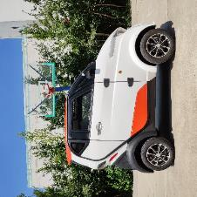
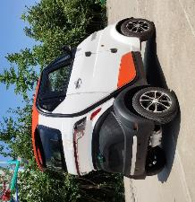
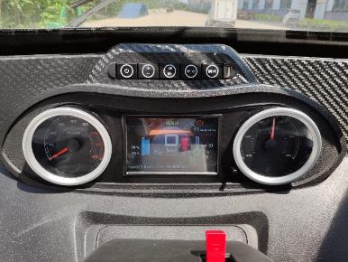
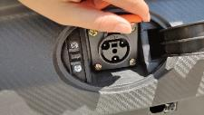

Slide 10
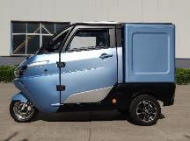
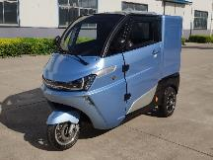
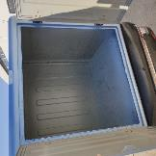


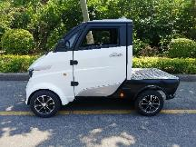
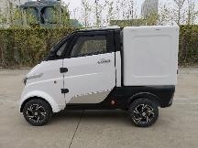
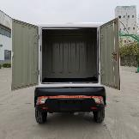
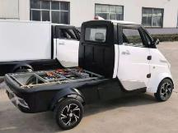
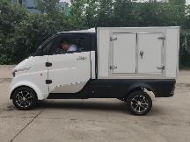
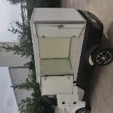
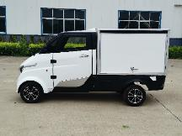
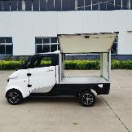
Last mile delivery
Express delivery
Food delivery
Cold chain delivery
Municipalities
Facility management
Hotels
Resorts
Mobile vending
Theme parks

Slide 11
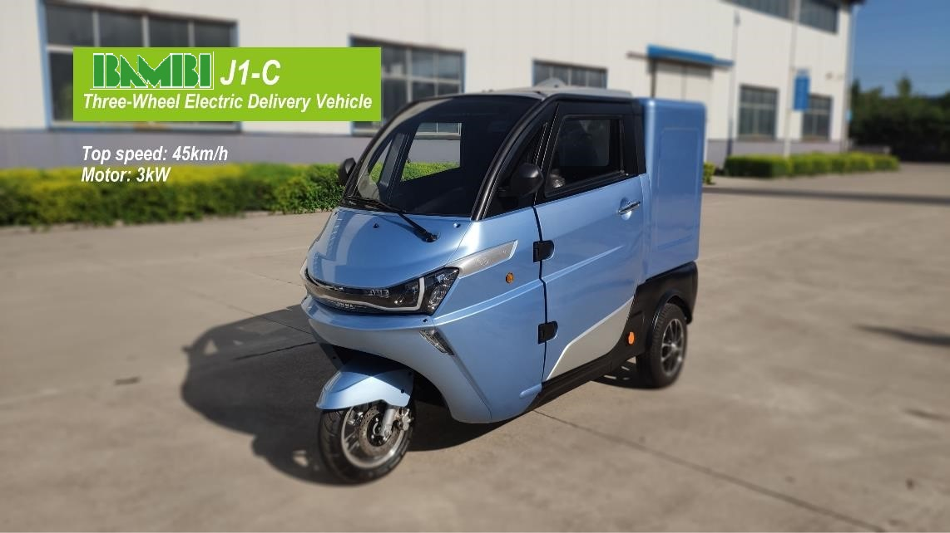

Slide 12
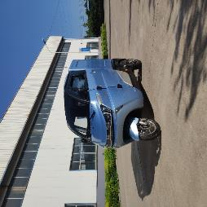
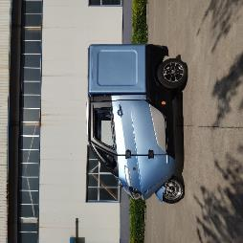

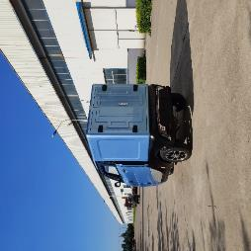
Configuration | Item | Standard
Parameter | L*W*H （mm) | 2890*1180*1780
 | Speed Limit(km/h) | 45
 | Max. Distance（km） | 80-200
 | Capacity (Person) | 1
 | Curb Weight（kg） | 470
Power System | Motor | 3000w/4000w/5000w
 | Lithium Battery | 60V70Ah ,60V100Ah or 60V200Ah Lithium iron phosphate battery(Including BMS and Heating)
 | Lead Acid battery | 60v80Ah Lead-acid Maintenance-free
 | Charger | Smart Charger
Brake System | Front | Disc
 | Rear | Drum
Suspension System | Front | Independent Suspension
 | Rear | Integral Rear Axle
Wheel Suspension | Type | F:120/70-12 R:135/70-12
 | Wheel Hub | Aluminum Alloy Wheel
Function | Multi Media | Mp5+rearview Camera
 | Electric Heater | 60v400w
 | Central Lock | ●
 | Electric Door And Window | ●
 | One-button Start | ●
J1-C
EEC L6e

Slide 13
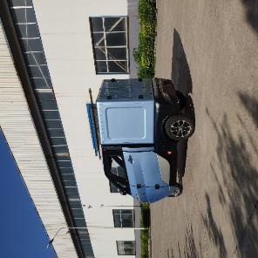
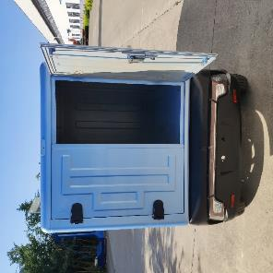
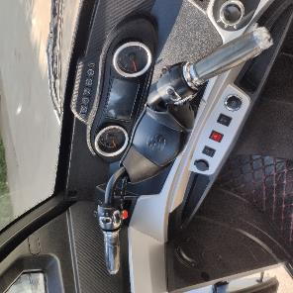
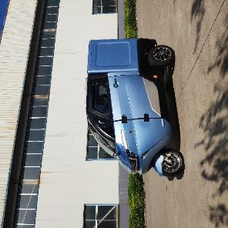
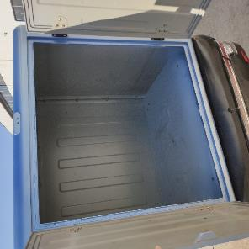
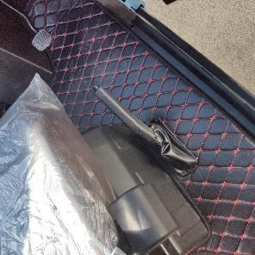

Slide 14
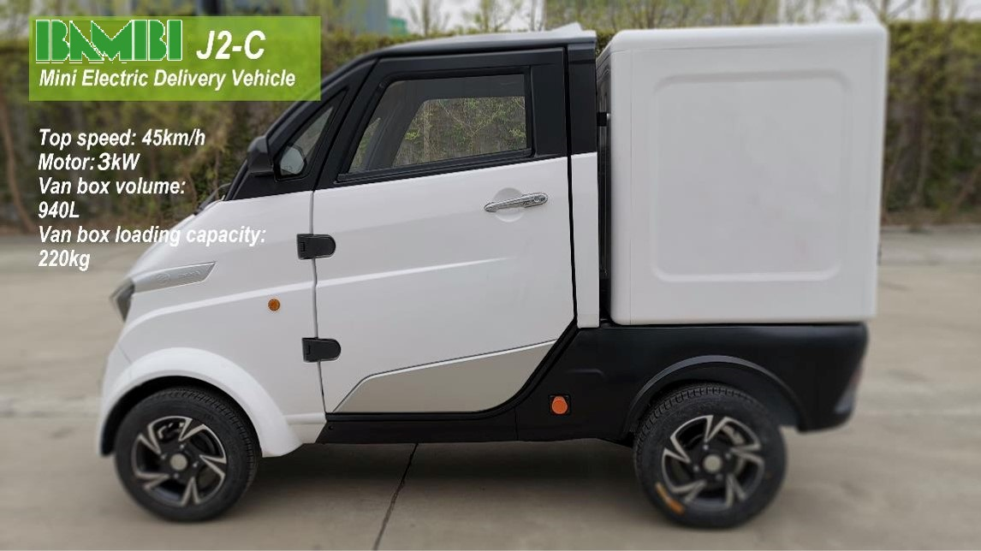
EEC L6e

Slide 15
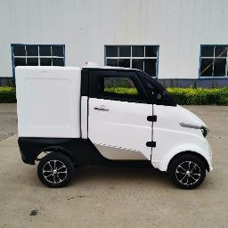
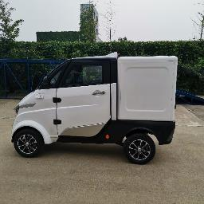
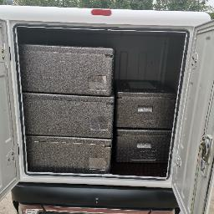

Configuration | Item | Standard
Parameter | L*W*H （mm) | 2890*1180*1780
 | Speed Limit(km/h) | 50
 | Max. Distance（km） | 100-200
 | Capacity (Person) | 1
 | Curb Weight（kg） | 470
Power System | Motor | 3000w/4000w/5000w
 | Lithium Battery | 60V100Ah or 60V200Ah Lithium iron phosphate battery(Including BMS and Heating)
 | Charger | Smart Charger
Brake System | Front | Disc
 | Rear | Drum
Suspension System | Front | Independent Suspension
 | Rear | Spiral Spring Integral Rear Axle
Wheel Suspension | Type | F:135/70-R12 R:145/70-R12
 | Wheel Hub | Aluminum Alloy Wheel
Function | Multi Media | Mp5+rearview Camera
 | Electric Heater | 60v400w
 | Central Lock | ●
 | Electric Door And Window | ●
 | Skylight | ●
 | One-button Start | ●
 | Air-condition | ⭕
J2-C
EEC L6e

Slide 16







Slide 17

EEC L7e

Slide 18



Configuration | Item | Standard
Parameter | L*W*H （mm) | 3600*1345*1765
 | Speed Limit(km/h) | 52
 | Max. Distance（km） | 100-200
 | Capacity (Person) | 1
 | Curb Weight（kg） | 507
Power System | Motor | 4000w/5000w
 | Lithium Battery | 60V100Ah or 60V200Ah Lithium iron phosphate battery(Including BMS and Heating)
 | Charger | Smart Charger
Brake System | Front | Disc
 | Rear | Drum
Suspension System | Front | Independent Suspension
 | Rear | Spiral Spring Integral Rear Axle
Wheel Suspension | Type | F:135/70-R12 R:145/70-R12
 | Wheel Hub | Aluminum Alloy Wheel
Function | Multi Media | Mp5+rearview Camera
 | Electric Heater | 60v400w
 | Central Lock | ●
 | Electric Door And Window | ●
 | Skylight | ●
 | One-button Start | ●
 | Air-condition | ⭕
J2-P
EEC L7e
ADIJ2-P Wing door box
ADIJ2-P hinged door box

Slide 19






ADIJ2-P Customized
ADIJ2-P V02 Van Box Body with Hinged Doors
ADIJ2-P V02 Van Box Body with Wing Doors

Slide 20

EEC L7e

Slide 21



Configuration | Item | Standard
Parameter | L*W*H （mm) | 3600*1345*1765
 | Speed Limit(km/h) | 52
 | Max. Distance（km） | 100-200
 | Capacity (Person) | 1
 | Curb Weight（kg） | 507
Power System | Motor | 4000w/5000w
 | Lithium Battery | 60V100Ah or 60V200Ah Lithium iron phosphate battery(Including BMS and Heating)
 | Charger | Smart Charger
Brake System | Front | Disc
 | Rear | Drum
Suspension System | Front | Independent Suspension
 | Rear | Spiral Spring Integral Rear Axle
Wheel Suspension | Type | F:135/70-R12 R:145/70-R12
 | Wheel Hub | Aluminum Alloy Wheel
Function | Multi Media | Mp5+rearview Camera
 | Electric Heater | 60v400w
 | Central Lock | ●
 | Electric Door And Window | ●
 | Skylight | ●
 | One-button Start | ●
 | Air-condition | ⭕
J2-T
EEC L7e

Slide 22



Slide 23

Configuration | Item | Standard
Parameter | L*W*H （mm) | 2800*1260*1700
 | Speed Limit(km/h) | 45
 | Max. Distance（km） | 80-120
 | Capacity (Person) | 1
 | Curb Weight（kg） | 380
Power System | Motor | 3000w/4000w/5000w
 | Lithium Battery | 60V70Ah Lithium iron phosphate battery(Including BMS and Heating)
 | Charger | Smart Charger
Brake System | Type | Hydraulic Brake
 | Front | Disc
 | Rear | Drum
Suspension System | Front | McPherson Independent Suspension
 | Rear | Spiral Spring Integral Rear Axle
Wheel Suspension | Type | 135/70-12
 | Wheel Hub | Aluminum Alloy Wheel
Function | Multi Media | Mp5+rearview Camera
 | Electric Heater | 60v400w
 | Central Lock | ●
 | Electric Door And Window | ●
 | Skylight | ●
 | One-button Start | ●
 | Air-condition | ⭕
ADIJ2-W

Slide 24




Slide 25
3
EXHIBITS &
FACTORY VISITS

Slide 26





BRAND INTRODUCTION
Philippine Exhibition
ADIJ2 was lunched in Belgium for the Car-sharing Project

Slide 27



Shanghai Bauma Exhibition
BRAND INTRODUCTION

Slide 28



Team in Philippines
BRAND INTRODUCTION

Slide 29


Visitors from Spain
Visitor from Philippines

Slide 30


Clients from Spain
Clients from Russia

Slide 31



BRAND INTRODUCTION
Interview by local TV

Slide 32




BRAND INTRODUCTION
Car sharing project
Join venture with Belgium Government

Slide 33
4
abroad

Slide 34





Slide 35





Slide 36





Invest only 5000sqm workshop can be assemble 5000 units per year, total equipment cost only 60,000 USD.

