Slide 1
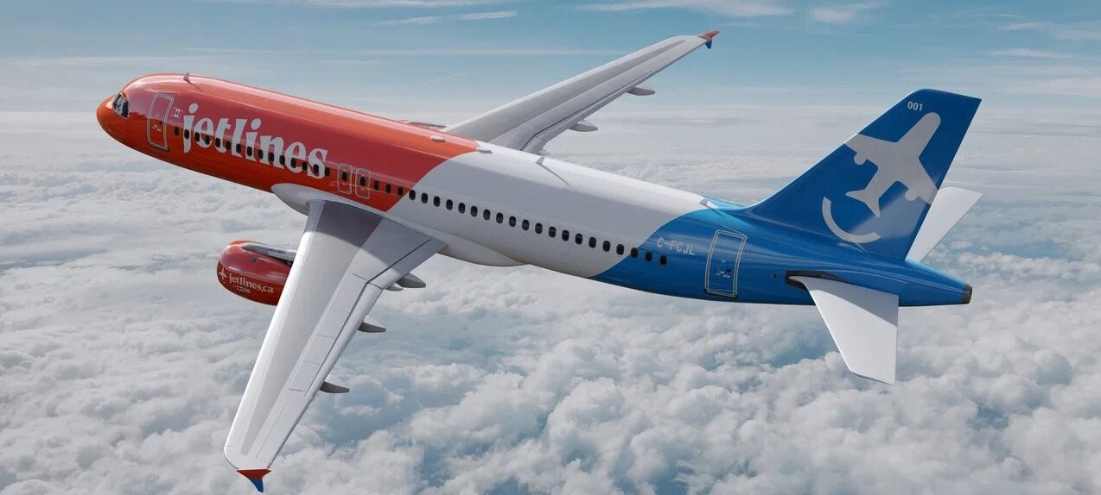
Investor Presentation – September 2022

Slide 2
Forward Looking Statement Disclaimer
The information contained herein, while obtained from sources we believe to be reliable, is not guaranteed as to accuracy or completeness. This Presentation is for information only and does not constitute an offer to sell or a solicitation to buy the securities referred to herein. No securities regulator or stock exchange has reviewed or accepted responsibility for the adequacy or accuracy of this Presentation. All figures in Canadian dollars unless indicated otherwise.
This Presentation contains “forward-looking statements” and “forward-looking information” within the meaning of applicable Canadian and United States securities legislation (together, “forward looking information”). Except for statements of historical fact relating to Canada Jetlines Operations Ltd. (the “Company”), the statements contained herein constitute forward-looking information, including any information as to strategy, plans or future financial or operating performance. Forward-looking statements are characterized by words such as “plan”, “expect”, “budget”, “target”, “project”, “intend”, “believe”, “anticipate”, “estimate” and other similar words or statements that certain events or conditions “may” or “will” occur. Forward-looking information is based on the opinions, assumptions and estimates of management that are considered to be reasonable at the time the statements are made, and are inherently subject to a variety of risks and uncertainties and other known and unknown factors that could cause actual events or results to differ materially from those projected in the forward-looking information. These factors include the need for additional financing; reliance on key personnel; the potential for conflicts of interest among certain officers, directors or promoters; the absence of dividends; competition; inability to secure required governmental, regulatory, stock exchange or other such approvals; the completion of the licensing process; the ability to acquire aircraft on favorable terms and general economic, market or business conditions. In particular, this Presentation contains forward-looking statements pertaining to the following: expectations as to future operations of the Company and the timing and receipt of all regulatory approvals required for operations by the Company; desirability of operating aircraft on certain routes and the pricing of airfares on such routes; anticipated competitive response from existing airlines as well as potential new market entrants which may compete with the Company; impact of governmental regulation on the Company; future development and growth prospects; expected operating costs, general administrative costs, costs of services and other costs and expenses; ability to meet current and future obligations; projections of revenues and profits; ability to obtain equipment, services and supplies in a timely manner, including the ability to lease or purchase aircraft; the destinations the Company intends to service, the details of the Company’s business partners; and ability to obtain financing on acceptable terms or at all.
With respect to forward-looking statements contained in this Presentation, the Company have made assumptions regarding, among other things, the following: the timely receipt of governmental approvals, including the receipt of approval from regulators in the Canada and other jurisdictions where the Company may operate; the timely commencement of operations by the Company and the success of such operations; the ability of the Company to implement its business plan as intended; the legislative and regulatory environments of the jurisdictions where the Company will carry on business or have operations; the impact of competition and the competitive response to the Company’s business strategy; availability of aircraft; timing and amount of capital expenditures; conditions in general economic and financial markets; and the Company’s ability to obtain additional financing on satisfactory terms. The actual results, performance or achievements of the Company could differ materially from those anticipated in these forward-looking statements as a result of the risk factors set forth below, including but not limited to: general economic conditions; the ability of management to execute its business plan; the competitive response from existing airlines in North America and potential new market entrants which may compete with the Company; the impact of the COVID-19 pandemic; the availability of sufficient financial resources to fund the Company’s expenditures; the possibility that government policies, regulations or laws may change or governmental approvals may be delayed, withheld or conditioned; stock market volatility and market valuations; and the availability of capital on acceptable terms or at all.
Although the Company has attempted to identify important factors that could cause actual actions, events or results to differ materially from those described in forward-looking information, there may be other factors that cause actions, events or results not to be as anticipated, estimated or intended. There can be no assurance that forward-looking information will prove to be accurate, as actual results and future events could differ materially from what is anticipated in such information. The reader is cautioned not to place undue reliance on forward-looking information. The forward-looking information contained herein is presented for the purpose of assisting investors in understanding the Company’s expected financial and operational performance and the Company’s plans and objectives and may not be appropriate for other purposes. Management the Company do not undertake to provide updates with respect to forward-looking information, except as may be required by law.
This Presentation also contains future-oriented financial information and financial outlook information (collectively, “FOFI”) about the pro forma revenue of the resulting issuer which are subject to the same assumptions, risk factors, limitations and qualifications as set forth in the above paragraphs. FOFI contained in this Presentation was made as of the date of this Presentation and was provided for the purpose of providing further information about the Company’s anticipated future business operations. the Company disclaims any intention or obligation to update or revise any FOFI contained in this Presentation, whether as a result of new information, future events or otherwise, unless required pursuant to applicable law. FOFI contained in this Presentation should not be used for purposes other than for which it is disclosed herein. Such future-oriented production information is provided for the purpose of providing information about management's current expectations and plans relating to the future. Readers are cautioned that such outlook or information should not be used for purposes other than for which it is disclosed in this Presentation

Slide 3
Investment Considerations
Rare ground floor opportunity to invest in a publicly traded leisure focused Canadian Airline.
Pandemic created an opportunity to lease relatively new aircraft at highly attractive rates.
Not encumbered with large debt & ticket vouchers accumulated during the pandemic , unlike many airlines.
Highly experienced management and world class Board of Directors.
Canadian Transport Authority (CTA) licenses and Transport Canada Air Operator Certificate (AOC) issued in August 2022. Canada Jetlines now has all approvals required by the Canadian government to start operations.
Inaugural flight on September 22nd, 2022.

Slide 4
Business Model
Toronto based airline focused on providing service to destinations in the USA, Mexico, the Caribbean and high demand Canadian city pairs.
Greater emphasis on Canadian destinations during peak summer domestic travel season.
Ability to increase fleet temporary during peak demand season such as December holiday and March break by leasing aircraft and crews at favorable rate from Canada Jetlines largest shareholder GlobalX.
Tour Operator subsidiary, Canada Jetlines Vacations, will be offering travel packages and generate ancillary revenue through commissions from hotel, cruises, ground tour packages, etc.
Travel Agents still represent significant proportion of bookings globally. Travel agents provide massive reach to committed consumers with an intent to travel.

Slide 5
Canadian Domestic Market - Opportunity (National Travel Survey 2018 statistics Canada catalogue n0 11-001-x)
Canadians made 278 million domestic trips in 2018 spending $45.7 billion.
The Maritime provinces had the largest shares of Canadian visitors coming from other provinces (NB 25%, NS 22%) of which 14 million from Ontario, 760k from Quebec, 224K from Alberta.
115.6 million trips main purpose of travel was Visiting family and Friends (VFR) and 96.4 million trips were for holidays/leisure travel. Conventions/trade show represented 14.2% of domestic trips and 9.6% were business trip.
Canadian domestic leisure travel increases significantly during the summer season, coinciding with a decrease in demand for sun destinations travel.
Canada Jetlines will deploy its fleet strategically with a stronger focus on Canadian destinations during the summer and southern destinations during the winter months.

Slide 6
Canadian Travel to USA - Opportunity (National Travel Survey 2018 statistics Canada catalogue n0 11-001-x)
In 2018, Canadian made 27.7 million trips to the USA, spending C$20.2 billion.
13.5 million trips were for holidays/leisure and another 5.8 million trips were for personal reason.
Ontario residents which represents 38.7% of the Canadian population but account for 45.5% of all Canadian trips to the USA.
Roughly half travel to the USA were by air (U.S travel association)
Top 6 U.S destinations in order of importance are:
1. Fort Lauderdale 2. Miami 3. Orlando 4. Los Angeles
5. Las Vegas 6. Phoenix

Slide 7
Canadian International Travel - Excluding USA - Opportunity (National Travel Survey 2018 statistics Canada catalogue n0 11-001-x)
In 2018, Canadian made 10.3 million international trips to countries other than USA.
After the USA, the next four most visited countries were:
Mexico - 1.7 million trips.
Cuba - 895,000 trips.
UK - 748,000 trips.
Dominican Republic - 585,000.
Nearly half the trips taken to Mexico, Cuba and Dominican Republic were during the winter months.
Canada Jetlines Airbus 320 can offer service to four of the top five international destinations. Potential addition of a long-range Airbus 321 aircraft at a future date (common type with A320 - no extra training for crews) would provide ability to offer service from Toronto to Western Europe.

Slide 8
Fleet Type A320
Fleet Delivery Schedule
Q2 ‘22 | Q4 ‘22 | Dec ‘23 | Dec ‘24 | Dec ‘25
1 | +1 = 2 | +5 = 7 | +4 = 11 | +4 = 15
The fleet will consist of Airbus 320s with an excellent dispatch reliability and safety record.
Configuration: 174 seats single class, all economy with extra comfort seats available at a premium.

Slide 9
Canadian Competitors
Air Canada and Westjet are the largest airlines with significant domestic and international networks. Both airlines have high operating cost driven mainly by well established unions and amenities, services and cabin configuration to attract business travellers. Both have subsidiaries (Rouge and Swoop respectively), however the Cost per Available Seat Miles (CASM) savings from these subsidiaries is driven almost entirely by an increased cabin seating configuration. Canada Jetlines CASM will still be lower than Rouge and Swoop due to lower overall cost.
Sunwing is a Canadian airline with a similar business model to Canada Jetlines. Sunwing has similar issues with higher cost due to unions etc. Westjet is in the process of acquiring Sunwing and once completed they will follow Westjet model. Westjet unions will object to Sunwing’s model of leasing aircrafts in winter from Europe operated by foreign crews.
Air Transat strong presence in the Quebec market with focus on flights to southern destinations and trans Atlantic flights to Europe.
Flair has LCC model and also struggles with very high debt.
Lynx ULCC model. Not a direct competition as right now operating from Calgary base and limited to Domestic flying.

Slide 10
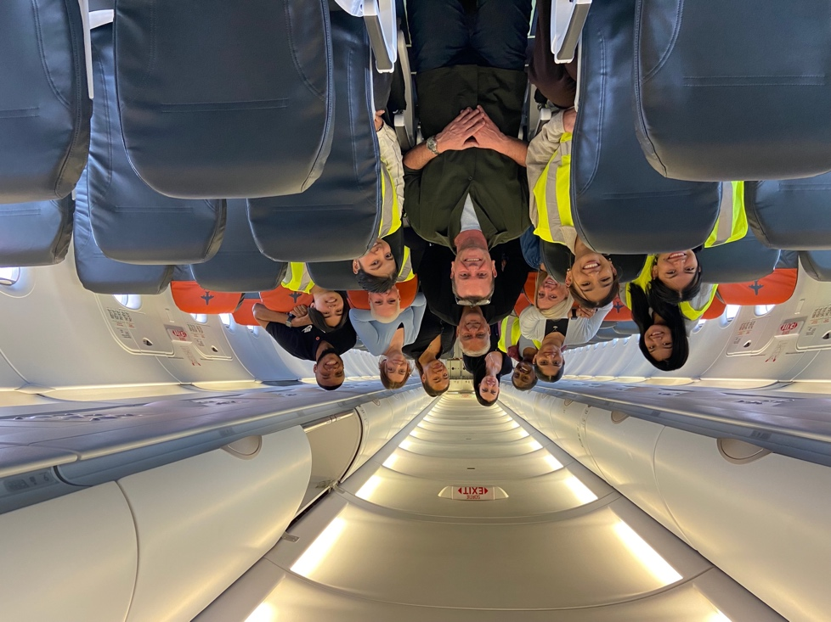
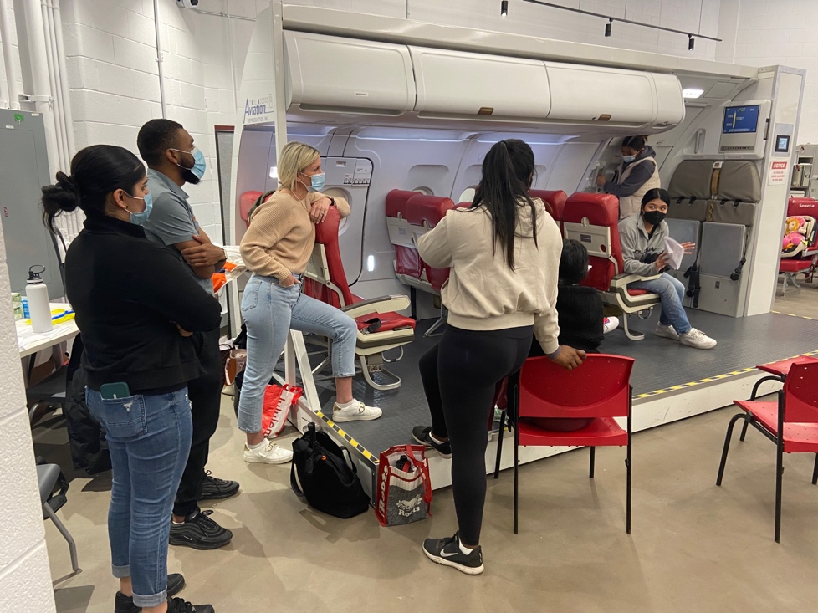
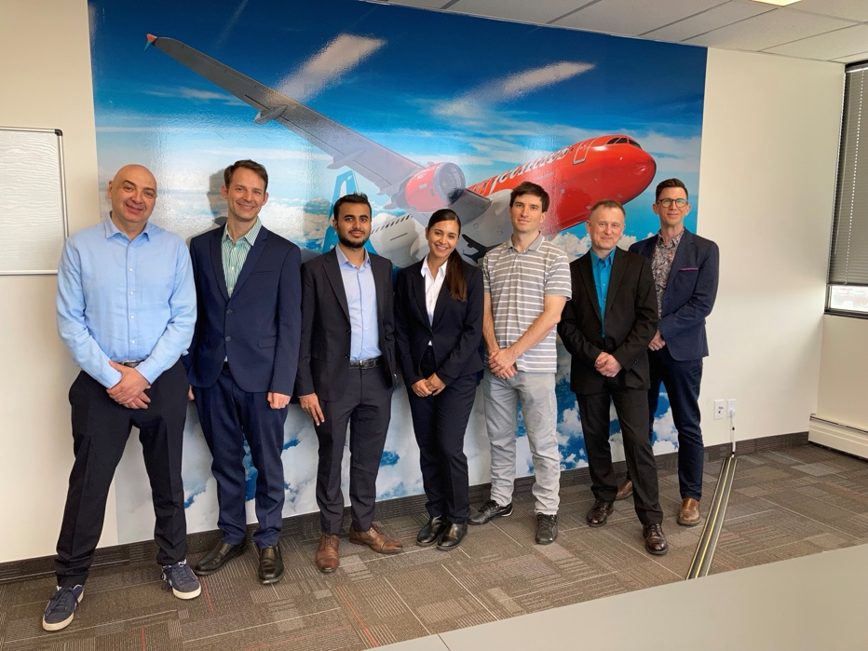
Positioning for Launch
CTA licenses and AOC obtained in August 2022.
Passenger service system, reservation system, departure control system, and other required commercial and operational systems modules are operational.
Inaugural flight Toronto to Calgary September 22nd 2022.
DOT and FAA approval to sell and fly to the USA in progress and expected in Oct 2022.
Flight Attendant class - April 2022
Pilot class – May 2022

Slide 11
Differentiating factors
Experienced executive and management team at building successful start-up and achieving great customer service while controlling cost.
Executives leveraging their previous relationship within travel industry have setup mutually beneficial partnerships with travel trade (travel agents, tour operators, cruise companies, hotels, etc.).
Canada Jetlines is going to be a travel trade friendly airline and will rely not only on direct online sales but will leverage on travel trade partners, unlike other airlines that are more focused on direct sales bypassing the trade.
Brand new Recaro seats providing increase leg room to passengers.
Great entertainment system and food options on board.
Attractive pricing that provides value to the customer.

Slide 12
Distribution Strategy
Objective is to have as much product on as many shelves as possible across the network – Jetlines will enable guests to transact with us the way they want to transact
Key Channels to get airline seats into the hands of consumers include:
Traditional Travel Agencies
Travel Management Companies
Jetlines Internet Booking Engine
Airline Call Centre / Service Centre
Online Travel Agents
Tour Operators
Consolidators
Third Party Loyalty Programs (redemption partnerships AirMiles, Aventura, etc.)
Canada Jetlines has strategic commercial agreements with all above channel partners..

Slide 13
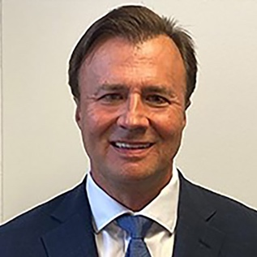
Executive Team
Eddy Doyle – Chief Executive Officer
Over 35 years experience in aviation. Ed started his career as a pilot in the Canadian Air Force before joining Air Canada in 1989.
Over 11,000 hours flying experience - has flown Airbus and Boeing aircraft domestically and internationally.
At Air Canada was responsible for nearly 4,000 pilots, dispatchers, load agents, and administrative staff.
Played a crucial role in the Air Canada restructuring process of 2004, the negotiation with the pilots’ union of the agreement that allowed the creation of Rouge, and major cost control improvements.
After retiring from Air Canada, Ed took the position of Deputy-CEO at Bamboo Airways in Vietnam, where he helped launch the airline.
Grew the airline to 25 aircraft (A320 & B787) by the end of its first year in operation.
Duncan Bureau – Chief Commercial Officer
Duncan was recently Senior VP Sales & Distribution at Etihad
President Air Canada Rouge.
Global Vice President Sales & Distribution Air Canada.
Senior VP Global Sales & Distribution at Malaysia Airlines.
VP Sales & Partnerships at Westjet.
In the coming months, Duncan will be building the commercial team and establishing Canada Jetlines Tour Operations business and distribution strategy.
Percy Gyara – Chief Financial Officer
Percy has an extensive experience in the airline industry. He previously served as VP Finance at Sunwing Travel Group for 10 years, managing Airlines, Tour Operator, Hotels and Destination management company division.
Percy also worked at Skyservice Airlines managing their Finance Department.
Percy has been instrumental in success of Sunwing Travel Group’s vertical integration plan. STG grew 30% YOY under his tenure. Airlines division grew from 10 aircrafts to 40 aircrafts and hotel division started operations in 2015 and grew rapidly to 10 hotels in the Caribbean with a total of owned and managed 10,000 rooms.
Brad Warren – Chief Operating Officer
Brad has over 25 years of experience in the airline industry. Prior to joining Canada Jetlines Brad served as the Managing Director at Air Canada accountable for line maintenance with more than 1,800 maintenance technicians across Canada and around the globe. Prior to that he held a senior leadership role at Air Canada Rouge after his time as Vice President of maintenance for Air Georgian and Regional 1.
Brad is very familiar with the Airbus 320 family having worked with this aircraft type both at Rouge and Air Canada.

Slide 14
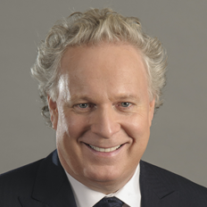
Board of Directors
Ken McKenzie, Chairman
Principal of Meridian Blue, LLC.
Seasoned airline executive who most recently held roles at Airbus Americas as EVP Customers, SVP Strategy & Corporate Development and SVP Customer Services.
Prior to Airbus, Ken served as Chief Operating Officer of Spirit Airlines, EVP Operations for WestJet and Chief Pilot, Regulatory Affairs for Air Canada Jazz.
The Honourable Jean Charest
Former Deputy Prime Minister of Canada and Premier of Québec.
Notably the initiator of the negotiation for the Canada-European Union Comprehensive Economic Trade Agreement (CETA).
As Minister of the Environment, he led Canada’s delegation at the 1992 Earth Summit on the economy and the environment in Rio and was praised for his leadership role among G7 countries on climate change and biodiversity.
Beth S. Horowitz
Former President & CEO, Amex Bank of Canada, and Former President & General Manager, Amex Canada, Inc.
Beth was appointed to the HSBC Bank Canada Board.
20 years of non-profit and corporate board experience.
David Kruschell
President & CEO at Frontier Lodging Solutions.
Prior to Frontier Lodging, David was Senior Vice President, Client Management & Consulting at Direct Travel, a leader in travel management in north America, employing over 725 travel professionals in Canada.

Slide 15
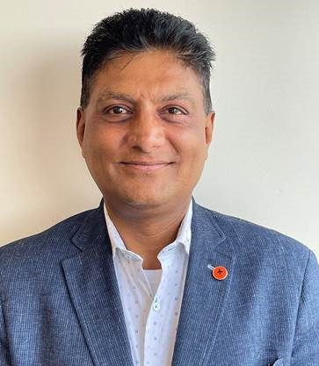
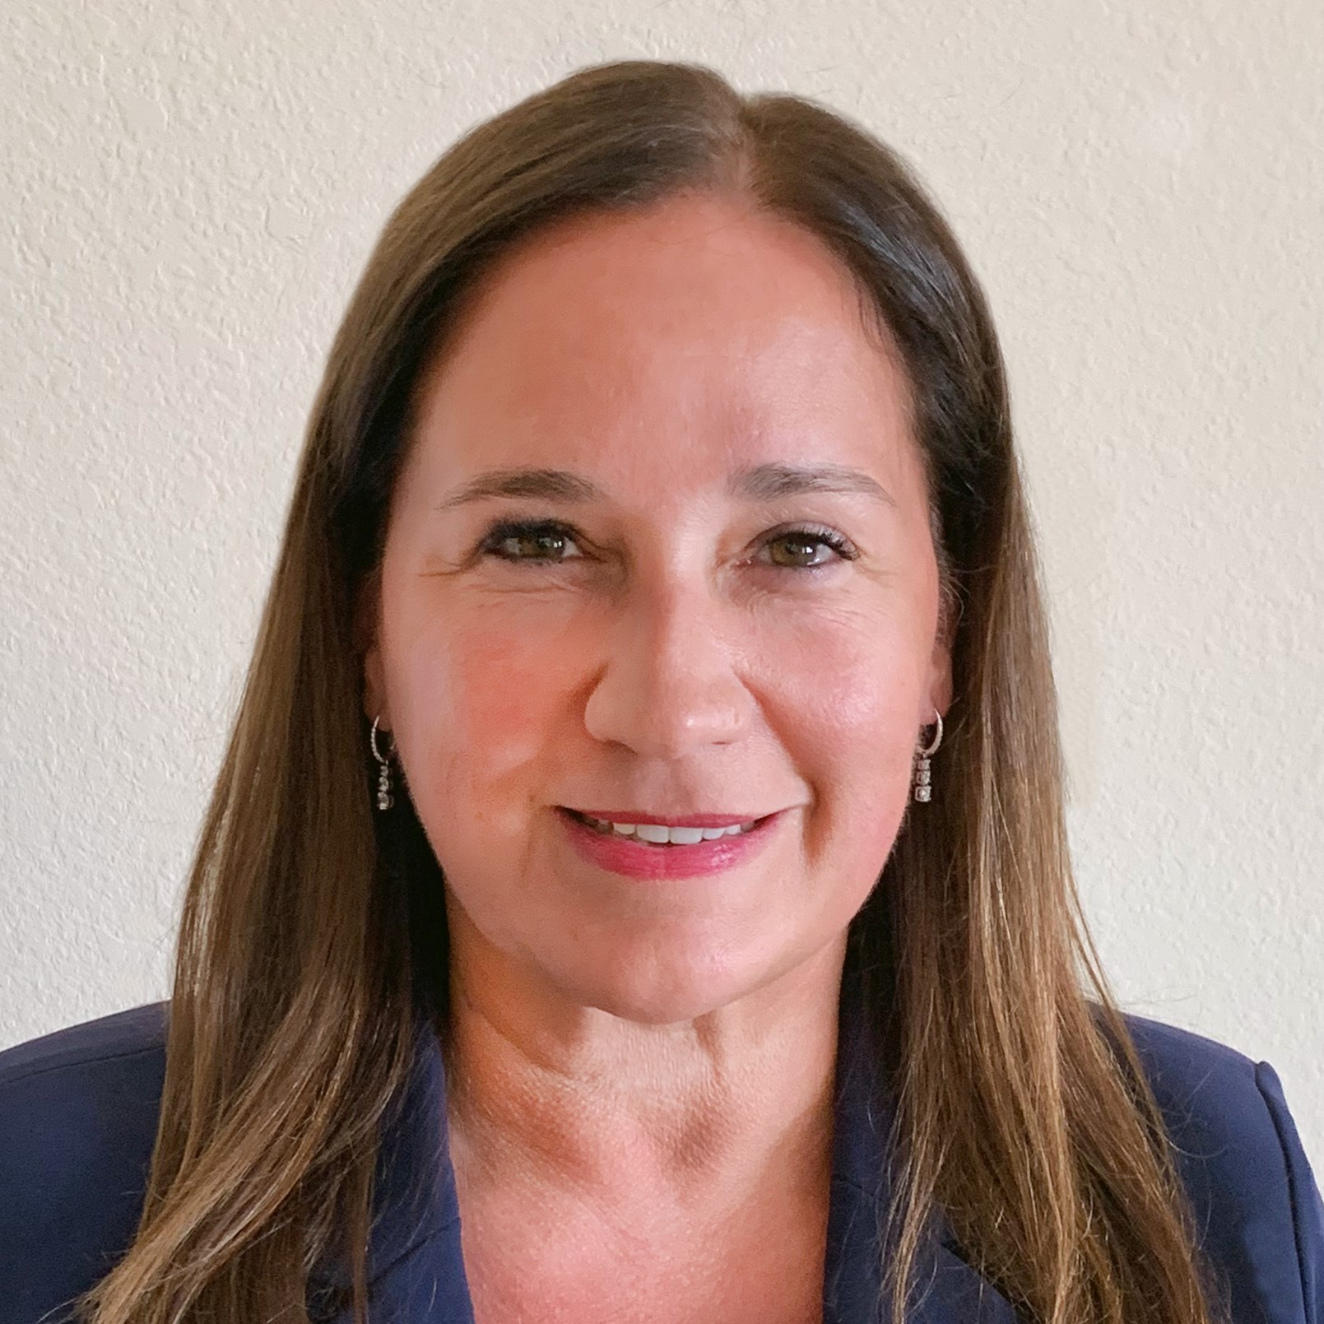
Board of Directors
Reg Christian
Advisor to the Chairman of the Board related to the Travel Trade.
Seasoned entrepreneur with a lifelong passion for travel and exploration.
Currently sits as President and CEO of multiple successful businesses in Mississauga, Canada. With a robust travel portfolio and active role in travel marketing since 2009, he operates Rhythm Travel and Tours, which is an IATA accredited and TICO Certified agency. Along with his travel holdings Reg is also the Founder President & CEO of RooSheila Group Inc.
Ryan Goepel
Over 20 years in Senior Finance Roles.
Significant LCC narrowbody CFO experience.
Multiple successful startups.
Key role in the first Burger King IPO.
Ravinder Minhas
Ravinder Minhas has a Bachelor of Science in Oil & Gas Engineering from the University of Calgary.
In 2006, they became the youngest brewery owners in the world.
The Minhas Craft Brewery is now ranked in the Top 10 breweries largest breweries in America.
Brigitte Goersch is President of Lionheart Enterprises, LLC, an investment firm.
Brigitte is a seasoned aviation executive who most recently held senior executive roles at the Greater Orlando Aviation Authority (Orlando International Airport-OIA) as Deputy Executive Director, the Federal Aviation Administration as Operations Oversight Executive, and United States Air Force Lieutenant Colonel and Command Pilot.
Brigitte holds and FAA Airline Transport Pilot License and is an Accredited Airport Executive (AAE)
Eddy Doyle - Canada Jetlines CEO

Slide 16
Financial Structure
Raised $6.5M in July 2021: 30% over subscribed.
Canadian NEO Exchange listing occurred October 13th 2021.
Raised $3.35M in April 2022
Cap Table:
Shares issued: 62,259,887
Fully Diluted: 83,999,251
Includes:
14.16M Warrants
(9.4M @ $0.70 to July 2023)
(4.78M @ $0.50 to March 2024 & $0.65 to April 2023-25)
7.33M RSU’s
0.25M Options

Slide 17
Next Step
Raise additional capital to fund additional aircraft and develop route network.
Currently in the process of raising funds internally. Raised more than $1M from executives and employees.
Capital raise target of over the next 6 months C$5-10 million.
Develop our tour operator subsidiary “Canada Jetlines Vacations” driving ancillary revenue from hotel, car rental, insurance, and ground tour commissions.
Introduce flights to sun destinations starting in December 2022.
Expand network focus outside Toronto hub in the next 18-24 months.

Slide 18
Thank you

