Slide 1
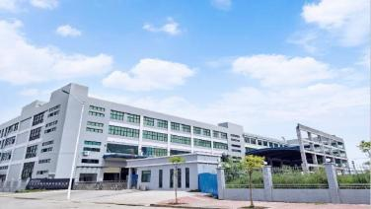
Infrastructure
Plant I
Plant II
Plant III
330,000 sq. ft.
500
65,000 units
330,000 sq. ft.
300
35,000 units
750,000 sq. ft.
700
150,000 units

Slide 2
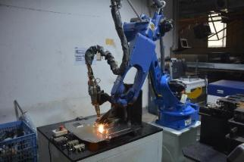
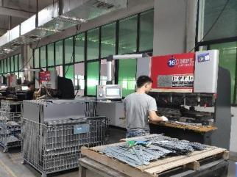
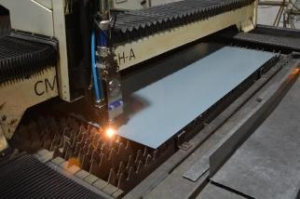
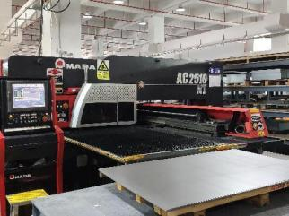
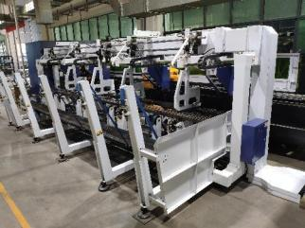
Equipment Investment
Robotic
AMADA
Laser
Bending
Machine
Equipment
Tooling
Fabricatio n
CNC
Punching

Slide 3
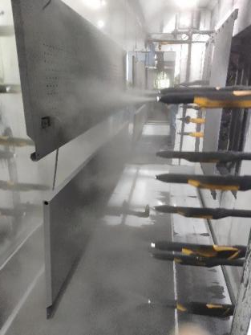
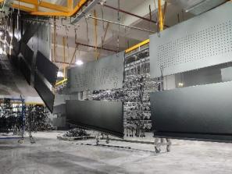
Equipment Investment
Semi - Automatic hanging line in the workshop. Colors: Black, Red, Blue etc

Slide 4
Porcelain Line
Germany Wagner Electrostatic Powder Porcelain Line

Slide 5
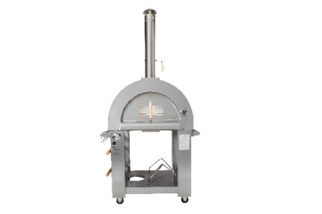
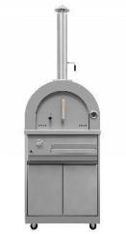
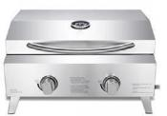
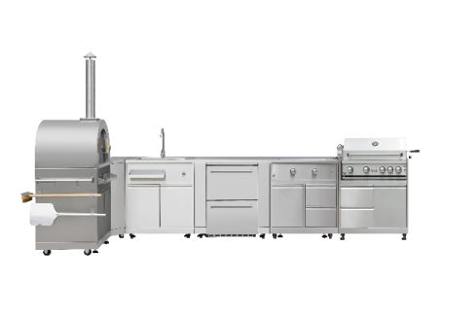
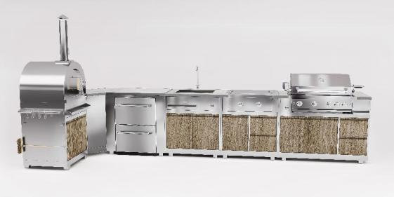
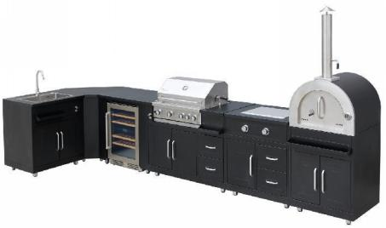
Outdoor Series
Pizza Oven
Gas Pizza Oven
Barbeque
Outdoor Cabinets

Slide 6
Outdoor Kitchen
Cabinet

Slide 7
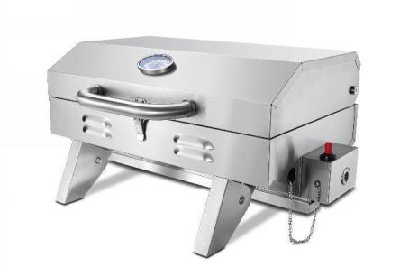
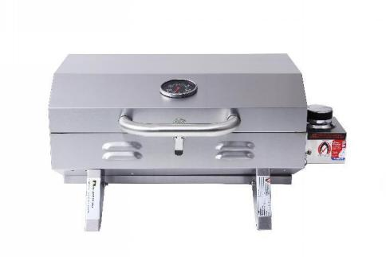
HGG2005U
Portable BBQ
Description
Square main lid
430 SS lid with SS tube handle
SS cooking grid
430SS grease tray
SS flame tamer
Cooking area:46.5cm*28.5cm
12000BTU- U Shape SS main burner
Piezoelectric ignition
With brown box
CSA/AGA certificated
Package
Product Dimension:50*40*30cm
Package Dimension: 61*39*32cm
Container load: 420PCS/20GP 798PCS/40GP
HGG2001A load : 864 Pcs /40HQ
HGG2005U load : 870 pcs/40HQ
Portable BBQ

Slide 8
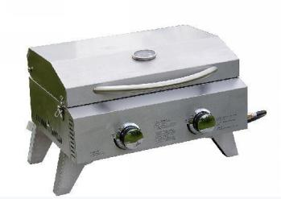
HGG2012U
Portable BBQ
Description
All 430SS Construction
SS Grid
2 for Main Burners
10,000BTU for a main burner
2 SS flame tamers
2 SS U shape burners
2 Push and turn Knobs
Foldable Legs
Cooking area : 52*33cm
CSA/AGA certificated
Package
Product dimension:55*46*38cm
Package dimension:68*51*35cm
Container loading : 219pcs/20GP 442pcs/40GP 490pcs/40HQ
Portable BBQ

Slide 9
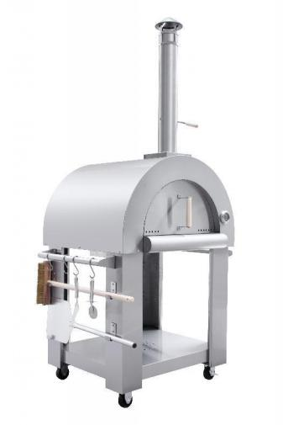
HPO01S-1
Pizza Oven (Wood Only)
Description
Material: Stainless Steel #430
Firebrick inside the oven
Cooking Time: 5 minutes
Dimension:82*73*120cm(W*D*H)
Cooking Area: 0.48m2 (64cm×75cm)
Wheels included, easy to move
Wood fuel
Package
Carton Size: 85×85×60cm
container load (without pallet):103 Pcs/40HQ
Pizza Oven
(Wood Only)

Slide 10
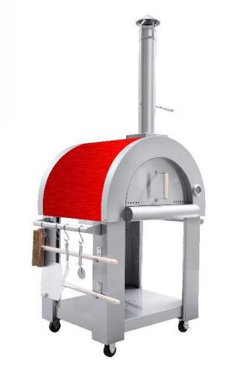
HPO01RC
Pizza Oven
Description
Material: Stainless Steel #430
Firebrick inside the oven
Heating Time: 20-30 minutes
Dimension:82*73*120cm(W*D*H)
Cooking Area: 0.48m2 (64cm×75cm)
Wheels included, easy to move
Wood fuel
Package
Carton Size: 85×85×60cm
container load (without pallet):103 Pcs/40HQ
Gas Pizza Oven (Wood Only)

Slide 11
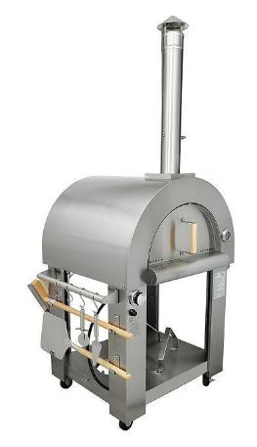
HPO03SH
Gas Pizza Oven
Wood fuel&gas
Description
Material: Stainless Steel #430
Firebrick inside the oven
Heating Time: 20-30 minutes
Dimension:82*73*120cm(W*D*H)
Cooking Area: 0.48m2 (64cm×75cm)
Wheels included, easy to move
Wood fuel&gas
1*35000BTU Burner
CSA/CE certificated
Package
Carton Size: 85×85×60cm
container load (without pallet):103 Pcs/40HQ
Pizza Oven
(Gas & Wood)

Slide 12
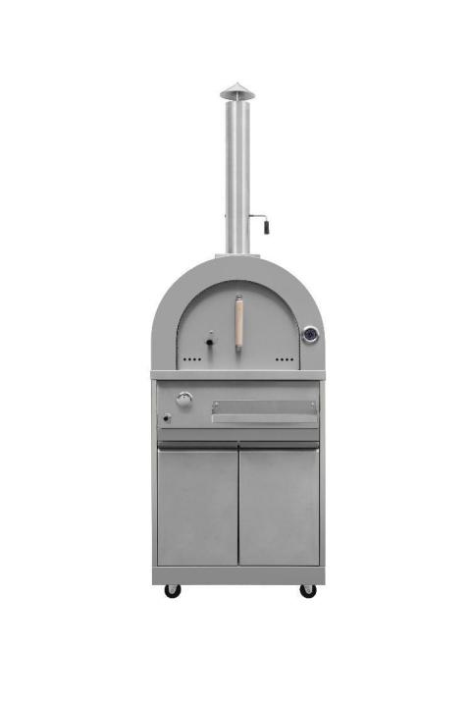
OKPC01S-G
Gas Pizza Oven
Description
1*35000 BTU Burner
Fuel type: gas
Material: 304 stainless steel
Fire brick Thickness: 0.6” (15mm)
Cooking Area: 23.6”* 21”
CSA/CE certificated
Production Dimension: 702.4*661.8*2068.9mm
Package Dimension: 850mm*740mm*705mm
Container Load: 117pcs/40HQ 36pcs/20GP
Pizza Oven

Slide 13
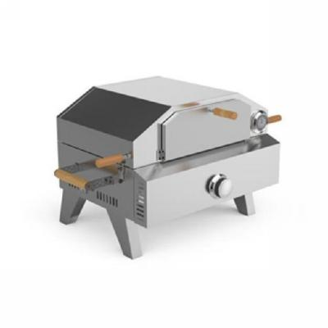
HPO02S
Gas Pizza Oven (Gas Only)
Description
All 430SS Construction
SS grill + pizza stone
12,000BTU for a main burner
pizza stone size: 32*32cm
Cooking grill area : 52*33cm
Foldable Legs
With brown box
CSA/CE certificated
Product size: 716*490*430mmH
Package size: 690*545*390mmH
Loading Qty: 200 sets/20GP 425sets/ 40”HQ
Gas Pizza Oven (Gas Only)

Slide 14
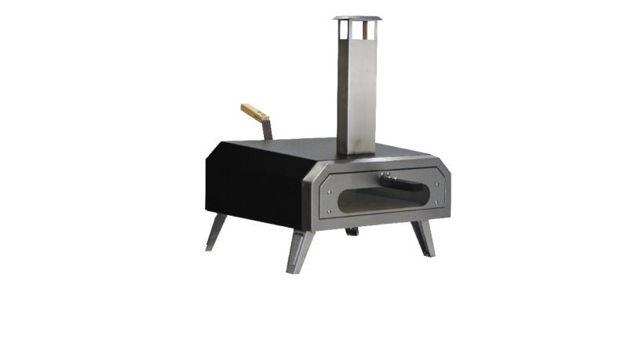
HPO1201S-W
12” Pellet or Gas(with optional adaptor)-Powered Outdoor pizza oven
Description
Product Dimension: 18*22*31”
CSA certificated
Body Material: 430SS.
Primary Cooking Area: 12 sq. inch
Primary Burner Output: 13500 BTU
Durable heat preservation cotton, powder-coated shell for superior heat retention and weather resistance
10mm cordierite stone baking board including
Built-in gas ignition for fast, easy cooking
4 folding legs for easy transport and storage
Box Dimension:28*18*12”
40HQ: 790 pcs for wood fuel
(package size :630*520*255mm)
40HQ :660 cps for pellet fuel
(package size :770*520*255mm )
12”
Pellet or Gas
(with optional adaptor)
-
Powered Outdoor
Pizza Oven

Slide 15
HPO1601GW
Pellet or Gas -Powered Outdoor pizza oven
Description
Product Dimension: 20*35*31”
CSA certificated
Color: Black
Body Material: 430SS
Primary Cooking Area: 16 sq. inch
Primary Burner Output: 13500 BTU
Durable heat preservation cotton, enamel-coated shell for superior heat retention and weather resistance
Runs on propane gas
0.6″ (15mm)cordierite stone baking board
Built-in gas ignition for fast, easy cooking
One ABS material knob to adjust oven fire
4 folding legs for easy transport and storage
Box Dimension: 32* 23* 15”
40HQ: 370pcs
Pellet or Gas
-
Powered Outdoor
Pizza Oven

Slide 16
MK series outdoor kitchen cabients
(full 304 stainles steel)
Description
1. Sink Cabinet - MK01SS304 - KD construction
2. Appliance Cabinet - MK02SS304 - KD Construction
3. Bottom Cabinet (BBQ) - MK03SS304 - KD construction
4. 30” Built in BBQ - MK04SS304
5. Side Burner With Bottom Cabinet - OKSB01S - Not KD Construction
6. Corner Cabinet - MK06SS304 - KD Construction
7. Pizza Oven With Bottom Cabinet - MK07SS304 - KD Construction
Outdoor Kitchen
Cabinet

Slide 17
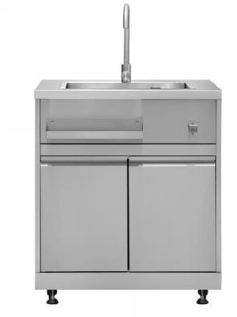
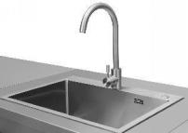
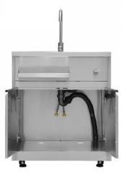
MK01SS304
Sink Cabinet - KD construction
Description
Storage tray
Bottle Opener
Storage cabinet
Kitchen sink including drain hose and water pipe
2 doors cabinet, with 3.5 cu ft (0.1m³) storage space
2x3” Fixed casters and 2x3”Locking Swivel Casters
Product Dimension: 813mm*660.4mm*962.1mm
Package Dimension: 885mm*730mm*455mm
Sink Cabinet
-
KD construction

Slide 18
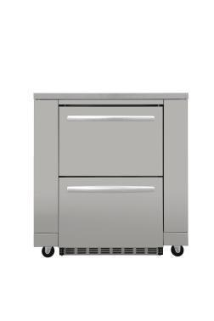
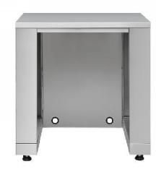
MK02SS304
Appliance Cabinet (Appliances excluded)- KD Construction
Description
Full S304 Stainless Steel Construction
Provide outdoor appliances with a flush built-in look
Provide additional preping space
2x3” Fixed casters and 2x3”Locking Swivel Casters
Product Dimension: 892.4*660.4*962.1mm
Package dimension:965mm*735mm*425mm
Container loading : 216pcs/40HQ
Appliance Cabinet (Appliances excluded)
-
KD Construction

Slide 19
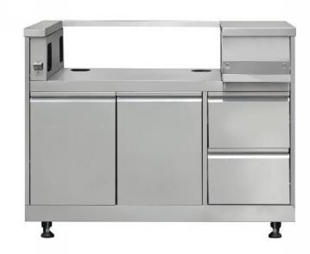
OKBC01S
Bottom Cabinet (BBQ) - KD construction
Description
Full S304 Stainless Steel Construction
4x3” caster, 2 with brake, 2 without + 4 adjustable legs
2 doors Cabinet on the left for gas tank only, no storage
2 drawers on the right, with 2.1 cu ft (0.06m³) storage space in total
Soft hing drawer slide
Gas tank tray inside the 2 door cabinet
4x3” caster, 2 with brake, 2 without + 2 adjustable legs
Product Dimension: 1219*660.4*962.1mm,
49”*26”*37.8”
Package Dimension: 885mm*705mm*320mm
34.8”27.8”12.6”
Container loading : 312pcs/40HQ
Bottom Cabinet (BBQ)
-
KD construction

Slide 20
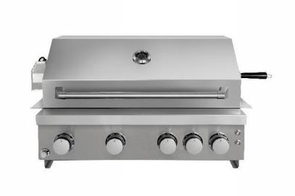
HBB3004E
30” Built in BBQ
Description
Gas Type: LP / NG Convertible, Ship with LP gas
3*12000BTU Tube Burner
1*10000BTU Rear Infrared Grill Burner
1*13500BTU Bottom Infrared Grill Burner
Rotisserie kit included
Warming Rack
2 halogen lamps
5 Knobs with Blue LED lighting
Product Size：770*591*504mm, 30”* 23”* 20”
Package Size: 925mm*780mm*587mm, 36.4”* 30.7” 14.3”
Container loading : 167pcs/40HQ
UPC: 6926697000533
CSA/CE certificate
30” Built in BBQ

Slide 21
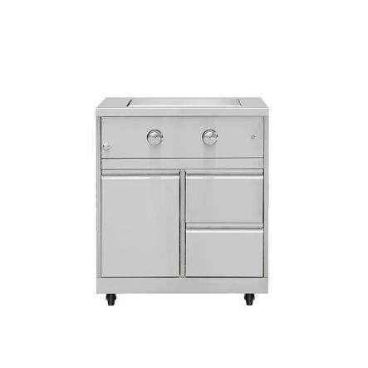
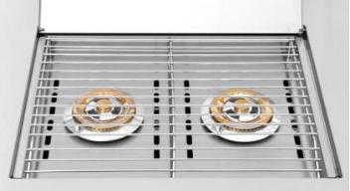
OKSB01S
Side Burner With Bottom Cabinet - Not KD Construction
Side Burner With
Bottom Cabinet
-
Not KD Construction
Description
Full S304 Stainless Steel Construction
2 *10000BTU Round Burners
Single Door with gas tank tray inside
2 drawers on the side
2x3” Fixed casters and 2x3”Locking Swivel Casters
Product Dimension: 813*660.4*962.3mm
Package Dimension: 890mm*740mm*1015mm
CE/CSA Certificated

Slide 22
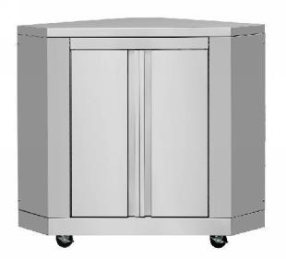
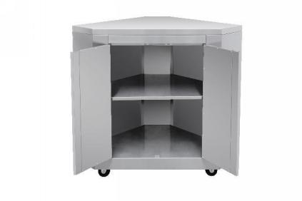
MK06SS304
Corner Cabinet - KD Construction
Description
Full S304 Construction
2 doors cabinet with one layer inside,with 8.5 cu ft (0.24m³) storage space
2x3” Fixed casters and 2x3”Locking Swivel Casters
Product Dimension: 776.9*776.9*962.3, 30.5”
Package dimension: 850mm*850mm*350mm,
Corner Cabinet -
KD Construction

Slide 23
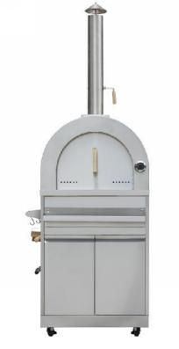
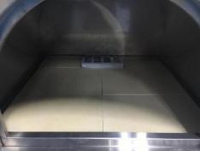
MK07SS304
Pizza Oven With Bottom Cabinet - KD Construction
Description
Full S304 Construction
It containes pizza oven
Bottom cabinet with 2 doors, with 6.3 cu ft (0.18m³) storage space
With flavour container in front of the cabinet
Cordierite stone fire bricks provide a great cooking surface and durability
Fire brick Thickness: 0.6” (15mm)
Cooking Area: 23.6”* 21”
2x3” Fixed casters and 2x3”Locking Swivel Casters
Production Dimension: 702.4*661.8*2068.9mm,
Package Dimension: 850mm*740mm*705mm
Pizza Oven
With
Bottom Cabinet -
KD Construction

Slide 24
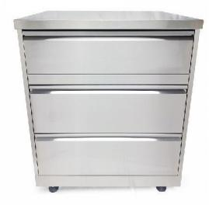
OK3D01S
^{3 drawers cabinet}
Description
Full S304 Construction
It containes 3 drawers
2x3” Fixed casters and 2x3”Locking Swivel Casters
Production Dimension:
813*660.4*962.3mm
Package Dimension:
890*740*1015mm
3 drawers cabinet

Slide 25
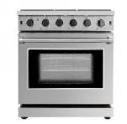
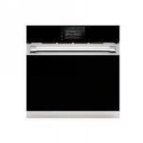
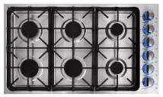
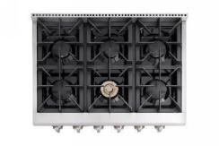
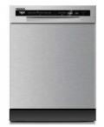
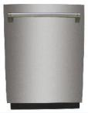
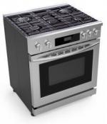
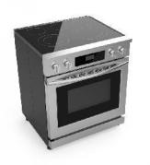
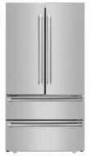
Kitchen Appliance Series
Range
Cooktop
Dishwasher
Fridge
Wine Cooler

Slide 26
Europe Style Kitchen Appliances

Slide 27
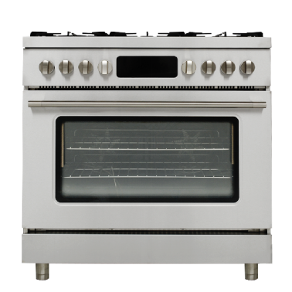
PDC901SS
900mm cooker with Multifunction oven and gas hob
Dimension:900W*600mmD*870-923mmH
GAS HOB
6 burners stainless steel pan stands rapid burners
6 burners
Front left: Ultra rapid 4.20 kW Rear left: 3.00 kW
Front centre: 1.00 kW Rear centre: 1.80 kW
Front right: 1.8 kW Rear right: Rapid 3.00 kW
Heavy duty cast iron pan stands
Automatic electronic ignition with thermocouple
Safety valves
ELECTRIC OVEN
Enamel interior Air cooling system
13 functions(bake, fan bake,fan forced, convection bake,grill,fan grill,
pizza,rotisserie,defrost,proof,dehydrate,keep warm,air fry)
Large LED display with dimentsion 218mm*78mm
Oven capacity: gross - 122 litres, net - 102 litres
Usable cavity space dimensions (HxWxD): 385x715x443mm
Large professional style controls
Easy clean grey enamel interior
Top Heater Power :2900W
Lower Heater Power :1700W
Rear Heater:1500W*2
Temperature probe including
2*25W halogen lights
Two convection fans
2 chrome plated racks 5 Rack positions
Quadruple glazed removable door glass
Removable inner door
Pyrolytic(Self) and steam cleaning function
Power cord:1.5M
CE/CB approved
900mm
Range Cooker

Slide 28
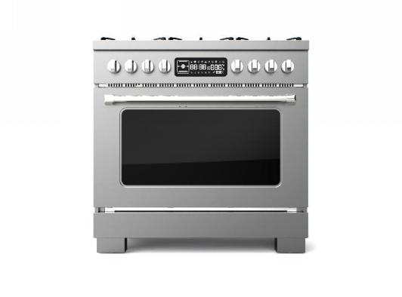
TDC901SS
900mm range cooker with
Multifunction oven and gas hob
Dimension:900W*600mmD*870-923mmH
GAS HOB
6 burners stainless steel pan stands rapid burners
6 burners
Front left: Ultra rapid 4.20 kW Rear left: 3.00 kW
Front centre: 1.00 kW Rear centre: 1.80 kW
Front right: 1.8 kW Rear right: Rapid 3.00 kW
Heavy duty cast iron pan stands
Automatic electronic ignition
Safety valves
ELECTRCIT OVEN
glazed 5 different cooking levels
Enamel interior Air cooling system
8 functions(fan forced,bake, fan bake,proof,convection bake,grill,fan grill,warm)
Oven capacity: gross - 122 litres, net - 102 litres
Usable cavity space dimensions (HxWxD): 385x715x443mm
Large professional style controls
Easy clean grey enamel interior
Top Heater Power :2900W
Lower Heater Power :1700W
Rear Heater:1500W*2
2*25W halogen lights
Two convection fans
2 chrome plated racks 6 Rack positions
Quadruple glazed removable door glass
Removable inner door
Steam cleaning function
Power cord:1.5M
CE/CB approved
900mm Range Cooker

Slide 29
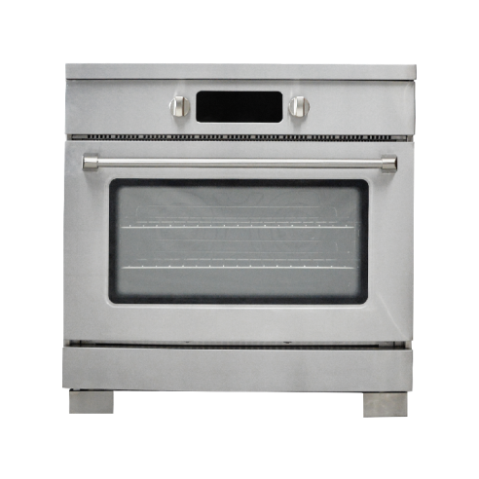
Dimension:900W*600mmD*870-923mmH
INDUCTION HOB
5 induction zones
Front left - Ø 14.5 cm, 1.40 kW
Rear left - Ø 18.0 cm, 1.85 kW
Central - Ø 27.0 cm, 2.60 kW
Rear right - Ø 21.0 cm, 2.30 kW
Front right - Ø 14.5 cm, 1.40 kW
With Bridge function
Slight touch control
9 power levels adjustment
1-99 minute timer
Red display fonts
Automatic safety switch off
Residual heat indicator
Child safety lock
ELECTRIC OVEN
Enamel interior Air cooling system
13 functions(bake, fan bake,fan forced, convection bake,grill,fan grill,
pizza,rotisserie,defrost,proof,dehydrate,keep warm,air fry)
Large LED display with dimentsion 218mm*78mm
Oven capacity: gross - 122 litres, net - 102 litres
Usable cavity space dimensions (HxWxD): 385x715x443mm
Large professional style controls
Easy clean grey enamel interior
Top Heater Power :2900W
Lower Heater Power :1700W
Rear Heater:1500W*2
Temperature probe including
2*25W halogen lights
Two convection fans
2 chrome plated racks 6 Rack positions
Quadruple glazed removable door glass
Removable inner door
Pyrolytic(Self) and steam cleaning function
CE/CB approved
PIC901SS
900mm Pro cooker with Multifunction oven and induction hob
900mm
Range Cooker

Slide 30
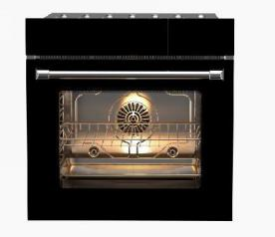
HBS6001E
60cm Steam & Baking Oven
The machine part
The whole machine size(W*D*H): 594*593*639mm
Cabinet size(W*D*H): 565*594*630mm
Description
Total oven capacity: 71L
The available capacity: 61L
The net weight: 47 KG
The energy efficiency: A
Control panel section
7 inch TFT color screen, Built-in menu mode
The control panel: Blue star grey glass
The tank to remind
Features: 4D_Hotfan, Sabbath day, Hot air eco....;
Technical details
Fuel typ: electric, Constrution: Built in
voltage: 208V/240V, current: 16 A, frequency: 60 HZ
Electric oven part
Zinc alloy handle seat, 304 handle tube
The oven door: Hover at any Angle, Lower than 15 degrees slow closing
Five mount layers, 2*3W LED lights
The tank volume: 1.3L，Steam for 50 minutes at moderate strength
Self-cleaning with high temperature
Support true convection fan
Upper heating tube power：1250+1450W
Delivery heat pipe power: 1250W; Back heating tube power:1800W
Oven temperature range: 30℃~300℃
CE/CB/CSA approved
Accessories:
2 rack,1 set steam plates,1 cooking plate,1 Air fryer mesh,1.5m power cord；
600mm Steam & Bake Built In Oven

Slide 31
America Style Kitchen Appliances

Slide 32
HRG3080U
30” freestanding gas range
Gas Cooktop:
1 dual burner x 15000BTU
1 single burner x 18000BTU
2 single burner x 12000BTU
Black Porcelain Drip Pan
3 x Flat cast-iron cooking grates
Automatic re-ignition if the burner flame extinguishes
Control panel:
SS Control panel
5 x high quality control knobs
Gas Oven:
4.2 cu.ft oven capacity
Tube burner: 1 x 13000BTU;
U shape stove burner: 1 x 22000BTU
Blue porcelain oven interior
Commercial convection fan circulates heat for even distribution
2 x Halogen Lights increase visibility for the oven interior
Thermostatically Controlled to attain the right temperature
Two nickel platted oven racks
CSA approved
Electrical Requirements: 120V/60Hz/15 or 20A
Product Dimension: 30”Lx27½”Wx39”H
Package Dimension: 32.3"L x 29.1"W x 44"H
Container load: 84 PCS/40HQ
30 inch
freestanding gas range

Slide 33
HRG3618U
36” freestanding gas range
Gas Cooktop:
2 x Sealed Dual Burner x 15000BTU
1 x Sealed Single Burner x 18000BTU
3 x Sealed Single Burner x 12000BTU
Automatic re-ignition if the burner flame extinguishes
Black Porcelain Drip Pan to facilitate surface cleaning
3 x Continuous cast-iron cooking grates
Automatic re-ignition if the burner flame extinguishes
Control panel:
SS Control panel
7 x high quality control knobs
Gas Oven:
5.2 cu.ft oven capacity
Infrared broil burner:1 x 16500BTU;
U shape stove burner: 1 x 22000BTU
Blue porcelain oven interior
Commercial convection fan circulates heat for even distribution
2 x Halogen Lights increase visibility for the oven interior
Thermostatically Controlled to attain the right temperature
Two nickel platted oven racks
CSA approved
Electrical Requirements: 120V/60Hz/15 or 20A
Product Dimension: 36”Wx27½”Dx39”H
Package Dimension: 38.1"L x 29.7"W x 44"H
Container load: 70pcs/40HQ
36 inch
freestanding gas range

Slide 34
HRG4808U
48” freestanding gas range
Gas Cooktop:
3 dual burners x 15,000BTU
3 single burners x 18,000BTU
Stainless steel drip pan
Stainless Steel Griddle
15,000 BTU griddle
3 x heavy casting iron cooking grates
Automatic re-ignition if the burner flame extinguishes
Control panel:
9 x high quality control knob
SS control panel
Gas Oven:
30” oven
4.2 cu.ft oven capacity
Oven broil burner at 16,500BTU
U shape bake burner at 22,000BTU
Blue oven interior
Commercial convection fan
2 halogen lights
18” oven:
2.5 cu.ft oven capacity
1 tube burner with 14,000BTU
1 halogen light
CSA approved
Electrical Requirements: 120V/60Hz/15 or 20A
Product Dimension: 48”Lx27½”Wx39”H
Package Dimension: 50.4"L x 29.5"W x 45.3"H
Container load: 54PCS/40HQ
48 inch
freestanding gas range

Slide 35
HRD3088U
30” freestanding dual fuel range
Type of Fuel:
Top burner : NG/LPG Bottom Oven : Electric
Gas Cooktop:
Front: 1 dual burner x 15000BTU 1 single burner x 18000BTU
Rear: 2 single burner x 12000BTU
Automatic re-ignition if the burner flame extinguishes
Black Porcelain Drip Pan to facilitate surface cleaning
3 x Continuous cast-iron cooking grates
Control panel:
SS Control panel
5 x high quality metal control knobs
Electric Oven:
4.2 cu.ft oven capacity
Electric Broiler (Top) Heating Element:1x3 500 W
Oven Electric Heating Element: 1x850 W(Top) & 3 000 W (Base)
Black porcelain oven interior
Commercial convection fan circulates heat for even distribution
2 x Halogen Lights increase visibility for the oven interior
Thermostatically Controlled to attain the right temp.
CSA approved
Electrical Requirements: 240V/60Hz/30A
Product Dimension: 30”Lx27½”Wx39”H
Package Dimension: 32.3"L x 29.1"W x 44"H
Container load: 84 PCS/40HQ
30 inch
freestanding dual fuel range

Slide 36
HRD3606U
36” freestanding dual fuel range
Type of Fuel:
Top burner : NG/LPG Bottom Oven : Electric
Gas Cooktop:
Front: 2 Sealed Single Burner x 18,000 BTU
1 Dual burner x 15,000 BTU with 650 BTU simmer function
Rear: 3 Sealed Single Burner x 12,000 BTU
Automatic re-ignition if the burner flame extinguishes
Black Porcelain Drip Pan to facilitate surface cleaning
3 x Continuous cast-iron cooking grates
Control panel:
SS Control panel
7 x high quality metal control knobs
Electric Oven:
5.2 cu.ft oven capacity
Electric Broiler (Top) Heating Element:1x3 500 W
Oven Electric Heating Element: 1x850W (Top) & 3 000 W (Base)
Black porcelain oven interior
Commercial convection fan circulates heat for even distribution
2 x Halogen Lights increase visibility for the oven interior
Thermostatically Controlled to attain the right temp.
CSA approved
Electrical Requirements: 240V/60Hz/30A
Product Dimension: 36”Wx27½”Dx39”H
Package Dimension: 38.1"L x 29.7"W x 44"H
Container load: 70pcs/40HQ
36 inch
freestanding dual fuel range

Slide 37
HRD4803U
48” freestanding dual fuel range
Type of Fuel:
Top burner : NG/LPG Bottom Oven : Electric
Gas Cooktop:
Front: 2 Sealed Single Burner x 18,000 BTU ,1* Dual Burner15000BTU
Rear: 2 Sealed Single Burner x 12,000 BTU ,1*Dual Burner 15000BTU
Automatic re-ignition if the burner flame extinguishes
Black Porcelain Drip Pan to facilitate surface cleaning
15,000BTU stainless steel griddle
3 x Continuous cast-iron cooking grates
Control panel:
SS Control panel
9 x high quality metal control knobs
Electric Oven:
30” oven
4.2 cu.ft oven capacity
Electric Broiler (Top) Heating Element:1x3 500 W
Oven Electric Heating Element: 1x850W (Top) & 3 000 W (Base)
Blue porcelain oven interior
Commercial convection fan
2 halogen lights
18” oven:
2.5 cu.ft oven capacity
Electric Bake Wattage:1x2 500 W (Base)
1 halogen light
CSA approved
Electrical Requirements: 240V/60Hz/30A
Product Dimension: 48”Lx27½”Wx39”H
Package Dimension: 50.4"L x 29.5"W x 45.3"H
Container load: 54PCS/40HQ
48 inch
freestanding dual fuel range

Slide 38
LRG2401
24” freestanding gas range
FEATURES
Black Porcelain Drip Pan On Cook Top
Heavy Duty Continuous Cast Iron Cooking Grates
5pcs of high quality control knobs
Heavy Duty handle Black oven interior 2pcs of oven racks 1 x Halogen Lights With storage drawer
Gas Cooktop:
Total Number of Range Top Burners | 4 Burners
Front Right (Single) | 18,000 BTU
Front Left (Single) | 12,000BTU
Rear Left (Single) Rear Right(Single) Oven Bottom Burner | 9,000 BTU 3,500BTU 12,000 BTU
Gas Oven:
3.73 cubic feet oven capacity ,Manual clean oven
TECHNICAL DETAILS
Fuel Type | Natural Gas / LP Convertible
Electrical Requirements | 120V
Circuit Breaker (A) | 15 or 20 A
Frequency (Hz) | 60 Hz
CSA approved
CONTAINER LOAD
102 PCS/40HQ Dimensions (24”Lx26.5”Wx36”H, by inches) (609*670*914mm)
24 inch
gas range

Slide 39
LRG3001U
30” freestanding gas range
Gas Cooktop:
1 single burner x 18000BTU
1 single burner x 8000BTU
1 oval burner x 9000BTU
1 single burner x 6000BTU
1 single burner x 4000BTU
Cooking grate: cast iron, flat
Black porcelain drip pan
Gas Oven:
4.8 cu.ft oven capacity
Broil burner: 1 x 10,000BTU;
U shape burner: 1 x 18,500BTU
1x Halogen Light
Black porcelain oven interior
Commercial convections fan
1x Halogen Light
Two black porcelain oven racks
Three layers glass window
Black Porcelain Material Storage drawer
CSA approved
Package:
Product Dimension: 30"L*29"D*38"H
package dimension: 33”*30”*44.5”
Container load: 84PCS/40HQ
30 inch
freestanding gas range

Slide 40
LRG3601U
36” freestanding gas range
Gas Cooktop:
2 single burner x 18000BTU
2 single burner x12000BTU
2 single burner x 9000BTU
Cooking grate: cast iron, flat
Black porcelain drip pan
Gas Oven:
6.0 cu.ft oven capacity
Broil burner: 1 x 10,000BTU;
U shape burner: 1 x 18,500BTU
1x Halogen Light
Grey porcelain oven interior
Commercial convections fan
Two black porcelain oven racks
Three layers glass window
Storage at the bottom
CSA approved
Package:
Product Dimension: 36"L*29"D*38"H
package dimension: 41”*30”*44.5”
Container load: 70PCS/40HQ
36 inch
freestanding gas range

Slide 41
LRG4807U
48” freestanding gas range
Gas Cooktop:
2*18000BTU
2*12000BTU
2*9000BTU
3*flat cast iron grates
Black porcelain drip pan
Griddle: 1*15000BTU
30" Gas Oven:
4.88 cu.ft oven capacity
Broil burner: 1 x 10,000BTU;
U shape burner: 1 x 2200BTU
1x Halogen Light
white flakes with gray background porcelain oven interior
Commercial convections fan
Two oven racks
18" Gas Oven:
2.2 cu.ft oven capacity
U shape burner: 1 x 14000 BTU
1x Halogen Light
white flakes with gray background porcelain oven interior
Two oven racks
CSA approved
Package:
Product Dimension: 48”Lx27½”Wx39”H
Package Dimension: 50.4"L x 29.5"W x 45.3"H
Container load: 54PCS/40HQ
48 inch
freestanding gas range

Slide 42
HRE2401
24” Electric Range
Key Spec
Product Dimension: 23 3/4” W *27 3/5 ” D *（35 3/5-36 7/8）” H
Fuel type:Electric
Black Polished plate glass-ceramics cooktop
The burner is silver printed on the glass
Hot sureface light on when the temp over 65℃（150 ℉）
Knob light (down shine)
Metal oven light/fan button with led light
4 elements :
Right Front:9"/6"Dual Element,2200W (1200W+1000W)
Left Front:8",2000W Right Rear:6”,1200W Left Rear:6”,1200W
Controls
Control type :360°Energy regulator to control
Control Panel :Blue Led indicators on panel , The light up when knob open
Electric Oven:
Oven capacity :3.73 Cu. Ft.
Oven color : Blue porcelain with white dots
Top heating element :3000W
Lower heating element :2700W
True convection,rear heating element:800W
Oven light qty :1, rear
2 chrome plated racks
6 Rack positions
Technical Information
Voltage :240V , Frequency : 60HZ
Certificate : CSA
Accessories
2 pcs Oven Rack, 1pc Gray pan , 1pc Bake pan cover
Container Load
102pcs/40HQ
24 inch
Electric Range

Slide 43
HRE3001
30” Electric Range
Key Spec
Product Dimension: 29 3/4” W *27 3/5 ” D *（35 3/5-36 7/8）” H
Fuel type:Electric
Black Polished plate glass-ceramics cooktop
The burner is silver printed on the glass
Hot sureface light on when the temp over 65℃（150 ℉）
Knob light (down shine)
Metal oven light/fan button with led light
5 elements :
Right Front:9"/12"Dual Element,3000W (1800W+1200W)
Left Front:6"/9"Dual Element,3000W (1500W+1500W)
Right Rear:6”,1200W Left Rear:6”,1200W Center:7”,100W Warming zone
Controls
Control type :360°Energy regulator to control
Control Panel :Blue Led indicators on panel , The light up when knob open
Electric Oven
Oven capacity :4.55Cu. Ft.
Oven color : Blue porcelain with white dots
Top Heater Power :3500W
Lower Heater Power :3500W
True convection,rear heating element:1300W
Oven light qty :1, rear
2 chrome plated racks
6 Rack positions
Technical Information
Voltage :240V , Frequency : 60HZ
Certificate : CSA
Accessories
2 pcs Oven Rack, 1pc Gray pan , 1pc Bake pan cover
Container Load
84pcs/40HQ
30 inch
Electric Range

Slide 44
HRE3601
36” Electric Range
Key Spec
Product Dimension: 35 3/4” W *27 3/5 ” D *（35 3/5-36 7/8）” H
Fuel type:Electric
Black Polished plate glass-ceramics cooktop
The burner is silver printed on the glass
Hot sureface light on when the temp over 65℃（150 ℉）
Knob light (down shine)
Metal oven light/fan button with led light
Electric cooktop 5 elements :
Right Front:9"/12"Dual Element,3000W (1800W+1200W)
Left Front:6"/9"Dual Element,3000W (1500W+1500W)
Right Rear:6”,1200W Left Rear:6”,1200W Center:7”,100W Warming zone
Controls
Control type :360°Energy regulator to control
Control Panel :Blue Led indicators on panel , The light up when knob open
Electric Oven
Oven capacity :6.0 Cu. Ft.
Oven color : Blue porcelain with white dots
Top Heater Power :3500W
Lower Heater Power :3500W
True convection,rear heating element:1300W
Oven light qty :1, rear
2 chrome plated racks
6 Rack positions
Technical Information
Voltage :240V , Frequency : 60HZ
Certificate : CSA
Accessories
2 pcs Oven Rack, 1pc Gray pan , 1pc Bake pan cover
Container Load
70pcs/40HQ
36 inch
Electric Range

Slide 45
HEW3001
30” Electric Single Wall Oven
Key Spec
Outside(Max.) Dimension: 30”W*24.8”D*29.29”H
Cut-out Dimension: 28.54”W*24”D*27.56”H
Fuel type:Electric
Color:Stainless steel
Construction: built-in
Controls
Electric touch display
Electric Oven Cavity
Oven capacity :4.8 Cu. Ft.
Oven color : Gray porcelain with white dots
Top Heater Power :3500W
Lower Heater Power :3000W
Oven light qty :1, rear
2 chrome plated racks including a Gliding Rack
6 Rack positions
Bake: 150℉-550℉
Convection Bake:150℉-550℉
Convection Roast:150℉-550℉
Broil: Low-High
Convenience
Self-Clean
Temprature Probe
Broil Element
Hidden Bake Element
Delay Start
Child Safety Lock
Warming mode
Kitchen Timer
30 inch
Wall Oven
Technical Information
Voltage :240V , Frequency : 60HZ
Certificate : CSA
Container Load
Package Dimension: 117pcs/40HQ

Slide 46
LDW3001
30 Inch Professional Double Wall Oven
Electric OVEN PERFORMANCE
4.8 cu. ft. per oven, provides an extra-large cooking capacity that's unsurpassed among 30 in. wall ovens and is perfect for large turkeys and roasts.
Glass-Touch display with control lock function features a responsive, easy-to-use interface that is also easy to clean.
Hidden bake element is positioned below the oven floor, creating a smooth oven surface so spills are easy to clean without maneuvering around heating coils.
Even-Heat Convection provides consistent heating convection fan that helps ensure the most even baking.
Self-cleaning cycle uses high temperature to power through soils in the oven cavity, requiring only a quick wipe down at the end of the cycle.
Large oven windows makes it easy to check on cooking food without opening the oven door.
Halogen oven lights provide bright illumination, allowing you to easily see the progress of your food.
Dark glass, do not use do not turn on the light can not see the interior, so that the product more atmospheric
Details(Upper oven/Lower oven)
Upper Oven Wattage: 3500W
Lower Oven Wattage: 3000W
Oven Features: Self clean,Broiler in Oven,Hidden Bake Element
Oven Settings: Timer/Delay Start
Oven light: 40w
Power Cord Length: 55inch
DIMENSIONS
Product Dimensions(Inch):
29 7/8”W*24 1/2”D*50 15/16”H
Cut-Out:
28.5’’-29”W*23.5”D*48 15/16”-50 1/4”H
Certificate : CSA
30 Inch Professional Double
Wall Oven
TECHNICAL DETAILS
Fuel Type: Electric
Constrution: Built in
Color: Stainless Steel
Votage: 240V 35A
Frequency(Hz): 60Hz
Controls Type:
LED touch screen

Slide 47
HFG3001G
30”Front Control Gas Range
FEATURES
Black Porcelain Drip Pan On Cook Top
Heavy Duty Continuous Cast Iron Cooking Grates
Electronic ignition Safety Feature
LED touch Pane for oven
Gas oven ,4.8 cu.ft oven capacity
Black porcelain drip pan and oven interior
5 high quanlity control knob
Stainless-Steel Professional look and stronger construction
Grey porcelain oven interior
1 x Halogen Lights
Commercial convection fan
Self Clean
With storage drawer
Icon casting griddle
Functions: Bake, broil, convection bake, convection roast,dyhydrate, slow cook, bread proof andself clean, timer
BURNER PERFORMANCE
Gas cooktop: 5 Burners
Front Right (Single): 18,000 BTU
Front Left (Single): 12,000BTU
Rear Left (Single): 6,000 BTU
Rear Right(Single): 4,000BTU
Center (big oval): 9,000BTU
Oven top broil burner: 10,000BTU
Oven bottom burner: 18,500BTU
TECHNICAL DETAILS
Fuel Type: Natural Gas / LP Convertible
Electrical Requirements: 120V
Circuit Breaker (A): 15 or 20 A
Frequency (Hz): 60 Hz
Certificate : CSA
CONTAINER LOAD： 84PCS/40HQ
30 inch
Front Control
Gas Range

Slide 48
HFG3001E
30” Front Control electric Range
FEATURES
Black Porcelain Drip Pan On Cook Top
Heavy Duty Continuous Cast Iron Cooking Grates
Electronic ignition Safety Feature
LED touch Panel for oven
Electric oven ,4.8 cu.ft oven capacity
Black porcelain drip pan and oven interior
5 high quanlity control knob
Stainless-Steel Professional look and stronger construction
Grey porcelain oven interior
1 x Halogen Lights
Commercial convection fan
Sefl Clean
With storage drawer
Icon casting griddle
Functions: Bake, broil, convection bake, convection roast,dyhydrate, slow cook, bread proof andself clean, timer
BURNER PERFORMANCE
Electric cooktop: 5 Burners
Front Right (Single): 12”/9”(1200W / 3000W)
Front Left (Single): 9”/6"(1200W/3000W)
Rear Left (Single): 6"(1200W)
Rear Right(Single): 6"(1200W)
Rear Middle: 7"(100W)
Broil Element: 3500W
Bake Element: hidden/3000W
TECHNICAL DETAILS
Fuel Type: Natural Gas / LP Convertible
Electrical Requirements: 240V
Circuit Breaker (A): 15 or 20 A
Frequency (Hz): 60 Hz
Certificate : CSA
CONTAINER LOAD： 84PCS/40HQ
30 inch
Front Control
Electrical Range

Slide 49
CRE3004U
30 inch Professional Electrical Range
ELECTRIC OVEN PERFORMANCE
Oven Capacity: 4.55 cu. ft.
Oven Color: Black
Oven Features: Bake,Broil,Conv bake,Conv Roast,Pizza,Keep Warm
Oven Settings: Start/Ok,Timer On/Off
Lower Heater Power: 3500W
Top Heater Power: 3500W
Convection: Convection
Oven Light: 1*40W, Rear
Oven Racks: 2
Rack Positions: 5
Oven Rack Material: Chrome Plated
Baking Sheet: Fits 23” x 16” Baking Sheet
ELECTRIC COOKTOP PERFORMANCE
Cooktop: Black Polished Plate Glass Ceramic Cooktop
Total Elements: 4
Front Left Burner (Dual): 3000 W (1500W and 1500W)
Front Right Burner (Single): 3000 W
Rear Left Burner (Single): 1200 W
Rear Right Burner (Single): 1200 W
TECHNICAL DETAILS
Fuel Type: Electric
Constrution: Built in
Color: Stainless Steel
Votage: 240V 50A
Frequency(Hz): 60Hz
Controls Type: Oven function button
Hot Surface Indicator Light: Front Right
Corner of Cooktop w/Temp at 150˚F (65˚C)
Certificate : CSA
30 inch Professional Electrical Range
DIMENSIONS
Product Width: 29 7/8"
Product Height: 36” - 37”
Product Depth (including door): 26 1/2”
Adjustable Legs: 1‘’ Max
Cutout Width: 30”
Cutout Height: 36‘’
Cutout Depth: 24‘’

Slide 50
CRE3605U
36 inch Professional Electrical Range
ELECTRIC OVEN PERFORMANCE
Oven Capacity: 4.55 cu. ft.
Oven Color: Black
Oven Features: Bake,Broil,Conv bake,Conv Roast,Pizza,Keep Warm
Oven Settings: Start/Ok,Timer On/Off
Lower Heater Power: 3000W
Top Heater Power: 3500W
Convection: Convection
Oven Light: 1*40W, Rear
Oven Racks: 2
Rack Positions: 5
Oven Rack Material: Chrome Plated
Baking Sheet: Fits 23” x 16” Baking Sheet
ELECTRIC COOKTOP PERFORMANCE
Cooktop: Black Polished Plate Glass Ceramic Cooktop
Total Elements: 5
Front Left Burner (Dual): 3000 W (1500W and 1500W)
Front Right Burner (Dual): 3000 W (1800W and 1200W)
Rear Left Burner (Single): 1200 W
Rear Middle Burner (Single): 1200 W
Rear Right Burner (Single): 1200 W
TECHNICAL DETAILS
Fuel Type: Electric
Constrution: Built in
Color: Stainless Steel
Votage: 240V 50A
Frequency(Hz): 60Hz
Controls Type: Oven function button
Hot Surface Indicator Light: Front Right
Corner of Cooktop w/Temp at 150˚F (65˚C)
Certificate : CSA
36 inch Professional Electrical Range
DIMENSIONS
Product Width: 35 7/8"
Product Height: 36” - 39”
Product Depth (including door): 26 1/2”
Adjustable Legs: 3‘’ Max
Cutout Width: 36”
Cutout Height: 36‘’
Cutout Depth: 24‘’

Slide 51
CRG3004U
30 inch Professional Gas Range
GAS OVEN PERFORMANCE
Oven Capacity: 4.55 cu. ft.
Oven Color: Black
Oven Features: Bake,Broil,Conv bake,Conv Roast,Pizza,Keep Warm
Oven Settings: Start/Ok,Timer On/Off
Lower Heater Power: 18500 BTU
Top Heater Power: 12000 BTU
Convection: Convection
Oven Light: 1*40W, Rear
Oven Racks: 2
Rack Positions: 5
Oven Rack Material: Chrome Plated
Baking Sheet: Fits 23” x 16” Baking Sheet
GAS COOKTOP PERFORMANCE
Cooktop: Continuous Grates,LP Convertible,Sealed Burners
Total Burners: 4
(1)Front Left Burner (Single): 12000 BTU
(2)Front Right Burner (Single): 18000 BTU
(3)Rear Left Burner (Single): 9000 BTU
(4)Rear Right Burner (Single): 3500 BTU
TECHNICAL DETAILS
Fuel Type: Gas
Constrution: Built in
Color: Stainless Steel
Votage: 120V 15 or 20A
Frequency(Hz): 60Hz
Controls Type: Oven function button
Certificate : CSA
30 inch Professional Gas Range
DIMENSIONS
Product Width: 29 7/8"
Product Height: 36” - 37”
Product Depth (including door): 26 1/2”
Adjustable Legs: 1‘’ Max
Cutout Width: 30”
Cutout Height: 36‘’
Cutout Depth: 24‘’

Slide 52
CRE3605U
36 inch Professional Gas Range
GAS OVEN PERFORMANCE
Oven Capacity: 4.55 cu. ft.
Oven Color: Black
Oven Features: Bake,Broil,Conv bake,Conv Roast,Pizza,Keep Warm
Oven Settings: Start/Ok,Timer On/Off
Lower Heater Power: 18000 BTU
Top Heater Power: 13500 BTU
Convection: Convection
Oven Light: 1*40W, Rear
Oven Racks: 2
Rack Positions: 5
Oven Rack Material: Chrome Plated
Baking Sheet: Fits 23” x 16” Baking Sheet
GAS COOKTOP PERFORMANCE
Cooktop: Continuous Grates,LP Convertible,Sealed Burners
Total Burners: 6
Front Left Burner (Single): 12000 BTU
Front center Burner (Single): 18000 BTU
Front RIGHT Burner (Single): 12000 BTU
Rear Left Burner (Single): 9000 BTU
Rear center Burner (Single): 12000 BTU
Rear Right Burner (Single): 9000 BTU
TECHNICAL DETAILS
Fuel Type: Gas
Constrution: Built in
Color: Stainless Steel
Votage: 120V 8 or 10A
Frequency(Hz): 60Hz
Controls Type: Oven function button
Certificate : CSA
36 inch Professional Gas Range
DIMENSIONS
Product Width: 35 7/8"
Product Height: 36” - 39”
Product Depth (including door): 26 1/2”
Adjustable Legs: 3‘’ Max
Cutout Width: 36”
Cutout Height: 36‘’
Cutout Depth: 24‘’

Slide 53
HRT3618U
36” range top
Top:
LF:1 single burner x 18,000BTU
MF: 1 dual burner x 15,000BTU w/650BTU simmer
RF:1 single burner x 18000BTU
REAR:3 single burner x 12,000BTU
Black Porcelain Drip Pan
3 x Heavy Duty Flat Cast-iron Cooking Grates
Control panel:
SS Control panel
6 x high quality Zinc alloy control knobs
Blue LED Light up the knobs
Certificate : CSA
Fuel :NG/LPG
Electrical Requirements: 120V/60Hz
Product Dimension: 36”Lx27½”Wx7”H
Package Dimension: 38.7"(L)*30"(W)*13.8"(H)
Container load: 102PCS/20GP 252 PCS/40HQ
36 inch
Range Top

Slide 54
HRT4806U
48” range top
Top:
Front: 3 single burner x 18,000BTU
Rear: 3 dual burner x 15,000BTU
18,000BTU stainless steel griddle
Black Porcelain Drip Pan
3 x Heavy Duty Flat Cast-iron Cooking Grates
Control panel:
SS Control panel
7 x high quality Zinc alloy control knobs
Blue LED Light up the knobs
Certificate : CSA
Fuel :NG/LPG
Electrical Requirements: 120V/60Hz
Product Dimension: 48”Lx27½”Wx9.2”H
Package Dimension: 51.4"(L)*30"(W)*14"(H)
Container load: 72PCS/20GP 144PCS/40HQ
48 inch
Range Top

Slide 55
LGC3001
30” Gas Cooktop
Key Spec
Outside(Max.) Cooktop Dimension: 30”W*21”D*4 2/5”H
Cut-out Dimension: 28 5/8”W*19 1/2”D
Fuel type:NG/LPG
Color:Stainless steel
Construction: built-in
ABS knob without knob ring
304 SS drip pan
Cooktop
Cast Iron 2-Piece Grates
Right Front:9000 BTU, Right Rear:9000 BTU
Left Front: 18000 BTU, Left Rear: 10000 BTU
Technical Information
Voltage:110-120V, Frequency:60HZ
Certificate:CSA
Package info
Package dimension: 84cmW*61.5cmD*23cmH
Container loading:570pcs/40HQ
Package standard: 6A
Gas
Cooktop

Slide 56
LGC3601
36” Gas Cooktop
Key Spec
Outside(Max.) Cooktop Dimension: 36”W*21”D*4 2/5”H
Cut-out Dimension: 34 5/8”*19 1/2”D
Fuel type:NG/LPG
Color:Stainless steel
Construction: built-in
ABS knob without knob ring
304 SS drip pan
Cooktop
Cast Iron 3-Piece Grates
18K BTU power burner
Right Front:6000 BTU, Right Rear:4000 BTU
Center Front:18000 BTU, Center Rear:12000 BTU
Left Front: 18000 BTU, Left Rear: 12000 BTU
Technical Information
Voltage:110-120V, Frequency:60HZ
Certificate:CSA
Package info
Package dimension: 99.5cmW*61.5cmD*23cmH
Container loading:462pcs/40HQ
Package standard: 6A
Gas Cooktop

Slide 57
LRT3601U
36” Gas Cooktop
Key Spec
Product Dimension: 35 7/8”Wx27½”Dx9 13/64”H
One full-piece drip pan
Total burner quantity: 6
2 single burner x 18000BTU 2 single burner x 12000BTU
2 single burner x 9000BTU
Black porcelain drip pan
cast iron cooking grates
ABS control knobs quantity: 6pcs
Blue LED light under control panel
Package info
Fuel:NG/LPG
Electrical Requirements:120V/60Hz/ 20A
Package Dimension: 39”Wx30”Dx13 13/32”H
CSA certificated
Container load: 210 units/40HQ
Gas Cooktop

Slide 58
TWD3001
30” Warming Drawer
FEATURES
1. Distributes heat evenly from 85 to 185 degrees Fahrenheit using fans.
2. Durable stainless steel drawer/Stainless steel front
3. Includes hidden electronic controls
4. Electronic controls with LCD display
5.PROOF/PLATES/CUPS/KEEP WARM 4 functional modes
1.Rated Voltage & power & Current ：120V/60Hz & 500W & 4A
2.Slides open and closed smoothly due to full-extension, ball-bearing drawers
3.Remove the stainless steel drawer pan for easy clean up
4. Removable Rack*1.Pan support rail locator notch*3
Certificate:CSA
TECHNICAL DETAILS
Product Size(inch) (W*D*H)：23 7/8*24 11/16*10 1/4"
Carton Size(inch) (W*D*H): 33 11/12*28 11/16*14 5/12"
Loading quantity 40HQ：279pcs
30 inch
Warming
Drawer

Slide 59
HDW2401SS
24” Dishwasher
Spec
Product Dimension: 24” Wx24½”Dx33½”H
Capacity: 14 place settings
Noise level:45dB
Rated Power Usage: Wash motor 95W Heater 840W
Four spray arms
inlet water temperature:min 120°F
water consumption:≤13.31L(3.1gal)
outlet hose length: 59“
Electrical Requirements: 120V/60HZ
CSA certificated
Feature
24 inch Semi-built in style
Fully Integrated Design
Delayed Start (Pre-programmed 1-24 hrs)
Multiple filter system (save water and energy)
Smart Wash System
Removable utensil basket
Detergent&Rinse-Aid dispenser
Package
Package Dimension:27.7”W*20.5”D*28.9”H
Loading qty: 48PCS/20GP 140pcs/40HQ
24 inch
Dishwasher

Slide 60
TWC1501
15'' 33 bottles Built-in wine cooler
Spec
Product Dimension: 15” Wx22 13/16”Dx341/4”H
Net capacity--Litre 88L
Capacity Bottle --33 Bottles
Refrigerant :R600a
Dual Temperature zone design: 41℉-68℉
100% HFC free & FCKW free
Electrical Requirements: 110-120V/60HZ
ETL certificated
Feature
Compressor-powered cooling
Built-in & free-standing installation
Six beech wood shelves
Blue LED Interior Light with switch
Tempered double pane glass door
Seamless Stainless steel door frame and handle
Blue LED Touch pad digital control readout
Adjustable thermostat
No frost with interior fan circulating
With Key & lock
Package
Package Dimension:17.3”x25.6”x37”
Loading qty: 216pcs/40HQ
15 inch
Built-in
wine cooler

Slide 61
TWC2402
Franch door 42 bottles Built-in wine cooler
Spec
Product Dimension: 23½” Wx22½”Dx341/4”H
Net capacity--Litre 126L
Capacity Bottle --42 Bottles
Refrigerant :R600a
Dual Temperature zone design: 41℉-68℉
100% HFC free & FCKW free
Electrical Requirements: 110-120V/60HZ
ETL certificated
Feature
Compressor-powered cooling
Built-in & free-standing installation
Ten Chromed metal shelves
Bule LED Interior Light with switch
Tempered double pane glass door
Seamless Stainless steel door frame and handle
Blue LED Touch pad digital control readout
Adjustable thermostat
No frost with interior fan circulating
Package
Package Dimension:25.2"x36.2"x24.6"
Loading qty: 147pcs/40HQ
Franch door
42 bottles
Built-in
wine cooler

Slide 62
TWC2403DI
24” Wide 162-Bottle Built-In Dual Zone Wine Cooler
Spec
Product Dimension: 23.94” Wx27”Dx73.625”H
Input Power:370W /3.2Amps
Net capacity--Litre 458L
Capacity Bottle --162 bottles
Refrigerant R600a
Dual Temperature zone design:Upper Zone 41-56°F Lower Zone 54-64°F
Electrical Requirements: 110V/60HZ
ETL certificated
Feature
Compressor-powered cooling
Built-in & free-standing installation
13 Roll-Out Wood racks and 1 drawer/1 display
Three colors of light
Tempered three pane glass door
With DEMO Model
With Sabaath model
Stainless steel door frame and handle
Blue LED Touch pad digital control readout
Adjustable thermostat
No frost with interior fan circulating
Package
UPC Code:6926697058558
Package Dimension:25.8”W*29”D*80.3”H
Loading qty: 54PCS/40HQ
MOQ:50PCS
24” Wide
162-Bottle Built-In
Dual Zone
Wine Cooler

Slide 63
TRF2401U
24” Under counter built-in outdoor drawer refrigerator
Spec
Product Dimension: 23.5”Wx23.4”Dx34.2“H(excl handle)
Net capacity:152 L
Temp range: 34℉ ~ 46℉
Electrical Requirements: 110V/60HZ
ETL,DOE,ROHS certificated
Feature
Built-in Type
Climate type:T, up to 109℉ ambient
Refrigerant:R600a
Cooling type:ventilated cooling. No frost
Energy rating :DOE consumer
Shelf(pcs):2 s.s. drawers
Controller:digital
Light:yes
Cabinet interior:hammered AL
Cabinet Exterior:black pre-coated metal
S.S. solid door
Foot/Castor:adjustable feet
Extra Feature:weather proof design,suitable for outdoor use
Up and low drawer with white LED illumination
Package
Package Dimension:25.4”W*26.2”D*35.5”H
Loading qty: 144pcs/40HQ
24” Under counter
built-in
outdoor
drawer refrigerator

Slide 64
HRF3601F
36” Stainless Steel French Style Refrigerator
Spec
Product Dimension: 36” Wx28½”Dx70”H
Net Capacity:
Total(L/cu.ft):586/20.70
Freezer(L/cu.ft):169.9/6.0
Refrigerator(L/cu.ft):416.26/14.70
Electrical Requirements: 110V/60HZ
UL certificated
Feature
Type: French door side by side
Climate Class: ST
Energy Class:DOE
LCD touch sceen electrinic control
Defrosting: Automatic
Refrigerant:R134a
Foam Blowing Agent: Cyclopentane
Freezer system with pull-out drawer
Multi-air flow
Total no frost
Automatic ice maker
3 LED lighting systems
Foldable shelves
Dual refrigeration systems
Stainess steel door and grip handle
Package
Package Dimension:38.8”W*30.7”D*72.4”H
Loading qty: 48pcs/40HQ
36”
Stainless Steel
French Style Refrigerator

Slide 65
HRF3602
FDBM Design——22.5cuft 36” width
Spec
Dimension: W 35.8 X H 69.9 X D 28.7
Capacity: 22.5 (R:16, F:6.5)
Climate: T
Energy: E-Star
Ice-maker: Automatic
Ice capacity: 4.0 lbs./24h
Loading: 48
Display: Digital
Gallon size: 6 gallon bins
Lighting: LED (Top and sides)
C/D: 24inch
Noise: 45dB
ADA design: Yes
Cooling system: Single
Humidity control: Yes
UL certificated
Package
Package Dimension:38.58*31.50*73.82in
FDBM Design
——
22.5cuft 36” width

Slide 66
TIM1501
15” Wide Built-In Automatic Indoor Ice Maker
Spec
Product Dimension: 15”Wx23.6”Dx33.5“H
Input Power:12.2 kWh/100 lbs of ice
Refrigerant :R134a, 3.88 oz
Power Plug: 76 inch
Electrical Requirements: 110V-120V/60HZ
UL certificated
Accessories: Water supply hose:71inch
Drain hose:59inch
Ice scoop:white
manual*1
Feature
Built-in Type
Exterior Finish: stainless steel
Internal pump allows more flexibility in placing the unit Reversible door
Ice-making capacity:50 lbs/day
Maximum ice storage: 25lbs
Features:Automatic Ice Level Control/Shutoff,Filtered Ice,Removable Basket
Ice Shape:Cube
Ice cube dimensions:7/8″ x 7/8″ x 7/8″
Lighting:White LED Interior Light
Door:Reversible door (for right or left swing)
Package
Package Dimension:17.9”W*28.3”D*36”H
Loading qty: 80pcs/20GP 166pcs/40HQ
15” Wide
Built-In Automatic Indoor
Ice Maker

Slide 67
HRH3007
30 inch ss wall mount range hood
Spec
30” width
Wall mount design
Touch control with display
3 speed
600 CFM airflow
Certificate:ETL
Noise level: 60 dB (Max)/52 dB (Mid)/46 dB (Min)
Feature
Clean canopy design
Easy installation
Durable brushed stainless steel
Easy lamp replacement, without tools
Extension chimney included
1 Dual 3.5W LED lamp with GU10 base
Large, full baffle filter design, mesh filter optional
Remote control
Clock shown, delay off, filter clean reminder
Vertical vent diameter 6” round
Package
Package Dimension:33”W*17.2”D*22.8”H
Loading qty: 310pcs/40HQ
30 inch
ss wall mount range hood

Slide 68
HRH3607
36 inch ss wall mount range hood
Spec
36” width
Wall mount design
Touch control with display
3 speed
600 CFM airflow
Certificate:ETL
Noise level: 61 dB (Max)/52.5 dB (Mid)/46.5 dB (Min)
Feature
Clean canopy design
Easy installation
Durable brushed stainless steel
Easy lamp replacement, without tools
Extension chimney included
1 Dual 3.5W LED lamp with GU10 base
Large, full baffle filter design, mesh filter optional
Remote control
Clock shown, delay off, filter clean reminder
Vertical vent diameter 6” round
Package
Package Dimension:39”W*17.2”D*22.8”H
Loading qty: 260pcs/40HQ
36 inch
ss wall mount range hood

Slide 69
TRH3006
Wall Mount Range Hood
Spec
30” width
Wall mount design
Key control Settings
2 speed
1000 CFM airflow
Certificate:ETL
Noise level: 66.9 dB (Max)/59 dB (Mid)/55 dB (Min)
Feature
Recommended for use with 30 in. wide ranges,
5-button control panel located under the face of the hood to give a clean and professional look
1000 CFM to efficiently get rid of smoke, odors and grease
Baffle filters are equipped with latch for easy removal
Power: 120-Volt/5 Amp/60Hz
2-long life LED lamp illuminates entire cooktop and saves energy
7 in. in diameter round duct located at top of hood
2-year limited warranty
Damper included
Power cord included
5-button control panel: power, light and 3-fans speeds
Package
Package Dimension:30W*22D*11H
Loading qty(20GP/40GP/40HQ): 135/269/ 335PCS
Wall Mount Range Hood

Slide 70
TRH3606
Wall Mount Range Hood
Spec
36” width
Wall mount design
Key control Settings
2 speed
1000 CFM airflow
Certificate:ETL
Noise level: 66.9 dB (Max)/59 dB (Mid)/55 dB (Min)
Feature
Recommended for use with 36 in. wide ranges,
5-button control panel located under the face of the hood to give a clean and professional look
1000 CFM to efficiently get rid of smoke, odors and grease
Baffle filters are equipped with latch for easy removal
Power: 120-Volt/5 Amp/60Hz
2-long life LED lamp illuminates entire cooktop and saves energy
7 in. in diameter round duct located at top of hood
2-year limited warranty
Damper included
Power cord included
5-button control panel: power, light and 3-fans speeds
Package
Package Dimension:36W*22D*11H
Loading qty(20GP/40GP/40HQ): 119/210/ 280PCS
Wall Mount Range Hood

Slide 71
TRH4806
Wall Mount Range Hood
Spec
48” width
Wall mount design
Key control Settings
2 speed
1200 CFM airflow
Certificate:ETL
Noise level: 66.9 dB (Max)/59 dB (Mid)/55 dB (Min)
Feature
Recommended for use with 48 in. wide ranges,
5-button control panel located under the face of the hood to give a clean and professional look
1200 CFM to efficiently get rid of smoke, odors and grease
Baffle filters are equipped with latch for easy removal
Power: 120-Volt/5 Amp/60Hz
3-long life LED lamp illuminates entire cooktop and saves energy
7 in. in diameter round duct located at top of hood
2-year limited warranty
Damper included
Power cord included
5-button control panel: power, light and 3-fans speeds
Package
Package Dimension:48W*22D*11H
Loading qty(20GP/40GP/40HQ): 76/156/216 PCS
Wall Mount Range Hood

Slide 72
TRH3005
Wall Mount Range Hood
Spec
30” width
Wall mount design
Key control Settings
2 speed
1000 CFM airflow
Certificate:ETL
Noise level: 66.9 dB (Max)/59 dB (Mid)/55 dB (Min)
Feature
Recommended for use with 30 in. wide ranges,
5-button control panel located under the face of the hood to give a clean and professional look
1000 CFM to efficiently get rid of smoke, odors and grease
Baffle filters are equipped with latch for easy removal
Power: 120-Volt/5 Amp/60Hz
2-long life LED lamp illuminates entire cooktop and saves energy
7 in. in diameter round duct located at top of hood
2-year limited warranty
Damper included
Power cord included
5-button control panel: power, light and 3-fans speeds
Noise level (max) :65 dB
Package
Package Dimension:30W*22D*16.54H
Loading qty(20GP/40GP/40HQ): 98/191/ 241PCS
Wall Mount Range Hood

Slide 73
TRH3605
Wall Mount Range Hood
Spec
36” width
Wall mount design
Key control Settings
2 speed
1000 CFM airflow
Certificate:ETL
Noise level: 66.9 dB (Max)/59 dB (Mid)/55 dB (Min)
Feature
Recommended for use with 36 in. wide ranges,
5-button control panel located under the face of the hood to give a clean and professional look
1000 CFM to efficiently get rid of smoke, odors and grease
Baffle filters are equipped with latch for easy removal
Power: 120-Volt/5 Amp/60Hz
2-long life LED lamp illuminates entire cooktop and saves energy
7 in. in diameter round duct located at top of hood
2-year limited warranty
Damper included
Power cord included
5-button control panel: power, light and 3-fans speeds
Package
Package Dimension:36W*22D*16.54H
Loading qty(20GP/40GP/40HQ): 80/152/197 PCS
Wall Mount Range Hood

Slide 74
TRH4805
Wall Mount Range Hood
Spec
48” width
Wall mount design
Key control Settings
2 speed
1200 CFM airflow
Certificate:ETL
Noise level: 66.9 dB (Max)/59 dB (Mid)/55 dB (Min)
Feature
Recommended for use with 48 in. wide ranges,
5-button control panel located under the face of the hood to give a clean and professional look
1200 CFM to efficiently get rid of smoke, odors and grease
Baffle filters are equipped with latch for easy removal
Power: 120-Volt/5 Amp/60Hz
3-long life LED lamp illuminates entire cooktop and saves energy
7 in. in diameter round duct located at top of hood
2-year limited warranty
Damper included
Power cord included
5-button control panel: power, light and 3-fans speeds
Package
Package Dimension:48W*22D*16.54H
Loading qty(20GP/40GP/40HQ):60/113/ 154PCS
Wall Mount Range Hood

Slide 75
TRH2406
Wall Mount Range Hood
Spec
24” width
Wall mount design
Key control Settings
3 Speeds
500 CFM airflow
Certificate:ETL
Noise level: 61 dB (Max)/52.5 dB (Mid)/46.5 dB (Min)
Feature
Recommended for use with 24 in. wide ranges,
5-button control panel located under the face of the hood to give a clean and professional look
500 CFM to efficiently get rid of smoke, odors and grease
430SS Baffle filters are equipped with latch for easy removal
Power: 110-120V~/60Hz
2-long life LED lamp illuminates entire cooktop and saves energy
Noise level (Max.): 60dB 53 dB (Middle) 46 dB (Lower)
Damper included
Power cord included
5-button control panel: power, light and 3-fans speeds
Product Dimensions (WxDxH inch):24"*22 1/16"*11"
Package
Package Dimension(WxDxH inch):27 1/2"*25 9/16"*14 3/8"
Loading qty(20GP/40GP/40HQ):141/303/405pcs
Wall Mount Range Hood

Slide 76
TRH30P
Wall Mount Range Hood
Spec
30” width
Wall mount design
Key control Settings
3 Speeds
500 CFM airflow
Certificate:ETL
Noise level: 64.4 dB (Max)/57.6 dB (Mid)/53.9 dB (Min)
Feature
Recommended for use with 30 in. wide ranges,
5-button control panel located under the face of the hood to give a clean and professional look
500 CFM to efficiently get rid of smoke, odors and grease
430SS Baffle filters are equipped with latch for easy removal
Power: 110-120V~/60Hz
2-long life LED lamp illuminates entire cooktop and saves energy
Noise level (Max.): 65dB
Damper included
Power cord included
5-button control panel: power, light and 3-fans speeds
Product Dimensions (WxDxH inch):30*20 1/2"*13 7/8"
Package
Package Dimension(WxDxH inch):33 7/16"*17 3/4"*24 3/16"
Wall Mount Range Hood

Slide 77
TRH36P
Wall Mount Range Hood
Spec
36” width
Wall mount design
Key control Settings
3 Speeds
500 CFM airflow
Certificate:ETL
Noise level: 64.4 dB (Max)/57.6 dB (Mid)/53.9 dB (Min)
Feature
Recommended for use with 36 in. wide ranges,
5-button control panel located under the face of the hood to give a clean and professional look
500 CFM to efficiently get rid of smoke, odors and grease
430SS Baffle filters are equipped with latch for easy removal
Power: 110-120V~/60Hz
2-long life LED lamp illuminates entire cooktop and saves energy
Noise level (Max.): 65dB
Damper included
Power cord included
5-button control panel: power, light and 3-fans speeds
Product Dimensions (WxDxH inch):36*20 1/2"*13 7/8"
Package
Package Dimension(WxDxH inch):39 3/8"*17 3/4"*24 3/16"
Loading qty(20GP/40GP/40HQ):78/174/233pcs
Wall Mount Range Hood

Slide 78
TRH48P
Wall Mount Range Hood
Spec
48” width
Wall mount design
Key control Settings
3 Speeds
500 CFM airflow
Certificate:ETL
Noise level: 64.6 dB (Max)/58 dB (Mid)/54 dB (Min)
Feature
Recommended for use with 48 in. wide ranges,
5-button control panel located under the face of the hood to give a clean and professional look
500 CFM to efficiently get rid of smoke, odors and grease
430SS Baffle filters are equipped with latch for easy removal
Power: 110-120V~/60Hz
3-long life LED lamp illuminates entire cooktop and saves energy
Noise level (Max.): 65dB
Damper included
Power cord included
5-button control panel: power, light and 3-fans speeds
Product Dimensions (WxDxH inch):48*20 1/2"*13 7/8"
Package
Package Dimension(WxDxH inch):51 9/16"*17 3/4"*24 3/16"
Loading qty(20GP/40GP/40HQ):60/132/177pcs
Wall Mount Range Hood

Slide 79
Garage Series
Garage
With additional parts
Stainless Steel
Powder Coating

Slide 80
HTC4804W
48inch 4 Drawers Tool Chest
Description
Dimension: 48”W*18”D*37.4”H
All 430 anti-fingerprint stainless steel
4 drawers with 1 storage
30mm Thickness Rubber wood top
100lbs drawer ball bearing slide
Alu. drawer pull (handle)
4x6” caster, 2 with brake, 2 without
4 Drawer liner included
1 side handle
flat key included
Package
Package Dimension: 50inchWx20inchDx42inchH
Package: 1pc/carton
Container loading :72pcs/40GP,106pcs/40HQ 120pcs/45HQ
48inch
4 Drawers
Tool Chest

Slide 81
HTC5510W
55inch 10 Drawers Tool Chest
Description
Dimension: 55”W*18”D*37.4”H
All 430 anti-fingerprint stainless steel
10 drawers
30mm Thickness Rubber wood top
100lb ball bearing drawer slide
Alu. drawer pull (handle)
4x6” caster, 2 with brake, 2 without
Drawer liner included
2 side handles
flat key included
Package
Package Dimension: 58inchWx20inchDx42inchH
Package: 1pc/carton
Container loading :94pcs/40HQ,104pcs/45HQ
55inch
10 Drawers
Tool Chest

Slide 82
HTC5512W
55inch Tool Cabinet With Up Cabinet&Pegboard
Description
Dimension: 55”W*18”D*73.6”H
430 anti-fingerprinting
15 drawers
rubber wood on top
With SS Pegboard
2pcs of large wall-mount upper cabinet
100lbs Drawer slide
2 side handles
4x6” caster, 2 with brake, 2 without
alu. drawer handles
Drawer liner included
flat key included
55inch
Tool Cabinet With Up
Cabinet
&
Pegboard

Slide 83
HTC6109PC
61inch Tool chest with 9 drawers
Description
Dimension: 61”W*18”D*37.4”H
Black powder coating optional
9 drawers
rubber wood on top
100lbs Drawer slide
2 side handles
4x6” caster, 2 with brake, 2 without
alu. drawer handles
Drawer liner included
flat key included
power strip with ETL certificate
61inch
Tool chest
with
9 drawers

Slide 84
HTC7210W
72inch 10 Drawers Tool Chest
Description
Dimension: 72”W*18”D*37.4”H
All 430 anti-fingerprint stainless steel
10 drawers 1 cabinet
35mm Thickness Rubber wood top
100lbs Drawer slide
2 side handles
4x6” caster, 2 with brake, 2 without brake
alu. drawer handles
Drawer liner included
flat key included
Package
Package Dimension: 74inchWx22inchDx42inchH
Package: 1pc/carton
Container loading :72pcs/40HQ, 80pcs/45HQ
72inch
10 Drawers
Tool Chest

Slide 85
HTC7215W
72inch 15 Drawers Tool Chest
Description
Dimension: 72”W*18”D*37.4”H
All 430 anti-fingerprint stainless steel
15drawers
35mm Thickness Rubber wood top
100lbs Drawer slide
2 side handles
4x6” caster, 2 with brake, 2 without
alu. drawer handles
Drawer liner included
flat key included
Package
Package Dimension: 74inchWx22inchDx42inchH
Package: 1pc/carton
Container loading :72pcs/40HQ, 80pcs/45HQ
72inch
15 Drawers Tool Chest

Slide 86
HTC7215PC
72inch 15 Drawers Tool Chest
Description
Dimension: 72”W*18”D*37.4”H
Black powder coating optional
15drawers
25mm Thichness MDF top
100lbs Drawer slide
2 side handles
4x6” caster, 2 with brake, 2 without
alu. drawer handles
Drawer liner included
flat key included
Package
Package Dimension: 74inchWx22inchDx42inchH
Package: 1pc/carton
Container loading :72pcs/40HQ, 80pcs/45HQ
72inch
15 Drawers
Tool Chest

Slide 87
HTC7218W
72inch 15 Drawers Tool Chest With Up Cabinet&Pegboard
Description
Dimension: 72”W*18”D*73.6”H
430 anti-fingerprinting
15 drawers
35mm thickness rubber wood on top
With SS Pegboard
3pcs of large wall-mount upper cabinet
100lbs Drawer slide
2 side handles
4x6” caster, 2 with brake, 2 without
alu. drawer handles
Drawer liner included
flat key included
Package
Package Dimension: 74inchWx22inchDx48.4inchH
Package: 1pc/carton
Container loading :48pcs/40HQ
72inch
15 Drawers
Tool Chest
With Up
Cabinet
&
Pegboard

Slide 88
HSC2401W
Tall storage
Description
430 anti-fingerprinting ss
One storage 4pcs of adjusted shelf with 7 different position
Alu. drawer pull (handle)
adjustable legs
flat key included
Package
Product Dimension:23.6”W*18”D*73.5”H
Package Dimension: 26.5inchW*21.6inchD*77.5inchH
Package: 1pc/carton
Loading qty: 68pcs/40HQ
Tall storage

Slide 89
HTC7218RC
72inch 15 Drawers Tool Chest With Up Cabinet & Pegboard
Description
Dimension: 72”W*18”D*73.6”H
Red powder coating
15 drawers
MDF top
With SS Pegboard
3pcs of large wall-mount upper cabinet
100lbs Drawer slide
2 side handles
4x6” caster, 2 with brake, 2 without
alu. drawer handles
Drawer liner included
flat key included
Package
Package Dimension: 74inchWx22inchDx48.4inchH
Package: 1pc/carton
Container loading :48pcs/40HQ
72inch
15 Drawers
Tool Chest
With Up Cabinet
&
Pegboard

Slide 90
HSC2401RC
RED Tall Cabinet
SPECIFCIATION
Four(4) galvanized shelf with 5 adjustable Height
Mat black Frame
Red Door
Black aluminumn Door handle
Flat Keys Internal Locking System (2 Keys)
Height adjustable Feet
Product Dimension:23.6”W*18”D*73.5”H
KD construction
RED Tall Cabinet

Slide 91
HTC9624W
96inch 24 Drawers Tool Chest
Description
Dimension: 96”W*18”D*37.4”H
430 anti-fingerprinting
24 drawers
rubber wood on top
100lbs Drawer slide
2 side handles
Alu. drawer handles
Drawer liner included
6x6” caster, 4 with brake, 2 without brake
flat key included
Package
Package Dimension: 98inchWx22inchDx42inchH
Package: 1pc/carton
Container loading :32pcs/40HQ plus 9pcs 7215, 40pcs/45HQ
96inch
24 Drawers
Tool Chest

Slide 92
Multi-function tool cabinet
Description
Material 430SS
size: 72“*18“*37.4”
MDF countertop
10 drawers +Storage box
Includes 1 storage rack and bottle opener
Multi-function tool cabinet

Slide 93
HOLC5209BB1M
Lifting tool cabinet
Description
Lifting platform panel,
adjustable height from 38in. To 48inch
can be fixed in any position
SPCC
52“ or 72”
Lifting
tool cabinet

Slide 94
Workbench
Workbench
Description
52”,62”,72“
SPCC
Rubber solid wood top , also can do MDF
KD construction

Slide 95
Pro-Style Garage Suites
--Weld structure
Pro-Style Garage Suites

Slide 96
Pro-Style Garage Suites
Family Look
Pro-Style Garage Suites
3pcs suites
4pcs suites
Work top(wood, stainless steel available)
4pcs suites
3pcs suites

Slide 97
Pro-Style Garage Suites
Measure
Pro-Style Garage Suites

Slide 98
HTC3280PC
32inch Tall Cabinet
Description
Heavvy duty Black Powder Coated Steel
2 * Shelves
Easy leveling feet on tall locker allow you to adjust the feet from inside the cabinet without lift the cabinets up
Specifications
Product Dimension: 32''W*24''D*80''H
Package Dimension: 34.63''W*27''D*85.13''H
Loading capacity up to 1370lbs.
Loading qty: 43pcs/40”HQ
32inch
Tall Cabinet

Slide 99
HWC2402PC
24inch Wall Cabinet
Description
Heavvy duty Black Powder Coated Steel
1 Shelf
Specifications
Product Dimension: 24”W*14”D*20”H
Loading capacity up to 200 lbs.
24inch
Wall Cabinet

Slide 100
HTC2405PC
24inch 5 Drawer Base Cabinet
Description
Heavvy duty Black Powder Coated Steel
5 drawers,Drawer liner included
4 height-adjustable Leveling feet
2 Anti-tipping Bracket
Option
casters compatible
Specifications
Product Dimension: 24”W*21.5”D*35”H
Package Dimension: 27”W*23.25”D*40”H
Loading capacity up to 1100lbs.
24inch
5 Drawer
Base Cabinet

Slide 101
HTC2402PC
24inch 2 Door Base Cabinet
Description
Heavvy duty Black Powder Coated Steel
1 flat key
one cabinet with a shelf
4 height-adjustable Leveling feet
2 Anti-tipping Bracket
Option
casters compatible
Specifications
Product Dimension: 24”W*21.5”D*35”H
Package Dimension:27”W*23.8”D*40”H
Loading capacity up to 900 lbs.
24inch
2 Door
Base Cabinet

Slide 102
T48RB
48inch Wooden Work Surface
Description
2 Support Brackets for easy mounting
25mm thickness rubber wooden work surface
Innovative moveable mechanism brings more options
Specifications
Product Dimension: 48”W*23”D*1”H
Package Dimension: 50”W*24”D*2.75”H
Loading capacity up to 750 lbs.
48inch
Wooden
Work Surface

Slide 103
Thank you!

