Slide 1
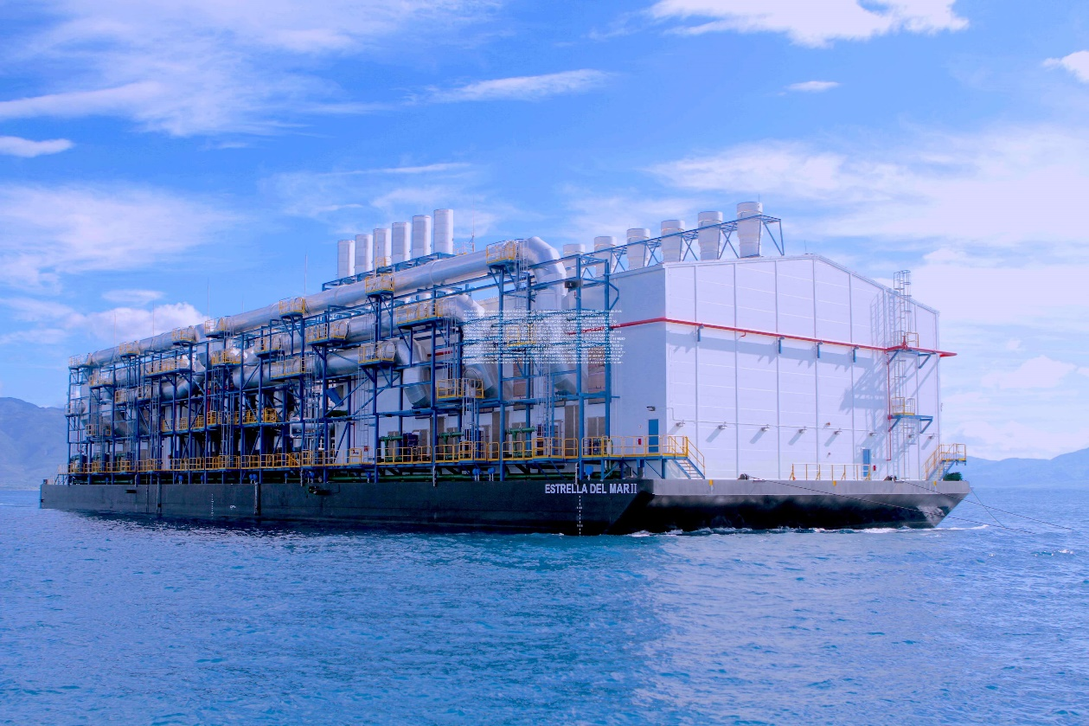
Estrella DEL mar II
106 MW Combined cycle medium speed engine power barge operating on natural gas or low sulfur heavy fuel oil

Slide 2
Operational Profile
Built and commissioned in 2011 by Wartsila
Currently moored in the Caribbean zone
Total average operating hours across 6 engines (June 2022)
around 88,000 operating hours

Slide 3
Basic Power Generation characteristics
Six Wartsila 18V50DF medium speed engines rated ~16.9 mWe each
One Dresser Rand steam turbine generator rated ~ 10,500 KVA
Total plant output rating at HV/GSU
On HFO ~108 mWe
On Natural gas ~106 mWe
Output Frequency 60 Hz at 13.8 kV
Highly efficient and reliable performance
Availability 2012-2016 - 91.1% (97.3% for 2016)
Heat Rate on natural gas (BTU/kWh HHV) 7,138 BTU/kWh
Heat rate on heavy fuel oil (BTU/kWh HHV) 7,138 BTU/kWh

Slide 4
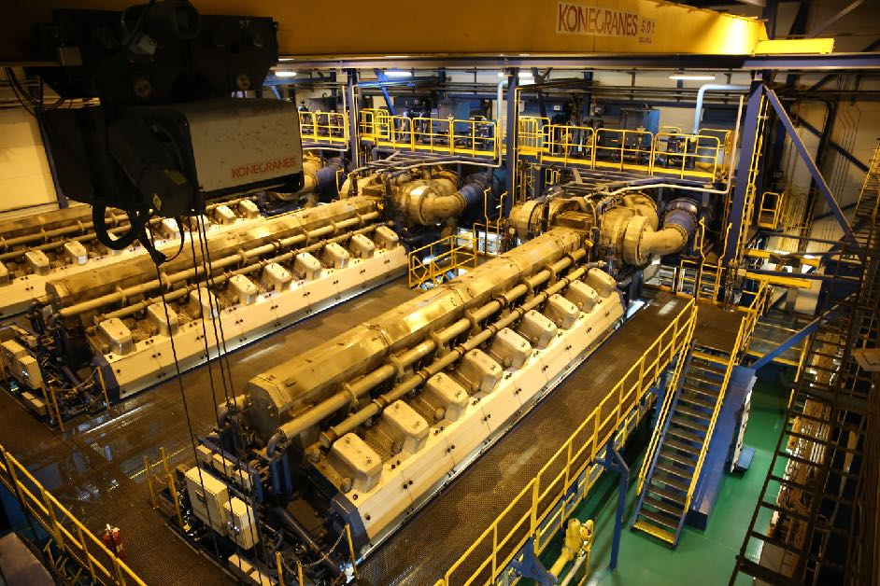
Configuration
Two Engine Halls
Each with 3 engines
Waste Heat Recovery Section
amidships
Deckhouse
amidships

Slide 5
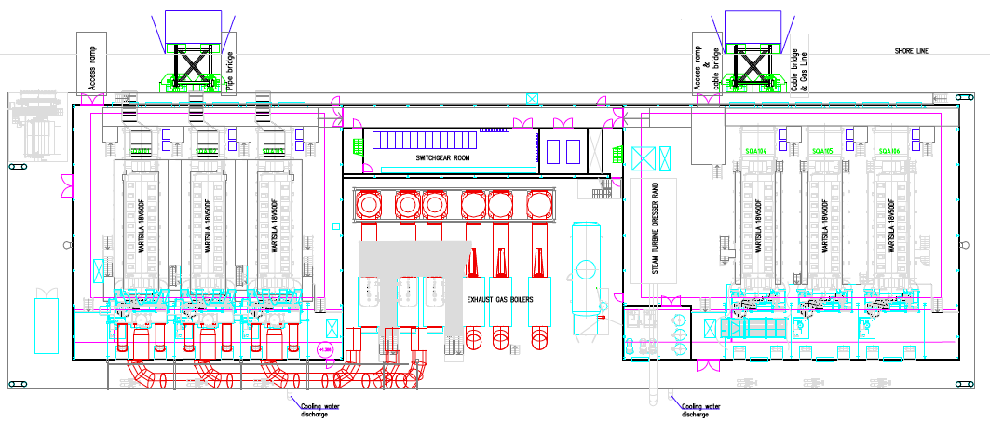
General Arrangement Plan

Slide 6
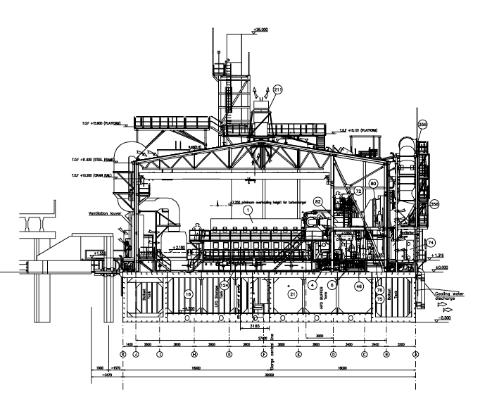
General Arrangement Elevation

Slide 7
Power barge Physical Dimensions
Length 104.4 meters
Width 32 meters
Height (air draft) ~ 29 meters
Depth 5.5 meters
Draft 3.2-4 meters

Slide 8
Codes and Classification
Marine
ABS – Power barge hull was designed, built and supervised during construction by ABS
Industrial plant
UBC
ISO 1996
EN
DIN
IEC, IEEE

Slide 9
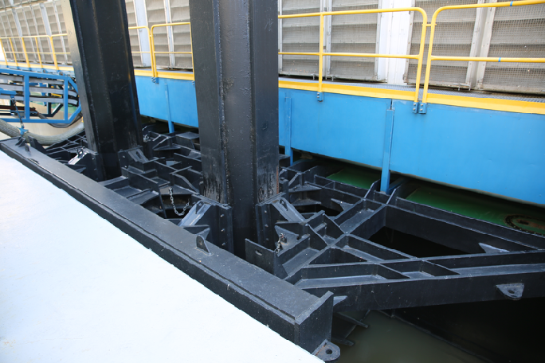
Mooring systems
Spud and Clamp System (with tiebacks)
2 Pairs of Spud and Clamp Devices Inboard
Wind Load
120 Mph sustained
Current
10 Knots
Tidal fluctuations (surge)
3 Meters

Slide 10
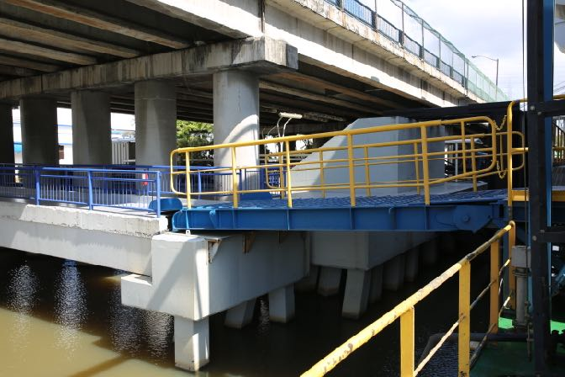
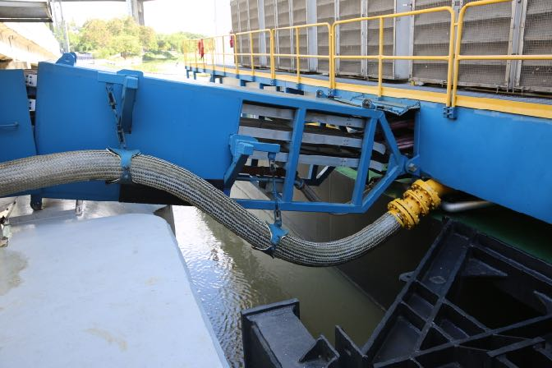
Access ramps and Connections
Two access ramps
Truck Ramp
Personnel
MV Cableway
HFO and Diesel Oil Flex Hoses
Natural Gas Flex Hose
LO Flex Hose
Sludge Flex Hose
Water and Fire Fighting Flex Hoses

Slide 11
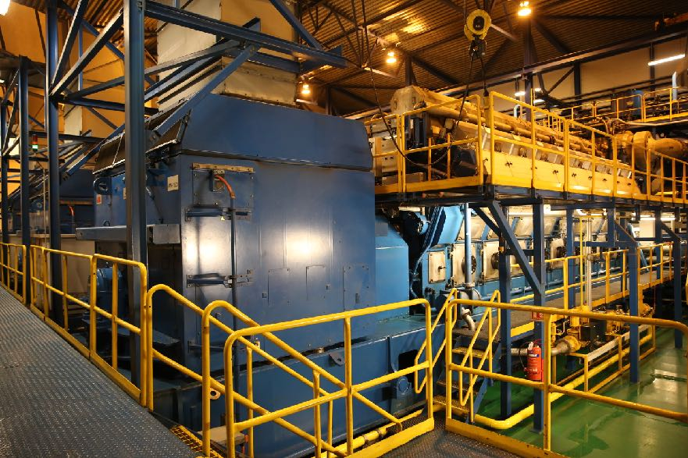
Wartsila 18V50DF Characteristics
18V50DF
Cylinder bore 500 mm
Stroke 580 mm
Speed 514 rpm
Mean Effective Pressure 19.5 bar
Compression ratio 11.5:1
Fwd flywheel rotation clockwise

Slide 12
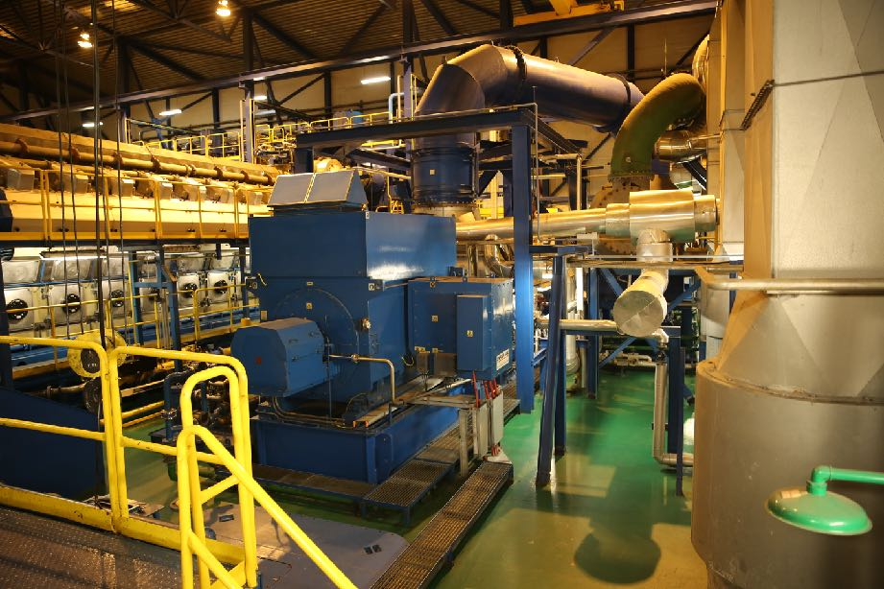
Steam Turbine Generator characteristics
Single cylinder multi-stage
Impulse/Condensing
Gearbox 1800 rpm
Electronic governor
Hydraulic Relay
Turbine protection system

Slide 13
Fuel System – Heavy Fuel Oil
Heavy Fuel Oil
Up to 700 cSt
HFO Temperature at HP Pumps 120 C @ 500 cSt
HFO Centrifuges AL 886 - 3 running, one stand-by at plant full load on HFO
Starting and stopping on HFO and diesel when in gas mode

Slide 14
Fuel Systems – Natural gas
Natural Gas
Pressure – 6.2 bar LP, 3.1 – 3.4 bar at engine inlet
Max Flow Rate – 23,160 Sm3/h
Consumption – 3,800 Sm3/h = 20,800 MMBTU/day at power plant full load
Starting and stopping fuel – light fuel oil

Slide 15
Internal Tank Capacities
Light fuel oil tanks (2) 785/807 m3
Heavy fuel oil buffer tanks (2) 455/429 m3
Heavy fuel oil day tanks (2) 384/384 m3
Pilot fuel oil tank 195 m3
New lube oil tank 202 m3
Used lube oil tank 164 m3
Fresh water/Fire fighting tank (2) 381/381 m3
Treated water tank 282 m3

Slide 16
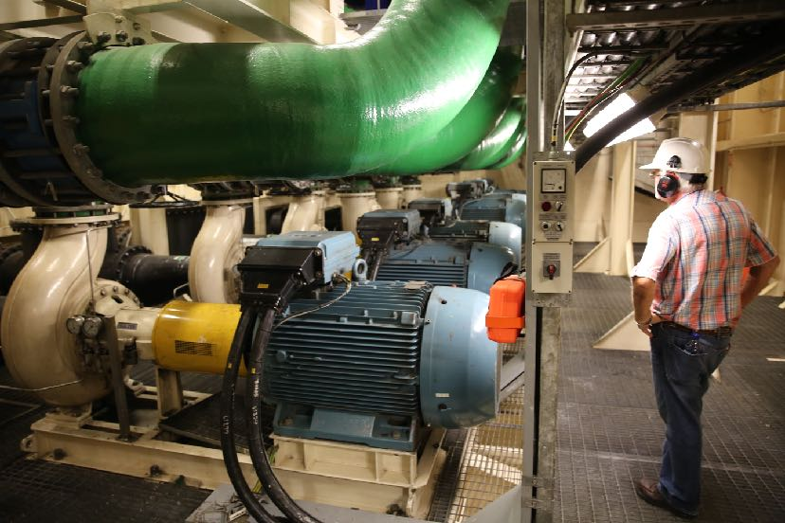
Engine/condenser Cooling water system
River water intake
Discharge downstream
Pumping Flat below deck

Slide 17
Modification options
Modification options
Cooling towers (landside)
SCR/CO (on barge)
50 Hz conversion to 11.2 kV under technical review
Generator swap
Frequency inverter (shoreside)

Slide 18
IMPORTANT DISCLAIMER: Although the statements and technical information contained herein are believed to be materially accurate as of the date hereof, no representation or warranty is given as to the accuracy of any of the information provided. Certain information contained herein is based on information from sources considered to be reliable. The information referred to herein is subject to change. Trans Continental Corporation and its affiliates and any of their officers, employees, agents and professional advisors, expressly disclaims any and all liability as to any reliance on such information; NO WARRANTY OF FITNESS FOR ANY PARTICULAR PURPOSE, WARRANTY OF MERCHANTABILITY OR ANY OTHER WARRANTY, EXPRESSED OR IMPLIED, IS MADE CONCERNING THE GOODS DESCRIBED OR THE INFORMATION PROVIDED HEREIN. This information has been provided to you for informational only and may not be relied upon by you in evaluating the merits of purchasing the assets described herein. This communication is not intended as and is not to be taken as an offer or solicitation in any jurisdiction, including these in which such an offer or solution is not authorized or to any persons to whom it is unlawful to make such a solution or offer. This document contains confidential information intended only for the use of the addressee. If you are not the intended recipient of this information then you are hereby notified that any use, dissemination, distribution or reproduction of this message is prohibited. If you have received this communication in error, please contact the sender immediately and delete this material in its exhibits.

