Slide 1
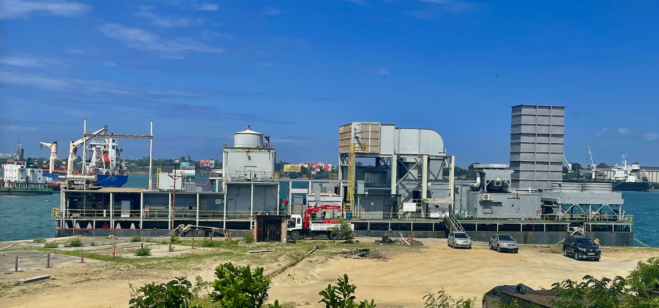
Power Barge Rigel I
Low Hour Fully Refurbished 48 MW 50/60 Hz Siemens Westinghouse Gas Turbine Power Barge
Power Barge

Slide 2
The 48 MW power barge Rigel I was designed by our power barge Siemens Westinghouse Joint Venture and built under Siemens Westinghouse supervision in 1997. It ran on condensates for less than 30K hours and fully overhauled and upgraded in 2011/12. Parent company went into bankruptcy and trustee placed power barge in hot layup until sold (2004 to 2008). 2008 a UK hedge fund acquired the power barge with PBC along with three other sister power barges. In 2019 the fund shut in the SPV with Rigel I acquired by PBC (PBLLC).
Acquired by PBLLC (owned by PBC) 2019. PBC kept the maintenance/security team of 11 on the payroll, keeping the unit in top condition. Only 20 test hours (full speed no load testing) since the overhaul.

Slide 3
Power Barge Basic Information
Barge name: Rigel I
ISO Output: 48 MW Natural Gas/46 MW Distillates
Turbine: SW251B11/12
Hull classification: American Bureau of Shipping (layup mode)
Type of construction: Steel hull (non-propelled)
General dimensions:
Length: 64.36 meters
Breadth : 18.28 meters
Draft: ~2 meters Gross tonnage: 2,876 tons

Slide 4
General Data
Frequency
Currently in 50 Hz configuration. The geared industrial gas turbine that can be re-geared to change frequency from 50 to 60 Hz. The generator is rated for both 50 Hz and 60 Hz
Fuels
The gas turbine (internal) is set to run on distillates, natural gas or propane. Current configuration is distillates.
Natural gas or propane will require additional piping and a gas control skid.
Fuel conversions would take around 3 to 4 months (order gas skid)
The internals of the gas turbine have been modified for HFO. A second fuel ring and supply piping will be required along with the fuel treatment skid (on land).

Slide 5
Rigel I Reconditioning Program
In 2008 various BOP reconditioning services were conducted and a combustion turbine component inspection was performed by TurboCare (Siemens).
December 2010 the turbine blades were removed to conduct a rotor evaluation.
2011/12 the barge was dry docked and a complete hot gas path inspection was done . All the major hot section parts were replaced including turbine blades, stationary vane segments, transition pieces and combustor baskets. Torque tube and compressor section were inspected, and new compressor diaphragms were installed on rows 8 to 11. Turbine journal and thrust bearings were also checked and cleaned. All pertinent clearances and readings were taken and checked according to OEM recommendations. Works were completed by 2012.
Turbine controls were replaced with a modern and versatile Allen Bradley PLC based system.
The final phase of the reconditioning project was completed in July 2012 with a 2-hour Full Speed No Load test.
Further FSNL tests were conducted in 2014 and 2016.

Slide 6
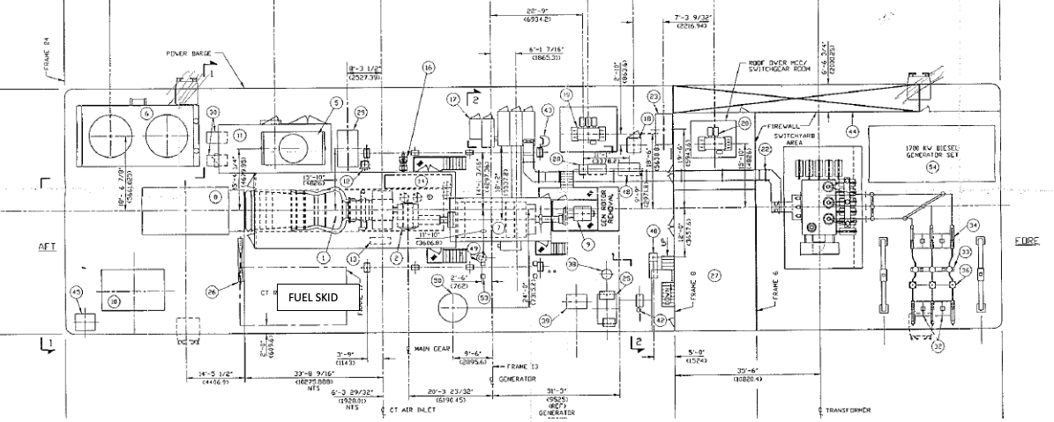
General Arrangement (as built)

Slide 7
Single Line Drawing

Slide 8
Output and Efficiency
Sea level
Temperature (oF): 59 Relative humidity (%): 60 Power Generator Factor 0.85
No. 1 Natural Gas
net power output | Kw | 48000 3
Heat rate | BTU/Kwh (LHV) | 10600
Efficiency | % | 32.2116
Exhaust flow | LB/HR | 1373800
Exhaust temperature | oF | 974
Fuel Flow | LB/Hr | 24280
Exhaust heat | BTU/LB LHV | 20960
No2. Diesel
net power output | Kw | 46400 4
Heat rate | BTU/Kwh (LHV) | 10750
Efficiency | % | 31.7621
Exhaust flow | LB/HR | 1376500
Exhaust temperature | oF | 975
Fuel Flow | LB/Hr | 26880

Slide 9
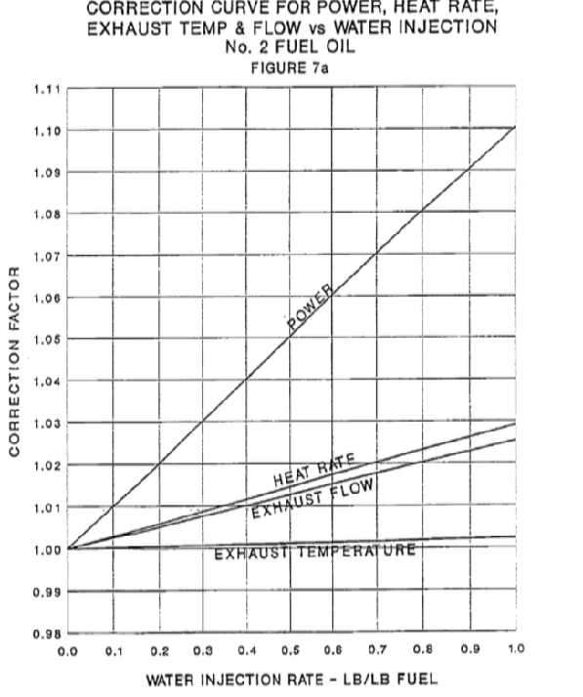
Power Curves with Water Injection

Slide 10
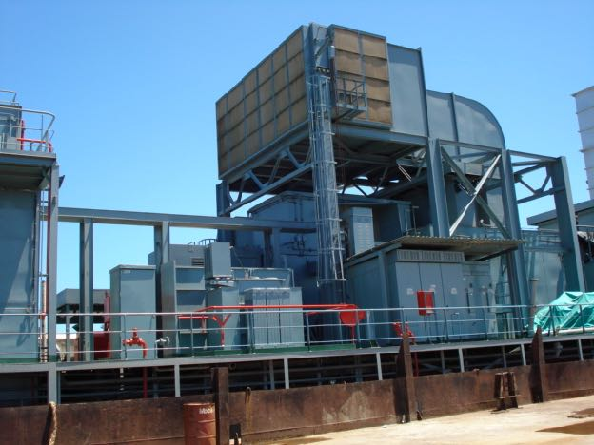
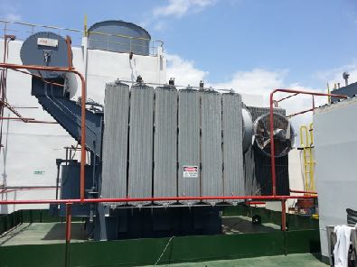
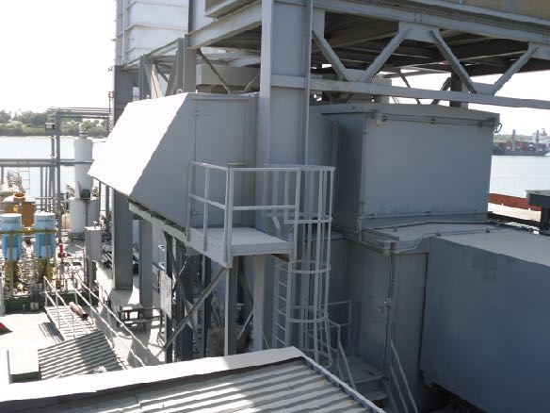
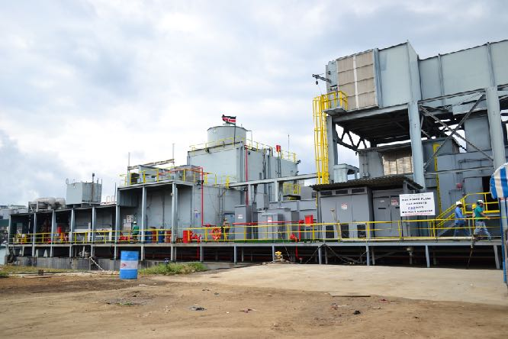
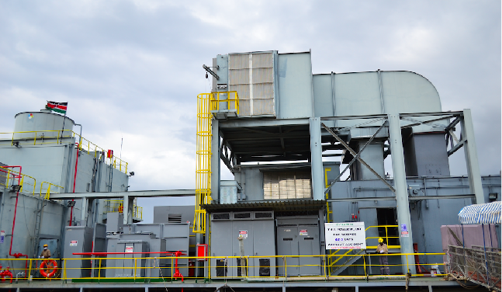
Photographs

Slide 11
Power Barge Advantages
Power barges can be quickly deployed quickly either wet towed with tug or dry towed on a semi-submersible
Power barges provide both permanent and temporary power with gas turbine and medium speed engines in simple and combined cycle
Power barges can be redeployed without significant cost when compared to a land-based plant
Power barges are not susceptible to rising sea levels and can be designed for tidal surge locations
Power barges are fully self-contained power plants

Slide 12
IMPORTANT DISCLAIMER: Although the statements and technical information contained herein are believed to be materially accurate as of the date hereof, no representation or warranty is given as to the accuracy of any of the information provided. Certain information contained herein is based on information from sources considered to be reliable. The information referred to herein is subject to change. PowerBarge LLC and their affiliates and any of their officers, employees, agents and professional advisors, expressly disclaims any and all liability as to any reliance on such information; NO WARRANTY OF FITNESS FOR ANY PARTICULAR PURPOSE, WARRANTY OF MERCHANTABILITY OR ANY OTHER WARRANTY, EXPRESSED OR IMPLIED, IS MADE CONCERNING THE GOODS DESCRIBED OR THE INFORMATION PROVIDED HEREIN. This information has been provided to you for informational only and may not be relied upon by you in evaluating the merits of purchasing the assets described herein. This communication is not intended as and is not to be taken as an offer or solicitation in any jurisdiction, including these in which such an offer or solution is not authorized or to any persons to whom it is unlawful to make such a solution or offer. This document contains confidential information intended only for the use of the addressee. If you are not the intended recipient of this information then you are hereby notified that any use, dissemination, distribution or reproduction of this message is prohibited. If you have received this communication in error, please contact the sender immediately and delete this material in its exhibits.

