Slide 1
COMMERCIAL OFFER
LKS 360
ONE (1) Mitsubishi
FT8 MOBILE PAC GAS TURBINE GENERATOR PACKAGE
DUAL FUEL, 50/60HZ
FT8 1405 FROM PRATT & WITHNEY
760 fired hours on Diesel YOM 2014
Dismantled and ready for freight

Slide 2
LKS 360
DETAILED DESCRITPION OF GOODS:
SCHNUE TRAILER (1):
Date of MFG 9/30/14 GVWR 120000LBS GAWR ALL AXLES 30000LBS - With 295/80R/22.5 TIRES AT 124 PSI COLD With 22.5 x 9.0 RIMS - VIN 1 S9B02042EH640346
HALDEX SEMI TRAILER (1):
SEMI TRAILER 640346 INPUT PRESSURE 6.5 BAR - VALVES No 602005001 AXLE LOAD 11300KG SUSPENSION PRESSURE 4.40 – 6.5 BAR
FONTAINE TRAILER (1)
DATE OF MANUFACTURE 07-2013 - VIN 13N – 24820-3-E1566062 MODEL HCICD 12 WSA TYPE TRAILER FRAME RATING 80000/36288L8/KG IN 48/1463 FEET/METER - TIRES 255/70R 22.5 PLY 16 RIMS 22.5 X 8.25 AT PRESSURE 120/823 PSI/KPA RATING AT 60 PMH/95KPH GROSS VEHICLE WEIGHT RATING 69185/31382 LB/KG NUMBER OF AXLES 2

Slide 3
All purchase sale negotiations shall be directly with Adrien Jackson from Angie Energy (previously Mobile power systems).
Borescope and Preservation Documents
Unit in excellent condition, very low hours, 760. The unit was used as redundancy and was only active in the year 2018. The unit was dismantled, stored, and parked at a local powerplant station in 2018. The brush generator, skids and accessories have been removed and placed inside containers in storage in Dubai along with the exhaust and inlets. There are no official preservation documents. No recent borescope.
Warranty, Commissioning, and Training
The Seller provides the warranty and warranty service, including spare parts. The specific Warranty Terms & Conditions will be provided after installation. The warranty will be the standard manufacturer’s warranty for a period of one (1) year and will be attached as an exhibit to this agreement. The installation and commissioning of the power plant at the final site will be carried out and certified by an Angie Energy FZE representative along with the P&W commissioning team.
Post-warranty service is available, including spare parts delivery on a paid basis.
Important Note: The equipment is currently in storage. The Seller provides a one-year manufacturer’s warranty only if the Buyer opts for commissioning at the final site at an additional cost of $500,000. Or Buy equipment AS IS
Price
$17,800,000 USD/unit FOB 18.5USD with commissioning and warranty
^Gas skids included, can swift from diesel to gas very fast
Availability
  Equipment is available for immediate delivery (10 days) after SPA contract signing.
    Unit 1 – SN 1405; Original RTS Date: 2014 760 hours
Payment Terms
  Payment via irrevocable and confirmed letter of credit or to escrow account of SELLER choosing, payable as follows:
  150,000 USD non-refundable deposit for inspection
  30% upon contract signing
  70% upon embarkation against bill of lading, bill of sale, and title
  Partial shipping authorized proforma invoice with details of the 1405 will be appendix to the final contract.

Slide 4


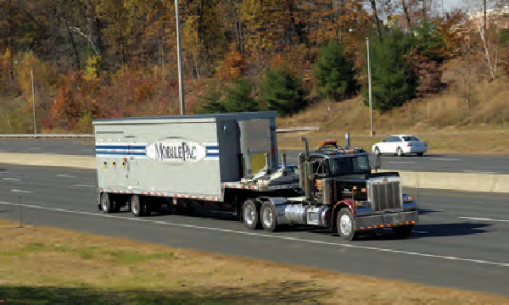
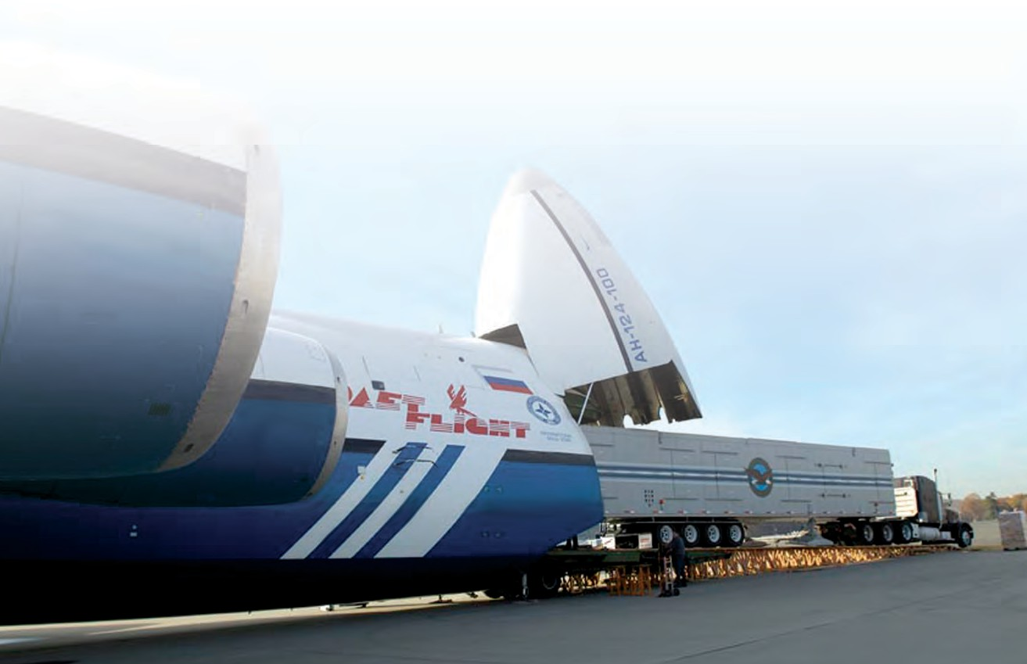
FT8MOBILEPAC® Gas Turbine Package
Power Systems
®
25 MW of Mobile Power
The MOBILEPAC® gas turbine package was introduced more than 30 years ago with the FT4 engine. After many successful years of operation, the MOBILEPAC gas turbine package now utilizes the FT8® engine and
offers 25 MW of moveable power. Utilizing the proven FT8 SWIFTPAC® technology, this package is designed to provide quick, reliable power and is especially useful in emergency situations.
The MOBILEPAC gas turbine package design includes two trailers. The first contains the gas turbine, electric generator, exhaust collector, diffuser and engine lube oil system. The second trailer carries the 15 kV switchgear, control system, operation panel, protective relays, batteries and charger, motor control center and the hydraulic start package. Compared to
a typical 21-day installation and commissioning cycle for the SWIFTPAC gas turbine package, the MOBILEPAC gas turbine package can be driven to a site and begin generating power in less than one day.
Benefits
Ready for emergency power within one day (site ready)
Environmentally compatible
Dual fuel/Dual frequency
Optional black start capability
Flexible trailer siting
Highway compatible
Three-point support and structural rigidity to maintain generator alignment
Remote operation
Leasing options available

Slide 5

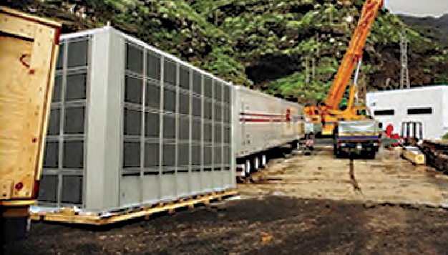
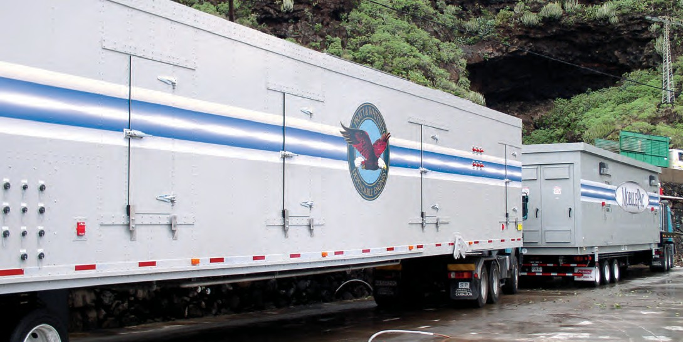




FT8® MOBILEPAC® Gas Turbine Package
25 MW of Mobile Power
The MOBILEPAC® gas turbine package has the smallest footprint in the industry, utilizing a 25-foot by 60-foot space. Very little advance site preparation is required, no foundation or concrete pad is necessary for installation of the unit. The unit is transportable by land, sea or air to anywhere
in the world, allowing worldwide delivery of the MOBILEPAC gas turbine package within 24 hours.
Pratt & Whitney. It’s in our power.TM
Product Facts
Output (kW) Base engine # of trailers Installation Noise NOx/CO Grid
Fuel
25000
FT8 2
8 hours (site ready) 95 dba at 1 meter 50/100 mg/m³
50 or 60 hertz Liquid or gas
Pratt & Whitney Power Systems
1-866-POWER-ALL (1-866-769-3725)
Outside USA: 1-860-565-0140
www.pw.utc.com
PS-S0013.05.09

