Slide 1
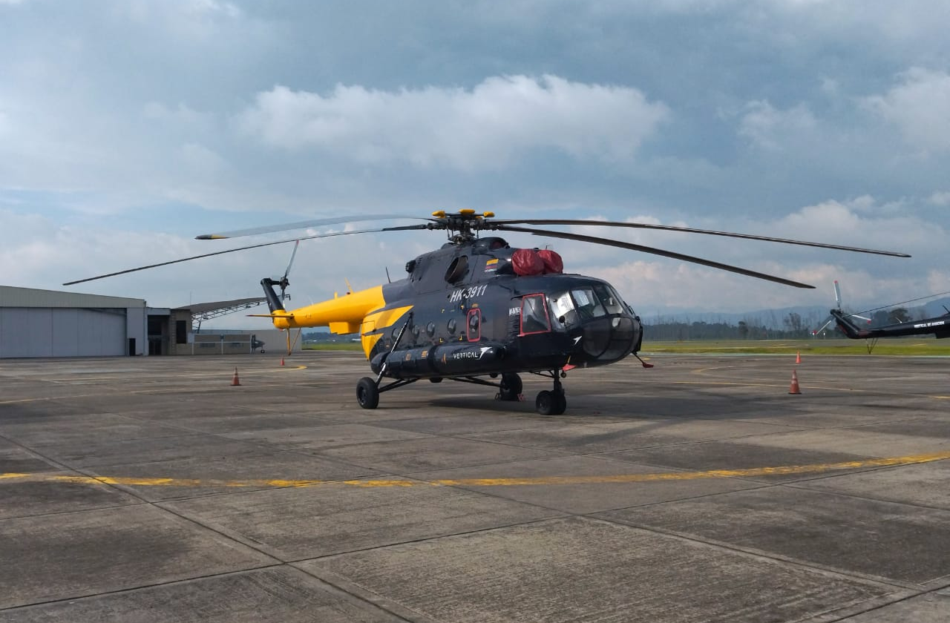

MI-8MTV helicopters (4 units) engines and parts for sale
YOM 2: 1992 and 2: 1993
HK 3/ HK2/ HK-3/ HK4

Slide 2
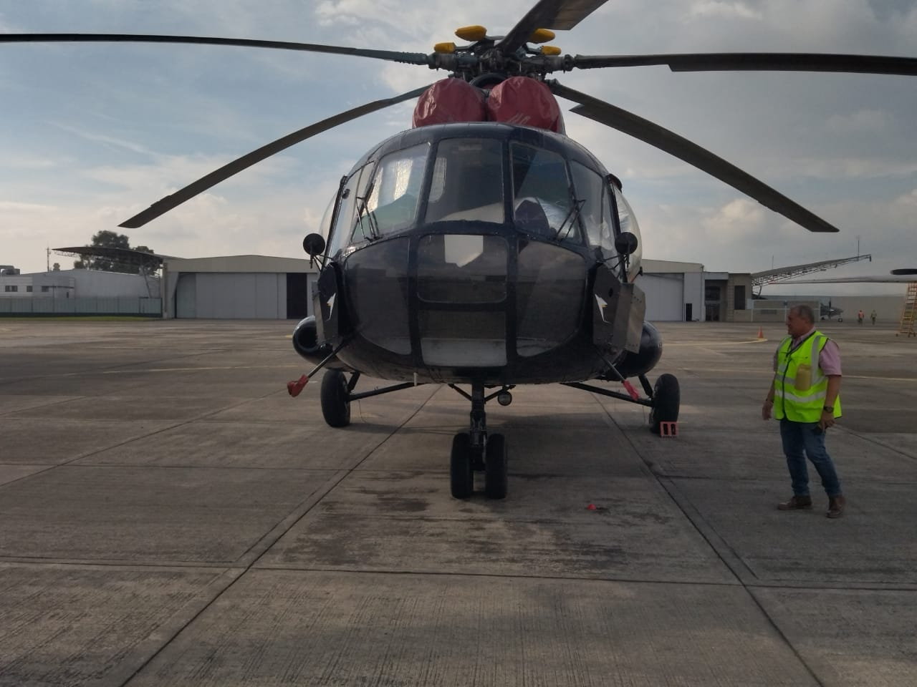
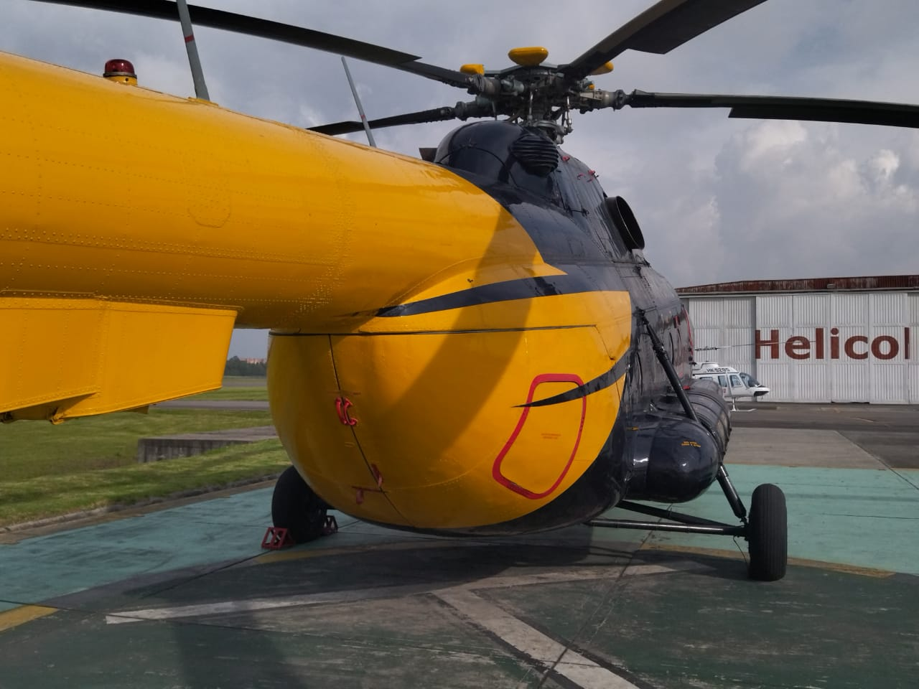

Slide 3
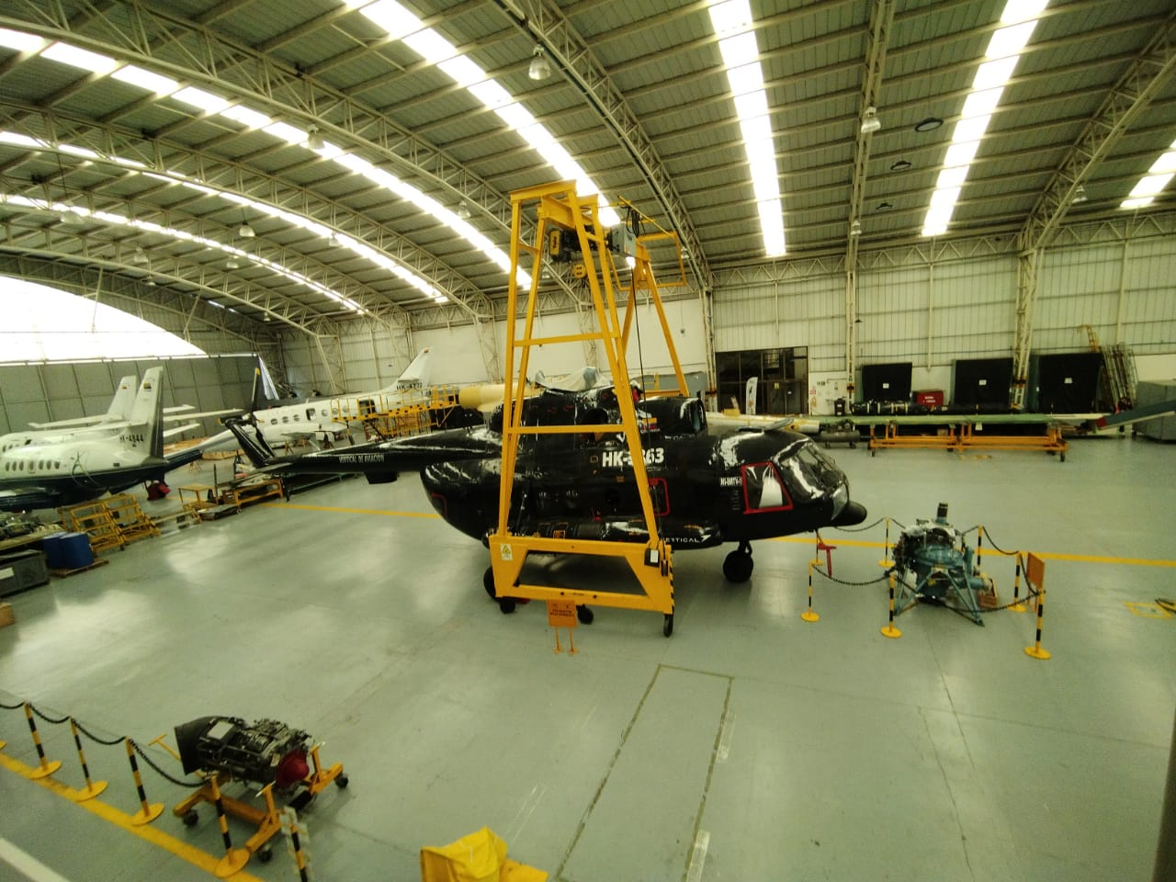
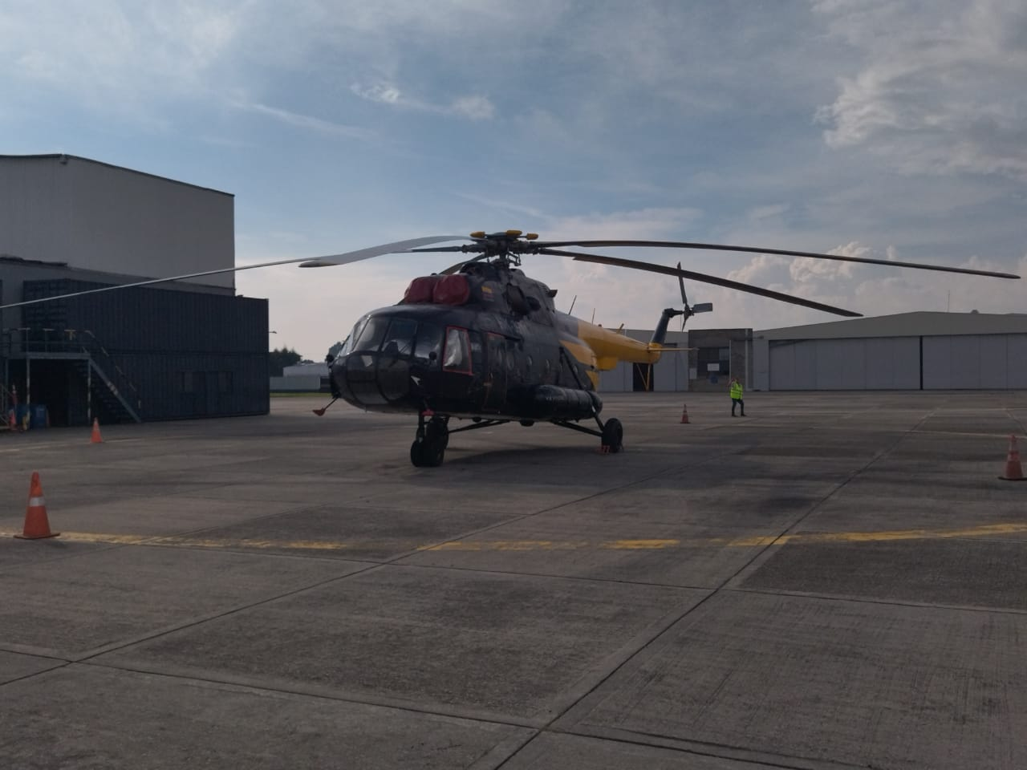

Slide 4
The offer
Technical specifications:
Crew: 1 PIC-1SIC + flight Engineers
Capability per Helicopter: 24 passengers
Cargo: 4000 Kilos internal /3000 external cargo
Length: 18.2 Mts (59.7ft)
Hight: 3mt (9.8ft)
Empty weight: 7100 kg
MTOW: 13.000 KG
Maximum Speed 250 Km/h
Engine: 2x Turbo TV3 117MV
Our client offer the possibility to “BULK” purchase 4 helicopters MI8 that were used for the oil and gas industry. All of them are airworthy for a total price - negotiable

Slide 5
Overhaul
Overhaul, an exhaustive process by which a helicopter is dismantled, repaired and then reassembled to restore its optimal functionality. The aim is to ensure that its operating parameters match the original specifications, guaranteeing its safety, airworthiness and operational efficiency.
The Overhaul is performed for a period of 7 years or every 3000 hours of flight, whichever comes first.
ALL HELICOPTERS WILL BE AIRWORTHY AT THE TIME OF PURCHASE

Slide 6
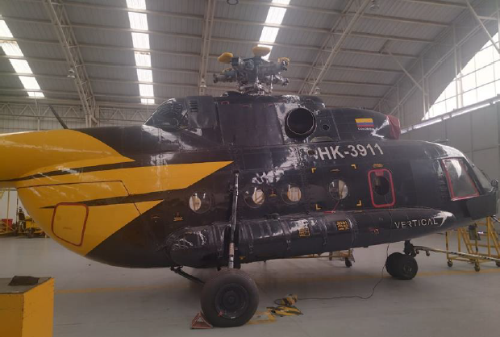
HK-1
Year of manufacture: 1993
Construction number: xxx124
Line number: 0xx1-24
Total aircraft hours: 17946 HRS
Aircraft overhaul time TSO: 2462 HRS, 500 HRS left to enter overhaul (approximately 1 year of operation).
Total aircraft cycles: 42XX9
Total time engine 1 RH 7087873603066 4487 HRS
Time since overhaul TSO engine 1 RH: 1281 HRS, 1719 HRS of operation left.
Cycles since new RH engine: 43XX
Total time engine 2 RH 7087882300088: 5540 HRS
Time since TSO overhaul engine 2 LH: 625 HRS, 2375 HRS remain available.
Cycles since new LH engine: 4980

Slide 7
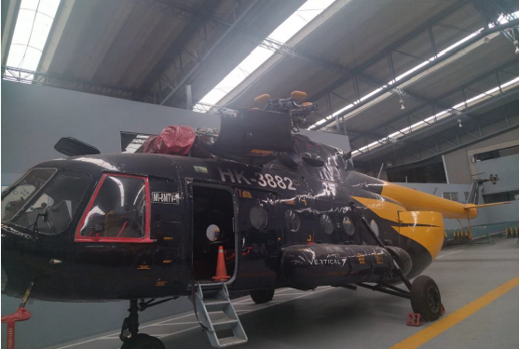
HK-2
Year of manufacture: October 1992
Build number: 96018
Line number: 060-18
Total aircraft hours: 12587 HRS
Aircraft TSO overhaul time: 1055 HRS 1945 HRS left to enter overhaul (2 years approx)
Total aircraft cycles: 29709
Total time engine 1 RH7087884100082: 3945 HRS
Time since TSO overhaul engine 1 RH: 94 HRS hours available 2906
Cycles since new engine RH:2452
Totaltimeengine2RH7087882200456:5489 HRS
Time since overhaul TSO engine 2LH: 1055 HRS available hours 1945
Cycles in the new engine LH:3159
NOTE:The main rotor blades are pending installation, aset was located, a visual check was performed and they are in good condition, traceability was not found. It has no tail rotor blade sand is not airworthy.

Slide 8
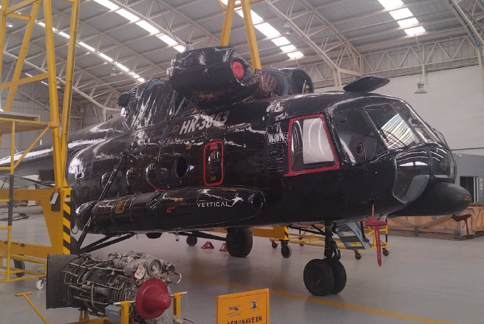
HK-3
Year of manufacturing: 1992 (31 years from date of manufacture)
Build number: 95XXX
Line number: 05XXX
Total aircraft hours: 12587 HRS
Aircraft overhaul time TSO: Met time to enter overhaul on 01-31-2024.
Total aircraft cycles:xxx
Total engine time 1RH: No engine installed
Total engine time 2RH: No engine installed
NOTE: AIRCRAFT BOOKLET PAGE 107 HELICOPTER OMI-8MTV-1DES/894, OPERATION IS ALLOWED WITH ALL IT SYSTEMS FOLLOWING OVERHAUL UNTIL 31-01-2024 AS ACCEPTANCE.

Slide 9
HK-4
Year of manufacture: December 1991
Construction number: 9 58XXX
Line number: 058-23
Total aircraft hours: 16855 HRS
Aircraft overhaul time TSO: Undergoing major maintenance progress 10%
Total aircraft cycles: 38XXX
Total engine time 1 RH: No engines assigned.
Total engine time 2 RH: No engines assigned.
NOTE: It should be taken into consideration that the aircraft is undergoing major maintenance with CMR, its cost, financial and technical status with this company and its duration of maintenance are unknown.
Currently, its status prior to overhaul or repair is unknown.

Slide 10
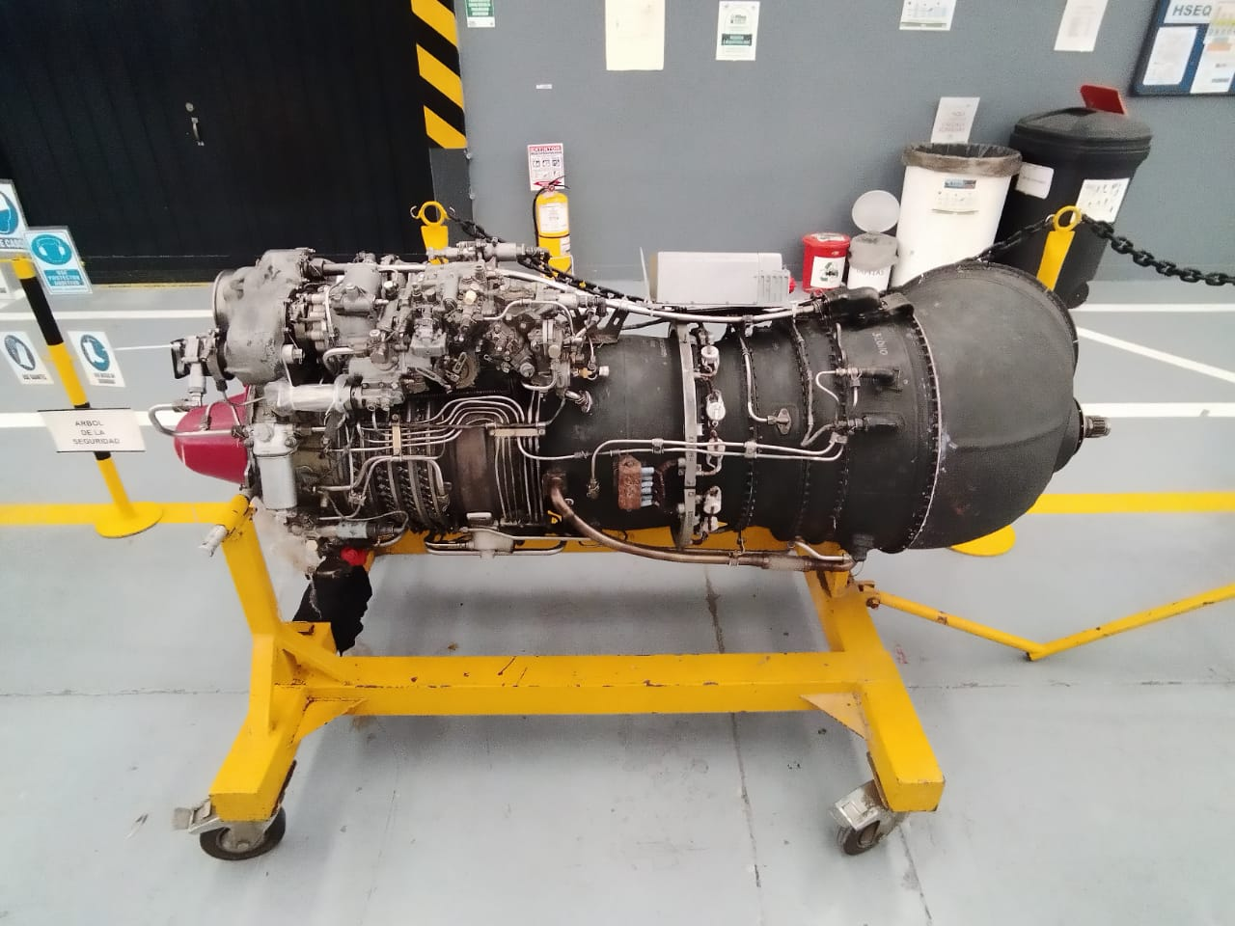
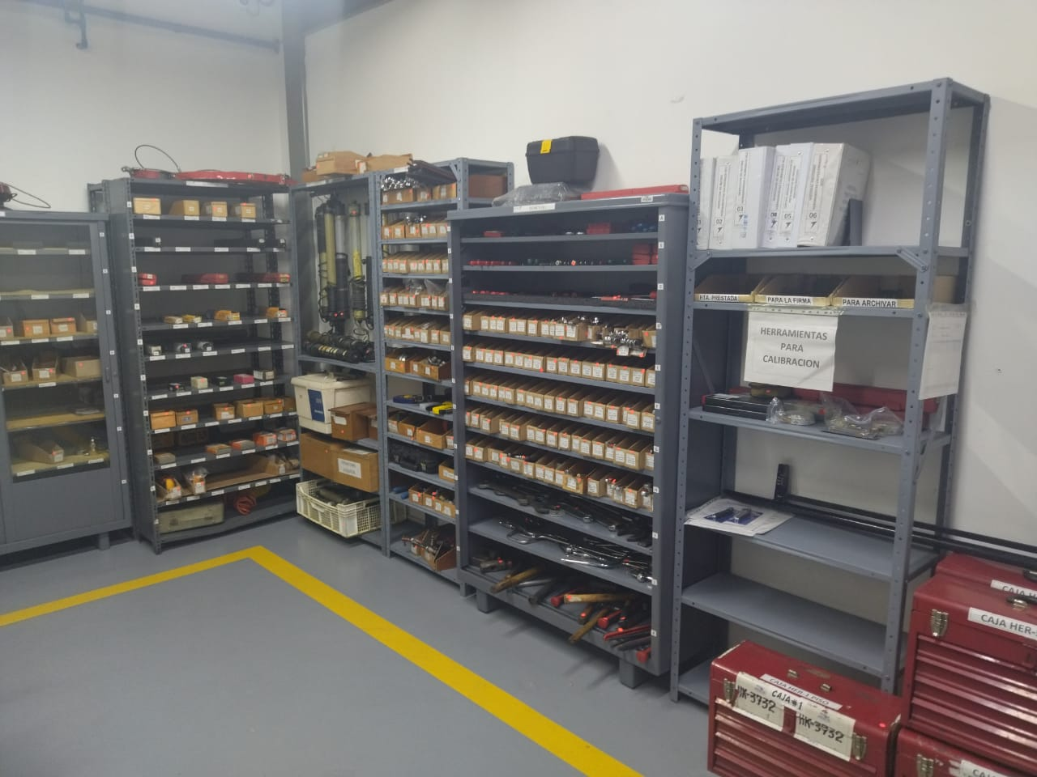
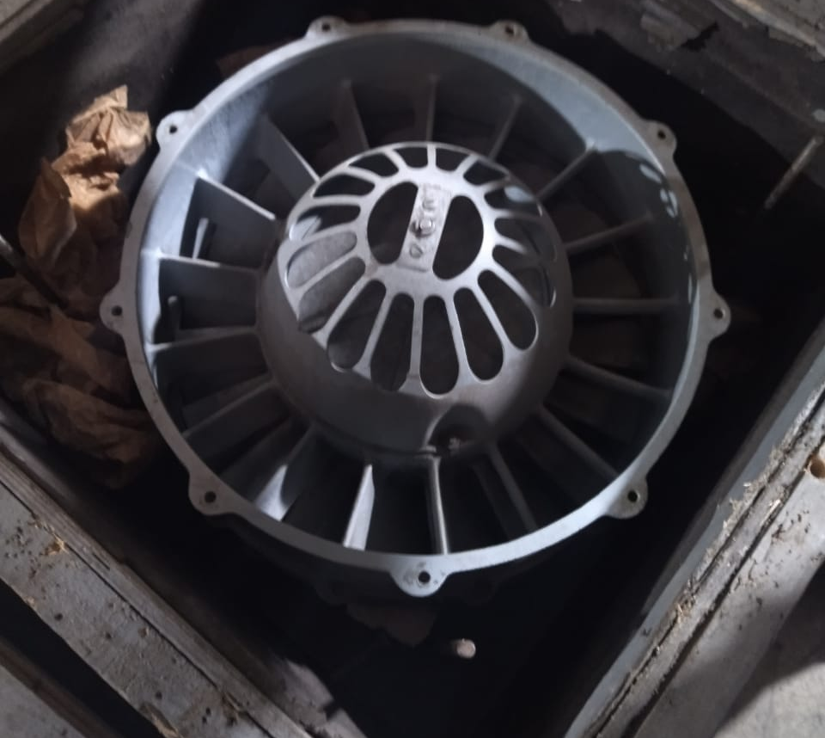
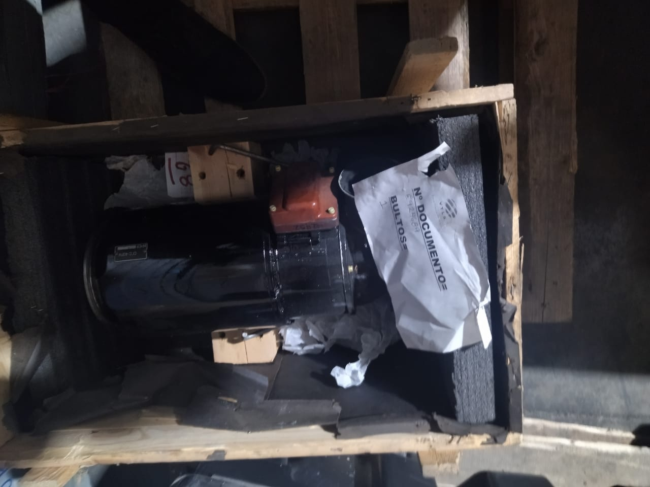
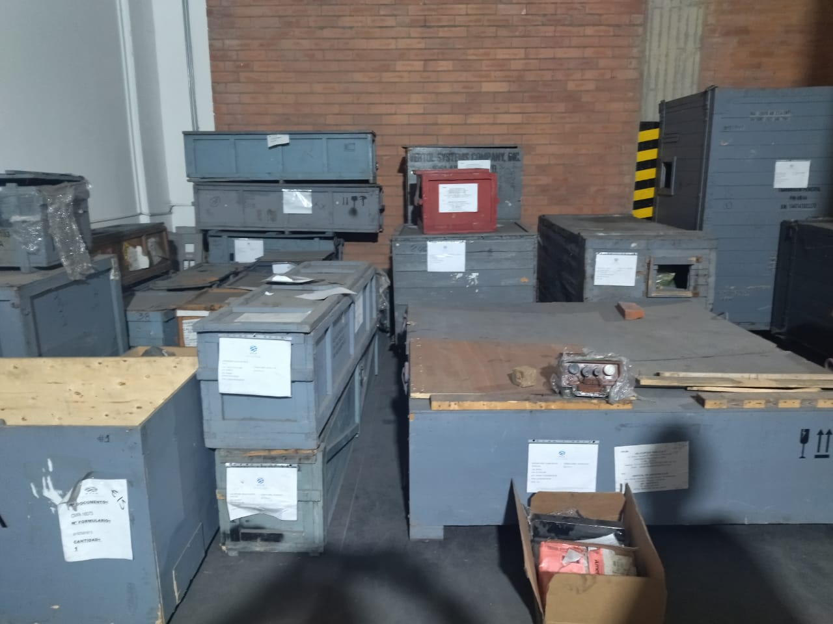
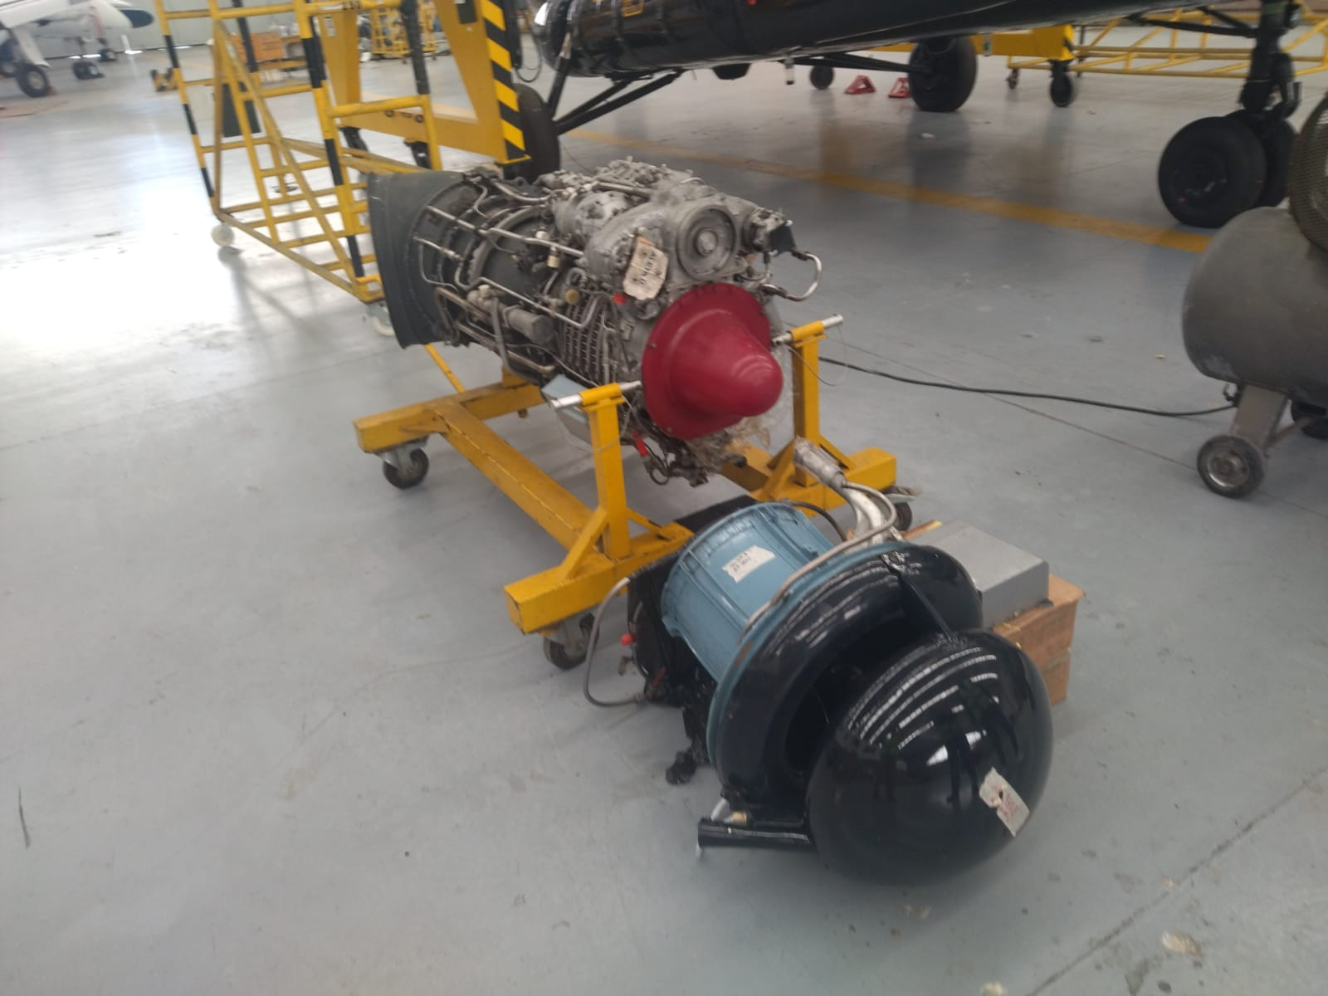
Spare Parts

Slide 11




All Documentation provided after signing LOI+POF+NCNDA

